Slide 1
1,2,3...QAP!
Matteo Fischetti
(joint work with Michele Monaci and Domenico Salvagnin)
DEI University of Padova
IPDU, Newcastle, July 2011

Slide 2
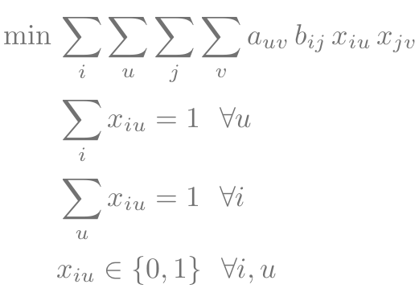
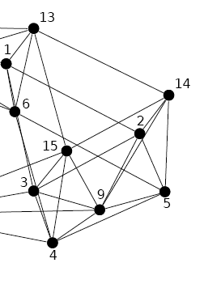
QAP definition
complete directed graph G=(V,A) and n=|V| facilities to be assigned to its nodes
distance from node i to node j is bij
required flow from facility u to facility v is auv
decision var.s: xiu =1 iff facility u is assigned to node i, =0 othw.

Slide 3
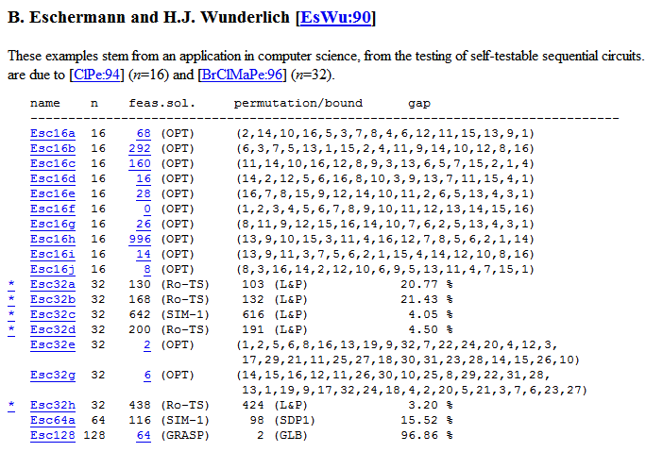
ESC instances in 3 steps

Slide 4
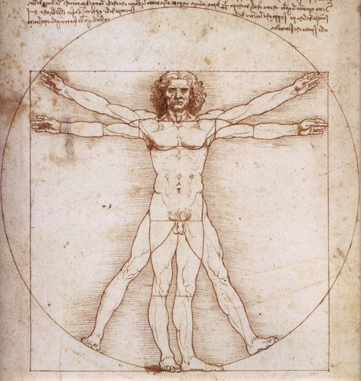
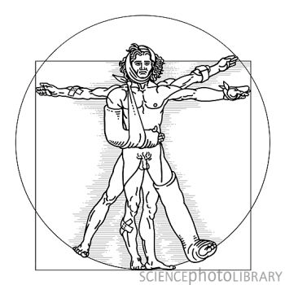
Step 1: don’t break my symmetries!
Many QAP instances are highly symmetrical (certain facility/node permutations do not affect solution cost nor feasibility)
Symmetry is typically viewed as a useful feature in mathematics, but…
… it tricks enumeration (equivalent sol.s visited again and again)
Usual recipe in discrete optimization: break it!
Instead, we propose a new way to exploit it to reduce problem size and complexity

Slide 5
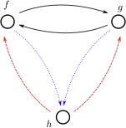
Clone definition
Assume wlog bii = 0 for all nodes i.
Two facilities f and g are clones iff:
afg = agf
afh = agh for all h <> f,g
ahf = ahg for all h <> f,g
Equivalence relation that partitions the set of facilities into clone clusters

Slide 6
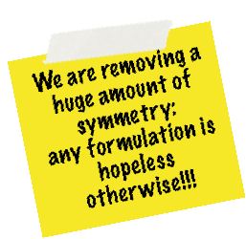
Shrinking clones
All esc instances have such clones (not just “isolated” ones…)
We shrink them and update the model accordingly
esc32a
32 x 32
32 x 26
esc32b
32 x 32
32 x 25
esc32c
32 x 32
32 x 10
esc32d
32 x 32
32 x 13
esc32h
32 x 32
32 x 14
esc64a
64 x 64
64 x 15
esc128
128 x 128
128 x 21

Slide 7
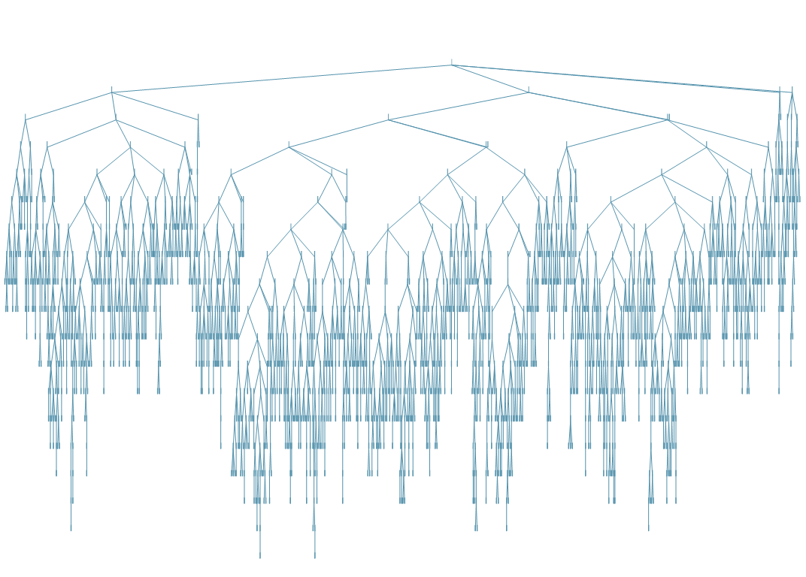
Step 2: B&C design

Slide 8
Main ingredients
carefully chosen MILP formulation
locally valid cut separation based on Gilmore-Lawler bounds
custom QAP-specific branching strategy
custom symmetry detection on matrix b and aggressive orbital branching

Slide 9
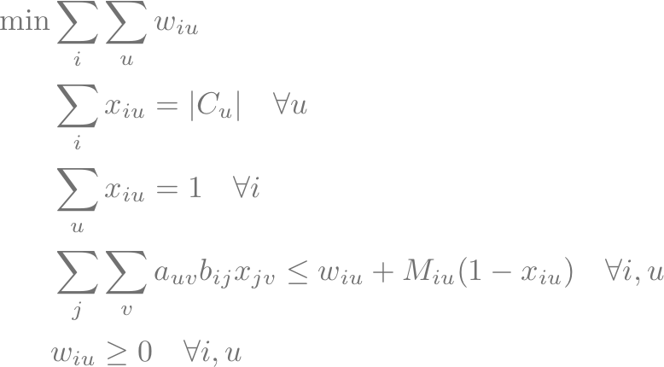
Step 2.1: choosing the model
Introducing variables
we get the basic Kaufman-Broeckx (KB) MILP model

Slide 10
Step 2.1: handy MILP
The Kb model is tiny and fast ... but its bound is really bad (always zero at the root)
However we can improve it through the following family of inequalities (Xia and Yuan, 2006)
where minAPiu is the Gilmore-Lawler term computed by solving a linear assignment problem with xiu = 1
This family of cuts strengthen the KB model a lot → we separate local versions of them throughout the B&C tree, by using a fast separation procedure

Slide 11
Step 2.2: branching
A good branching order is crucial for the B&C
Default strategies are NOT particularly effective on these instances
Basic idea → we want to branch first on the variables that have a larger range of objective values for the possible assignments
We define the branching priority for xiu as

Slide 12
Step 2.3: orbital branching
Clone shrinking takes care of (most of) symmetry on matrix a → what about matrix b?
On esc instances, also matrix b contains symmetries (but not of clone type) → resort to orbital branching (Ostrowski et al., 2011)
We compute the appropriate symmetry group directly on matrix b (faster than considering the whole model)
we could have used nauty, but we exploited the particular structure of esc instances and implemented an ad-hoc procedure

Slide 13
Step 2.3: matrix b structure
bij = HammingDistance(i-1,j-1)-1
Two operations on binary string preserve the Hamming distance:
0011
bit flip
0000
1001
1010
0011
bit permutation
1001
1001
1100
fix facility 11...1 form the beginning → no bit flips left
compute orbits and stabilizers from explicit list of bit permutations!

Slide 14
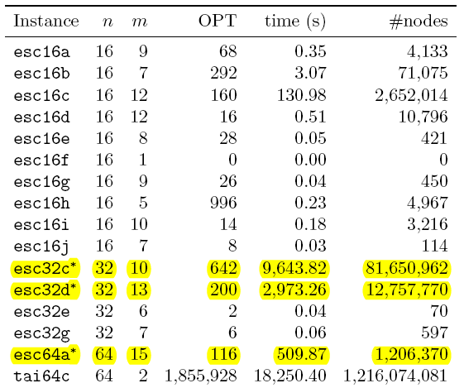
Cplex 12.2 interactive mode (8 threads, Intel Xeon 3.2Ghz, 16GB ram)

Slide 15
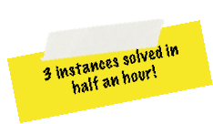
B&C results
esc32c
616
642
642
1156s
esc32d
191
200
200
473s
esc64a
98
116
116
84s
IBM Cplex 12.2 on Intel Xeon 3.2GHz - 16GB RAM - 8 threads

Slide 16
A closer look at esc64a
unshrunken
any
hopeless
+∞
shrunken
cplex default
>3.600
>8.000.000
shrunken
cplex tweaked
966
1.750.000
shrunken
cplex twk + ORD
577
1.300.000
shrunken
our B&C
84
142.000
IBM Cplex 12.2 on Intel Xeon 3.2GHz - 16GB RAM - 8 threads
Similar results are obtained on the other esc instances

Slide 17
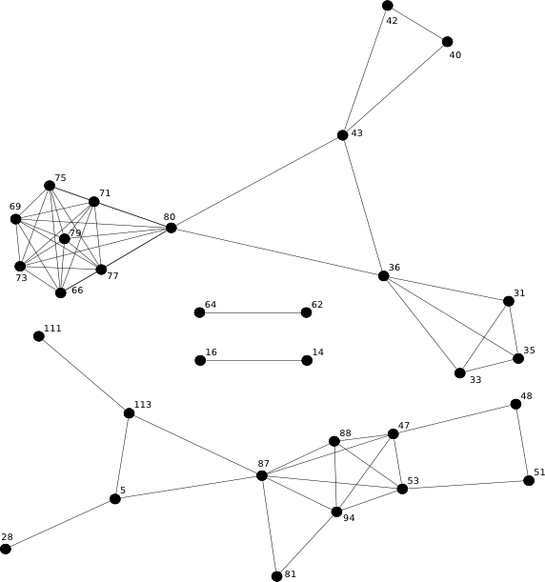
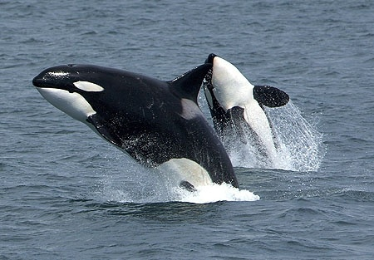
Whale watching (esc128)

Slide 18
Step 3: flow splitting
Split matrix a as a = a1+a2, with a1,a2≥0
Solve QAP(a1,b) and QAP(a2,b) separately
Lower bound property:
full equivalence if we impose the two solutions coincide (equality) → variable splitting model
just a relaxation otherwise (lower bound)

Slide 19
Two better than one?
the two models are still QAPs of the same size as before → why should we want to do this?
two main reasons:
the final bound after a fixed amount of enumeration on a weaker model might be much better than that based on a stronger model (strange but true!)
if the two QAPs have a simpler structure they might be much easier to solve than the original instance (in particular, we can actually add symmetry to the model!)

Slide 20
How to split the flow matrix?
two (independent) strategies
select a subset of facilities and zero out all distances in their clique → good strategy when there are (almost) disconnected components in flow support
define a1 as clip(a,[0,1]) and a2 = a - a1 → improve cost “uniformity”
can be applied sequentially to get a “longer” split chain a = a1 + a2 + ... ak

Slide 21
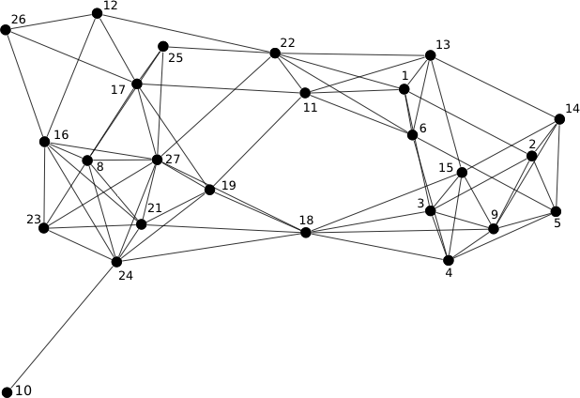
Flow splitting for esc32a …

Slide 22
… and for the big whale (esc128)

Slide 23
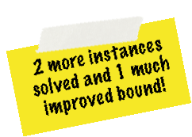
Flow splitting results
esc32a
130
68+60 = 128
6 + 45 = 51s
esc32h
438
340+98 = 438
4 + 7795 = 7799s
esc128
64
48+16 = 64
2 + 7 = 9s (!!!)
IBM Cplex 12.2 on Intel Xeon 3.2GHz - 16GB RAM - 8 threads

Slide 24
Conclusions & Future work
We could solve unsolved esc instances in a surprisingly short amount of time, including esc128 (the largest QAPLIB instance ever solved)
TODO list
develop a B&B algorithm using a variable-splitting model based on flow splitting
try other QAP classes
generalize to other classes of difficult MI(N)LPs → Orbital shrinking (F.-Liberti, 2011)

Slide 25
Thank you

