Slide 1
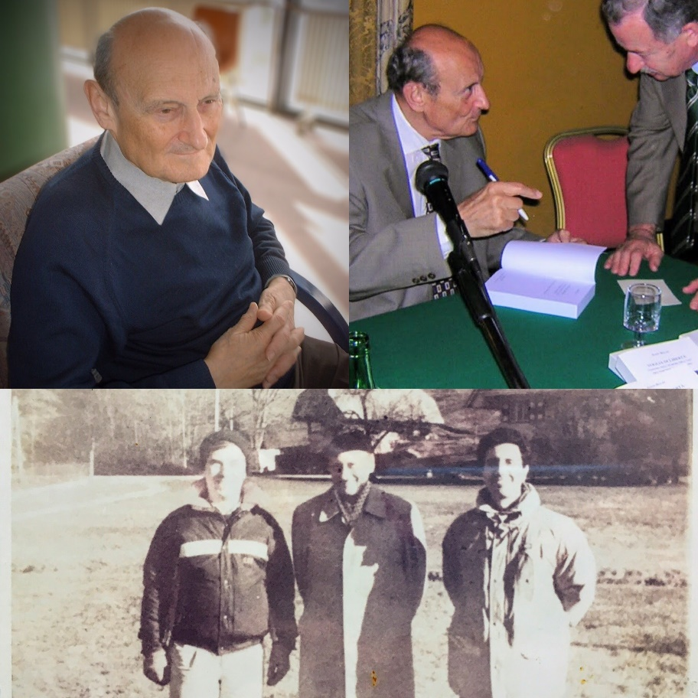
Intersection cuts from bilinear disjunctions
Matteo Fischetti, University of Padova
(joint work with Michele Monaci, University of Bologna)

Slide 2
Non-convex MIQP
Goal: implement a Mixed-Integer (non-convex) Quadratic solver
Two approaches:
  1. start with a continuous QP solver and add enumeration on top of it → implement B&B to handle integer var.s
  2. start with a MILP solvers (B&C) and customize it to handle the non-convex quadratic terms → add McCormick & spatial branching
  PROS: …
  CONS: …
This talk goes for 2.

Slide 3
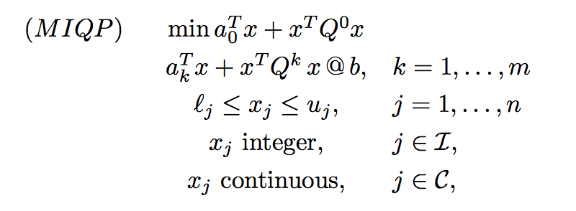
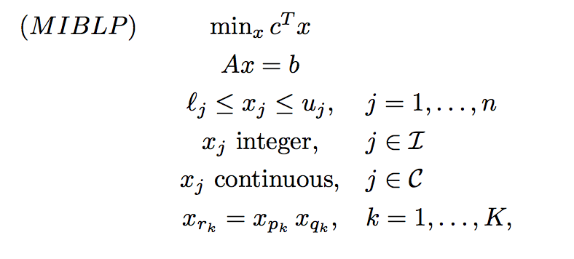
MIQP as a MILP with bilinear eq.s
We consider the Mixed-Integer Quadratic Problem (MIQP)
restated as Mixed-Integer Bilinear Problem (MIBLP)

Slide 4

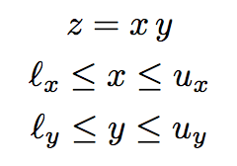
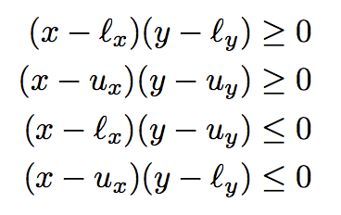
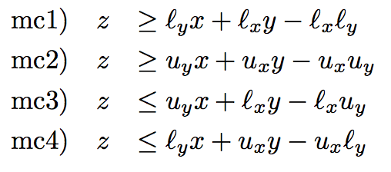

McCormick inequalities
To simplify notation, rewrite the generic bilevel eq. as:
Obviously
→
(just replace xy by z in the products on the left)
Note: mc1) and mc2) can be improved in case x=y → gradients cuts

Slide 5
Spatial branching
McCormick inequalities are not perfect
→ they are tight only when x and/or y
are at their lower/upper bound
→ at some B&C nodes, it may happen that the current (fractional or integer) solution satisfies all MC inequalities but some bilinear eq.s
z = xy are still violated (we call this #bilinear_infeasibility)
→ we need a bilinear-specific branching (the usual MILP branching on integrality does not work if all var.s are integer already)
Standard Spatial Branching: if z* = x* y* is violated, branch on
  (x ≤ x*) OR (x ≥ x*)
  to make the upper (resp. lower) bound on x tight at the left (resp.
  right) child node – thus improving the corresponding MC inequality

Slide 6


A new branching rule
Shifted Spatial Branching: let ρ* := z* - x* y* ; if ρ* > 0, branch on
  (x ≤ x* - δ ) OR (x ≥ x* - δ )
where δ is defined so as to balance the violation of the two child nodes (case ρ* < 0 is similar)
Left branch (u_{x} = x* - δ ) → violation of δ of the upper bound u_{x}
Right branch (l_{x} = x* - δ ) → violation of δ for the MC ineq.
by choosing
New Branching Rule: among all violated z* = x* y*, select the one maximizing the balanced violation δ

Slide 7
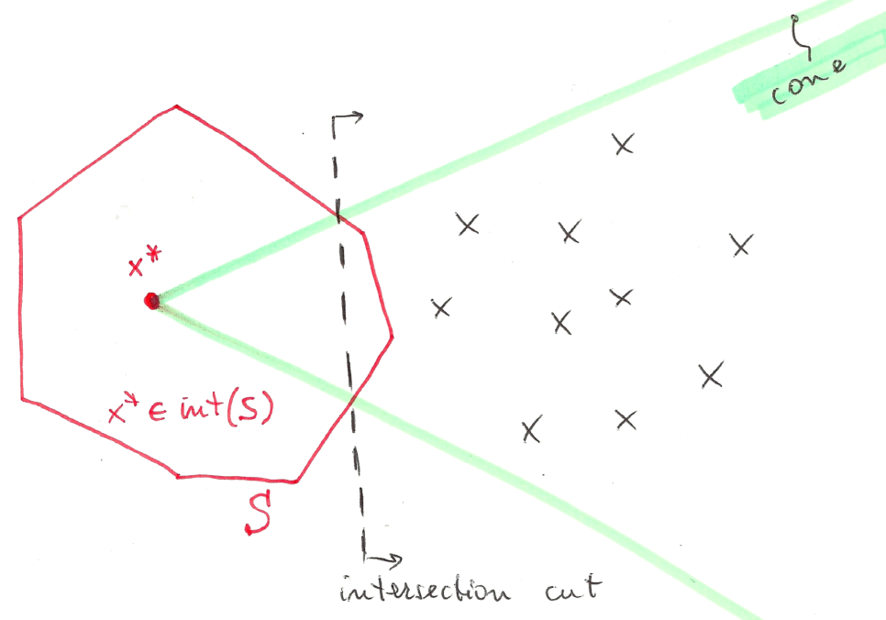
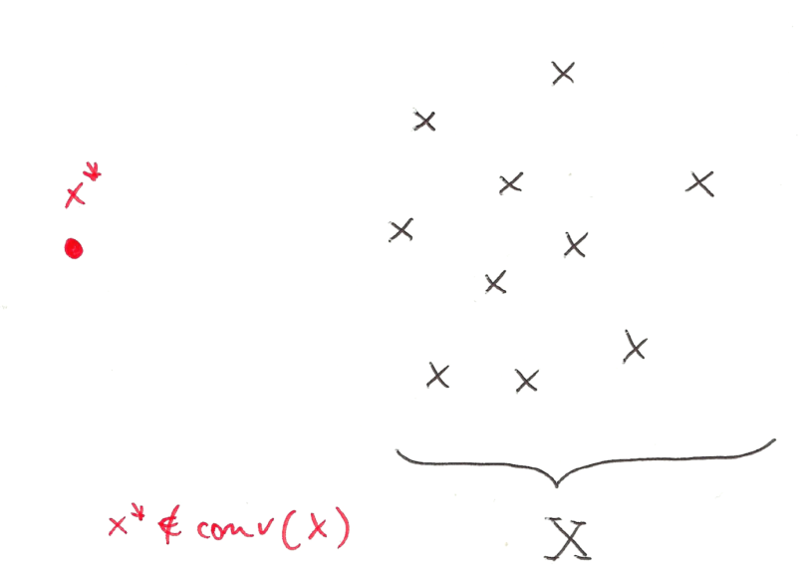
Intersection Cuts (ICs)
Intersection cuts (Balas, 1971): a powerful tool to separate a point x* from a set X by a liner cut
All you need is
  a cone pointed at x* containing all x ε X
  a convex set S with x* (but no x ε X) in its interior
If x* vertex of an LP relaxation, a suitable cone comes for the LP basis

Slide 8
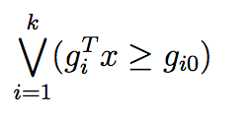


Bilinear-free sets
  Observation: given an infeasible point x*, any branching disjunction violated by x* implicitly defines a convex set S with x* (but no feasible x) in its interior
  →
  Thus, in principle, one could always generate an IC instead of branching → not always advisable because of numerical issues, slow convergence, tailing off, cut saturation, etc. #LikeGomoryCuts
  Candidate branching disjunctions (supplemented by MC cuts) are the 1- and 2-level (possibly shifted) spatial branching conditions:

Slide 9


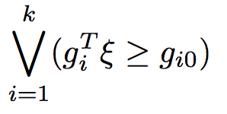
IC separation issues
IC separation can be probematic, as we need to read the cone rays from the LP tableau → numerical accuracy can be a big issue here!
Notation: consider w.l.o.g. an LP in standard form (no var. ub’s) and let
be the LP relaxation at a given node
be a given bilinear-free set
be the disjunction to be satisfied by all feas. sol.s

Slide 10
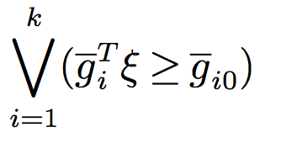
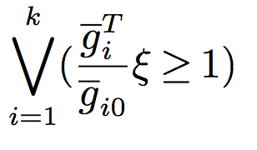
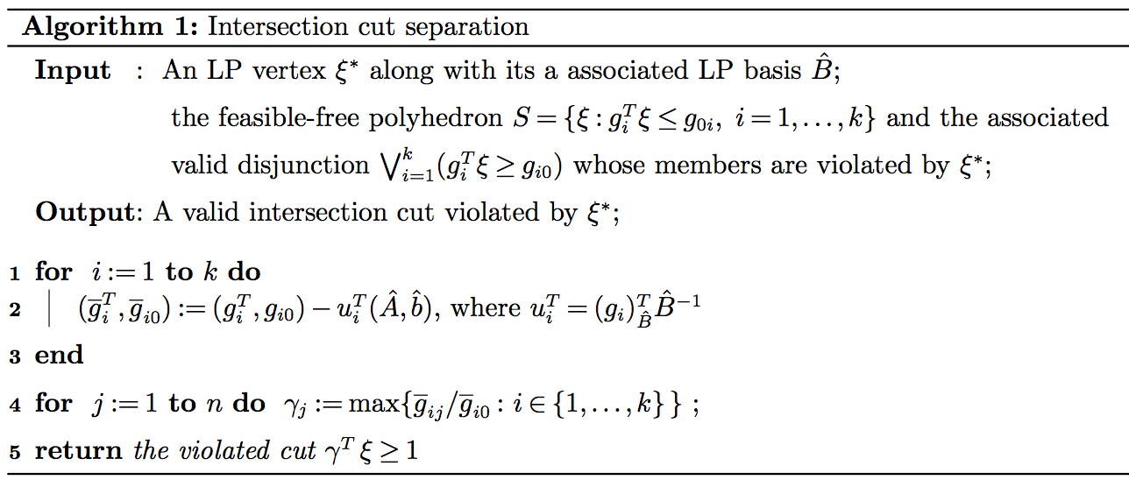
Numerically safe ICs
A single valid inequality can be obtained by
taking, for each variable, the worst LHS
Coefficient (and RHS) in each disjunction
To be applied to a reduced form of each
disjunction where the coefficient of all basic
variables is zero (kind of LP reduced costs)

Slide 11
B&C implementation
Implementation using IBM ILOG Cplex 12.8 using callbacks:
  Lazy constraint callback: separation of MC inequalities for integer sol.s
  Usercut callback: separation of fractional sol.s → not mandatory (and sometimes even detrimental)
  Branch callback: spatial branching (in a new variants)
  Incumbent callback: very-last resort to kill a bilinear-infeasible integer solution (when everything else fails e.g. because of tolerances)
  MILP heuristics (kindly provided by the MILP solver): active at their default level
  MIQP-specific heuristics: could be very useful, but not implemented yet

Slide 12
Computational analysis
Three algorithms under comparison
  SCIP: the general-purpose solver SCIP (vers. 5.0.1 using CPLEX 12.8 as LP solver + IPOPT 3.12.9 as nonlinear solver)
  basic: our branch-and-cut algorithm without intersection cuts
  with-IC: intersection cuts separated at each node where the LP solution is integral
Single-thread runs (parallel runs not allowed in SCIP) with a time limit of 1 hour on a standard PC Intel @ 3.10 GHz with 16 GB ram
Testbed: all quadratic instances in MINLPlib (700+ instances) …
… but some instances removed as root LP was unbounded
→ 620 instances left, 408 of which solved by all methods in 1 hour

Slide 13
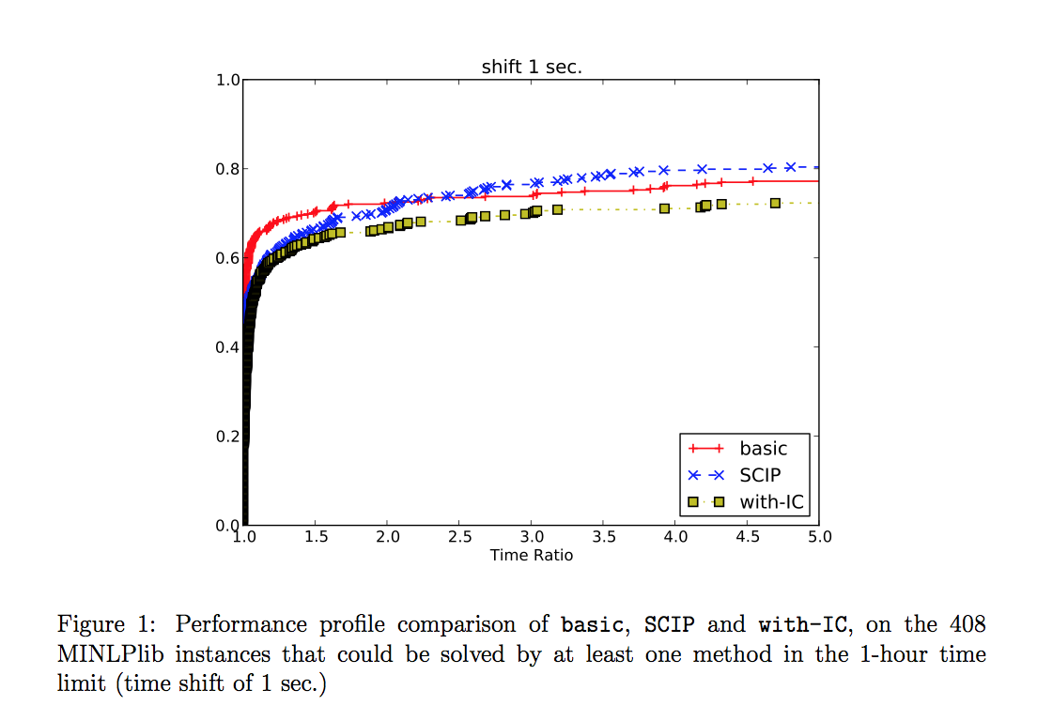
Results

Slide 14
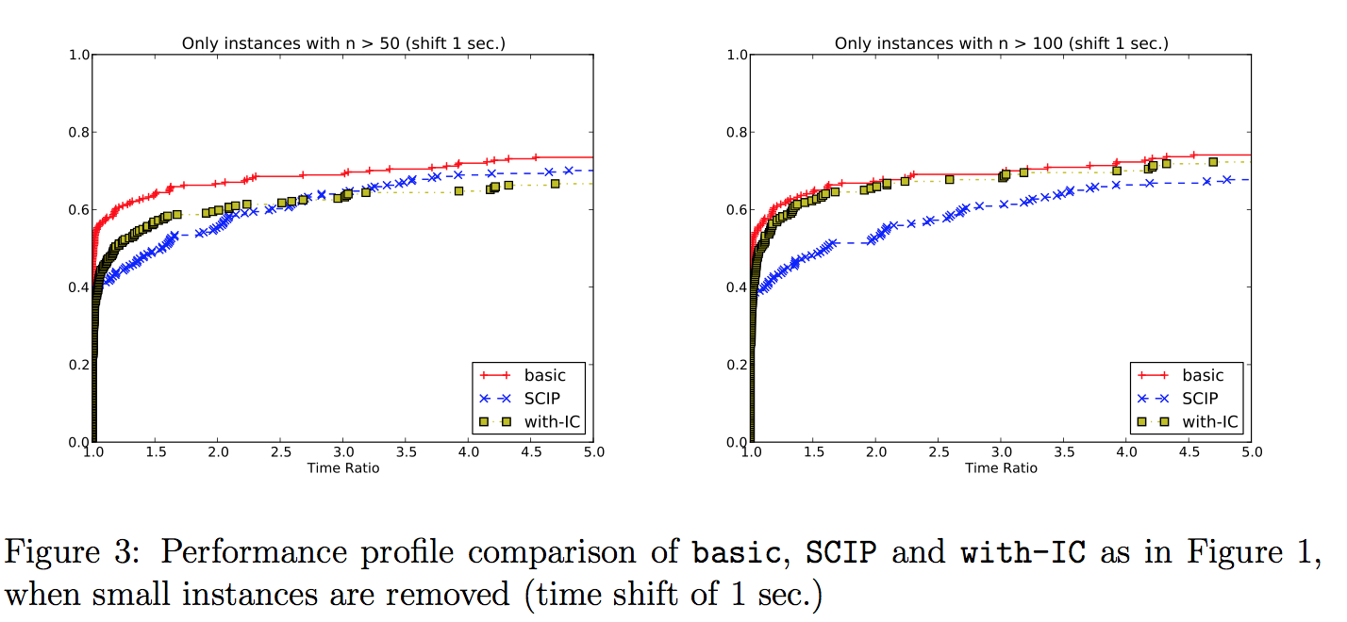
Results (without small instances)

Slide 15
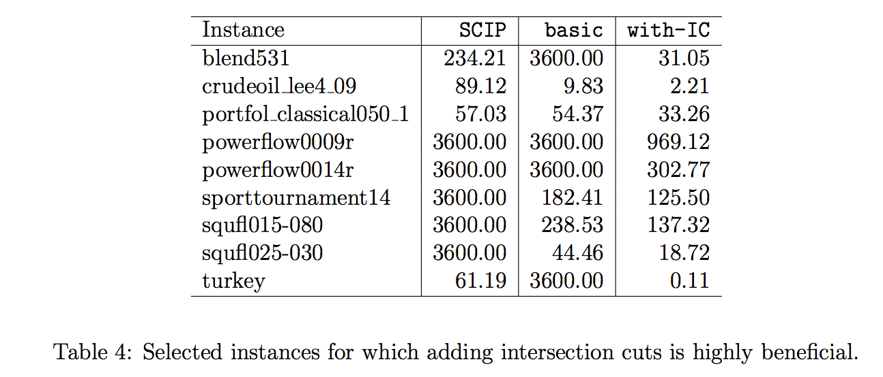
ICs can make a difference!

Slide 16
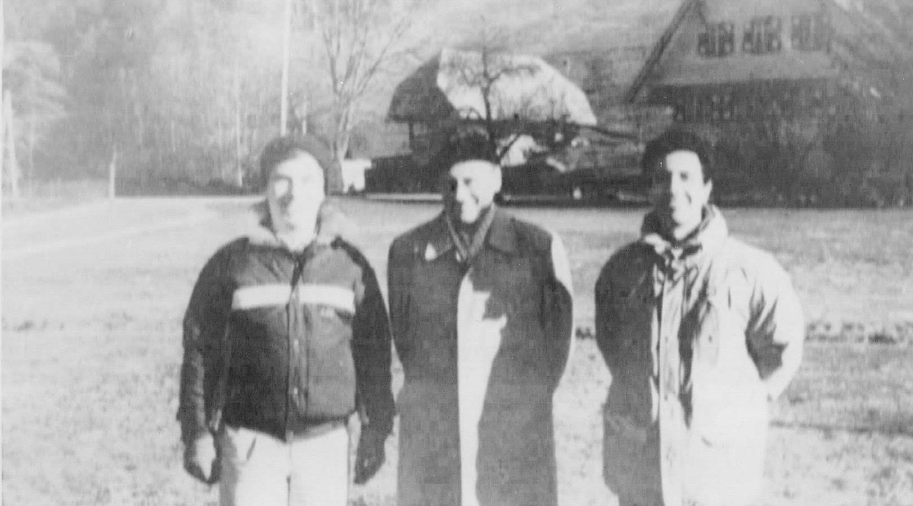
Thanks for your attention!
Paper available at http://www.dei.unipd.it/~fisch/papers/
Slides available at http://www.dei.unipd.it/~fisch/papers/slides/
.

