Slide 1
Intersection Cuts from Bilinear Disjunctions
Matteo Fischetti, University of Padova
(joint work with Michele Monaci, University of Bologna)

Slide 2
Non-convex MIQP
Goal: implement a Mixed-Integer (non-convex) Quadratic solver
Two approaches:
1. start with a continuous QP solver and add enumeration on top of it → implement B&B to handle integer var.s
2. start with a MILP solvers (B&C) and customize it to handle the non-convex quadratic terms → add McCormick & spatial branching
PROS: …
CONS: …
This talk goes for 2.

Slide 3
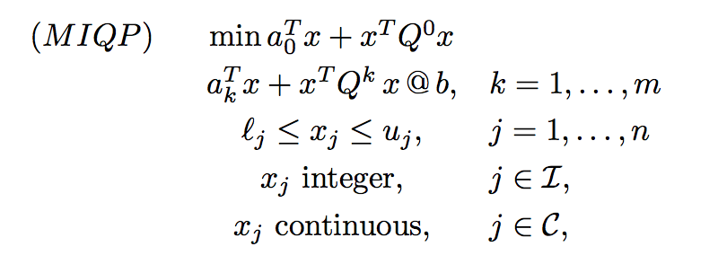
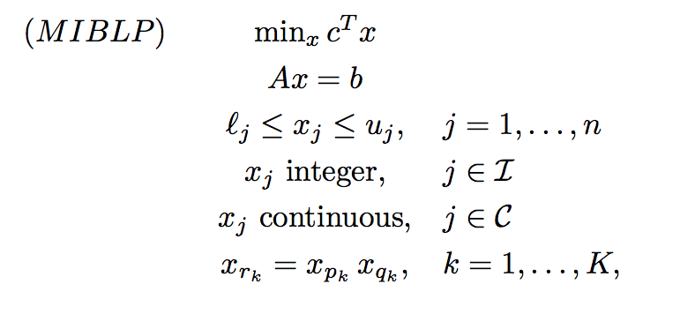
MIQP as a MILP with bilinear eq.s
The fully-general MIQP of interest reads
and can be restated as

Slide 4
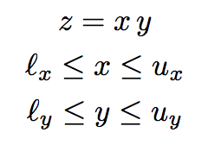
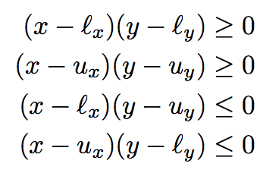
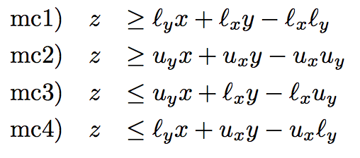
McCormick inequalities
To simplify notation, rewrite the generic bilevel eq. as:
Obviously
→
(just replace xy by z in the products on the left)
Note: mc1) and mc2) can be improved in case x=y → gradients cuts

Slide 5
Spatial branching
McCormick inequalities are not perfect
→ they are tight only when x and/or y
are at their lower/upper bound
→ at some B&C nodes, it may happen that the current (fractional or integer) solution satisfies all MC inequalities but some bilinear eq.s
z = xy are still violated (we call this #bilinear_infeasibility)
→ we need a bilinear-specific branching (the usual MILP branching on integrality does not work if all var.s are integer already)
Standard Spatial Branching: if z* = x* y* is violated, branch on
(x ≤ x*) OR (x ≥ x*)
to make the upper (resp. lower) bound on x tight at the left (resp.
right) child node – thus improving the corresponding MC inequality

Slide 6
A new branching rule
Shifted Spatial Branching: let ρ* := z* - x* y* ; if ρ* > 0, branch on
(x ≤ x* - δ ) OR (x ≥ x* - δ )
where δ is defined so as to balance the violation of the two child nodes (case ρ* < 0 is similar)
Left branch (u_{x} = x* - δ ) → violation of δ of the upper bound u_{x}
Right branch (l_{x} = x* - δ ) → violation of δ for the MC ineq.
by choosing
New Branching Rule: among all violated z* = x* y*, select the one maximizing the balanced violation δ

Slide 7
The branching procedure

Slide 8
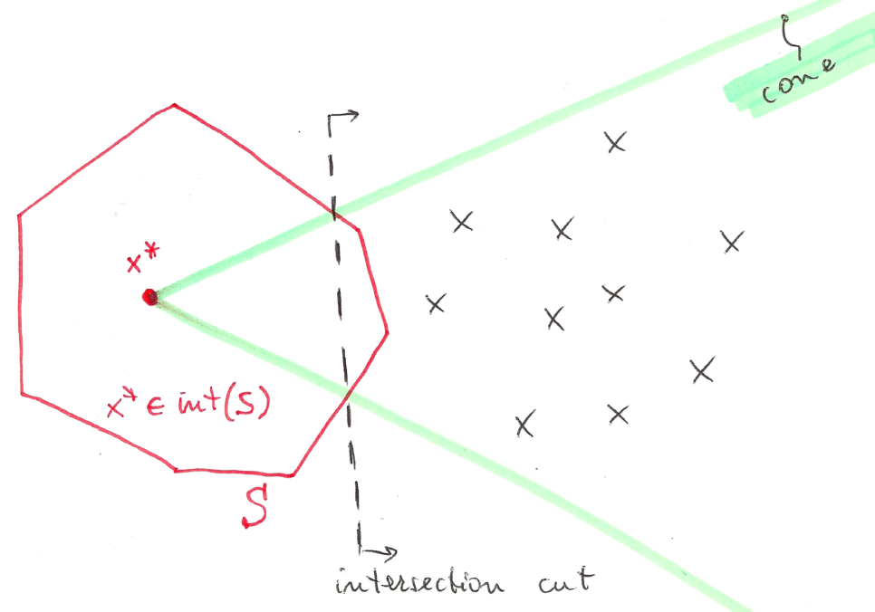
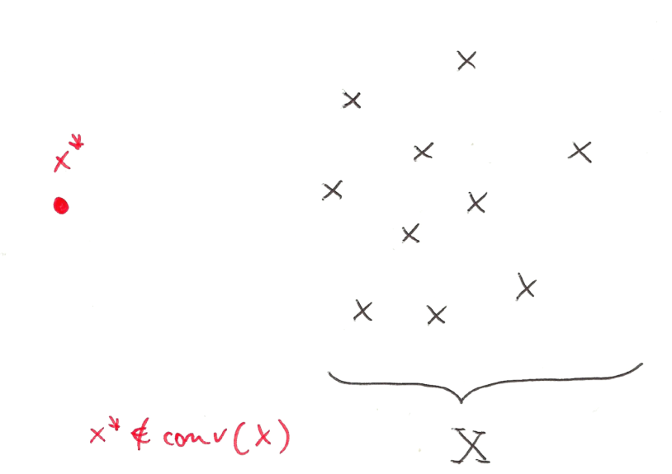
Intersection Cuts (ICs)
Intersection cuts (Balas, 1971): a powerful tool to separate a point x* from a set X by a liner cut
All you need is (love, but also)
a cone pointed at x* containing all x ε X
a convex set S with x* (but no x ε X) in its interior
If x* vertex of an LP relaxation, a suitable cone comes for the LP basis

Slide 9
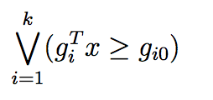
Bilinear-free sets
Observation: given an infeasible point x*, any branching disjunction violated by x* implicitly defines a convex set S with x* (but no feasible x) in its interior
→
Thus, in principle, one could always generate an IC instead of branching → not always advisable because of numerical issues, slow convergence, tailing off, cut saturation, etc. #LikeGomoryCuts
Candidate branching disjunctions (supplemented by MC cuts) are the 1- and 2-level (possibly shifted) spatial branching conditions:

Slide 10
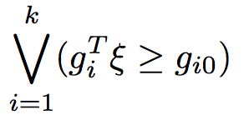
IC separation issues
IC separation can be probematic, as we need to read the cone rays from the LP tableau → numerical accuracy can be a big issue here!
For MILPs, ICs like Gomory cuts are not mandatory (so we can skip their generation in case of numerical problems), but for MIBLPs they are more instrumental #SeparateOrPerish
Notation: consider w.l.o.g. an LP in standard form and no var. ub’s
be the LP relaxation at a given node
be the bilevel-free set
be the disjunction to be satisfied by all feas. sol.s

Slide 11
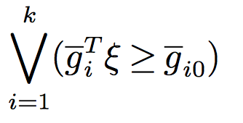
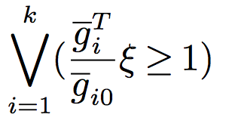
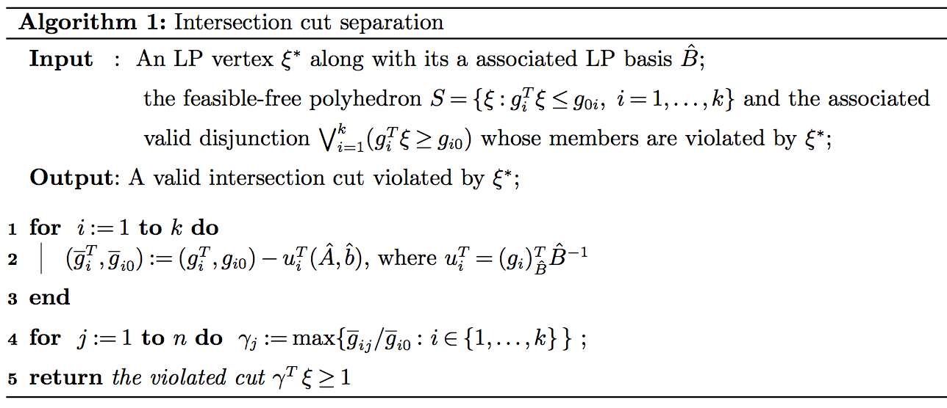
Numerically safe ICs
A single valid inequality can be obtained by
taking, for each variable, the worst LHS
Coefficient (and RHS) in each disjunction
To be applied to a reduced form of each
disjunction where the coefficient of all basic
variables is zero (kind of LP reduced costs)

Slide 12
B&C implementation
Implementation using IBM ILOG Cplex 12.8 using callbacks:
Lazy constraint callback: separation of MC inequalities for integer sol.s
Usercut callback: not needed (and sometimes detrimental)
Branch callback: our new spatial branching
Incumbent callback: very-last resort to kill a bilinear-infeasible integer solution (when everything else fails e.g. because of tolerances)
MILP heuristics (kindly provided by the MILP solver): active at their default level
MIQP-specific heuristics: not implemented yet

Slide 13
Computational analysis
Three algorithms under comparison
SCIP: the general-purpose solver SCIP (vers. 5.0.1 using CPLEX 12.8 as LP solver + IPOPT 3.12.9 as nonlinear solver)
basic: our branch-and-cut algorithm without intersection cuts
with-IC: intersection cuts separated at each node where the LP solution is integral
Single-thread runs (parallel runs not allowed in SCIP) with a time limit of 1 hour on a standard PC Intel @ 3.10 GHz with 16 GB ram
Testbed: all quadratic instances in MINLPlib (700+ instances) …
… but some instances removed as root LP was unbounded
→ 620 instances left, 248 of which solved by all methods in 1 hour

Slide 14
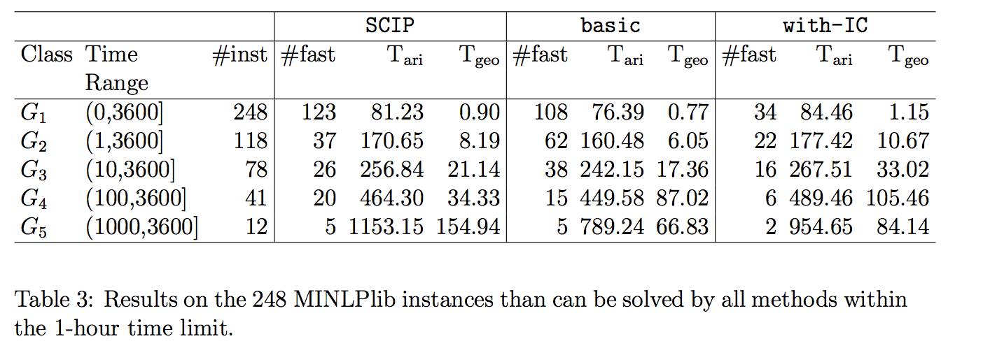
Results

Slide 15
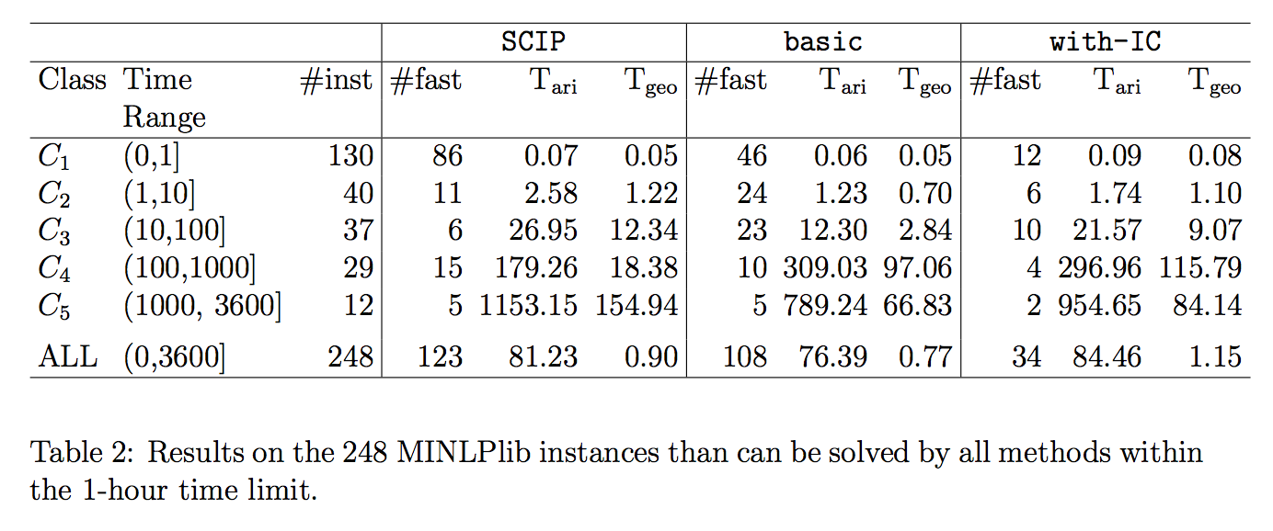
More statistics

Slide 16
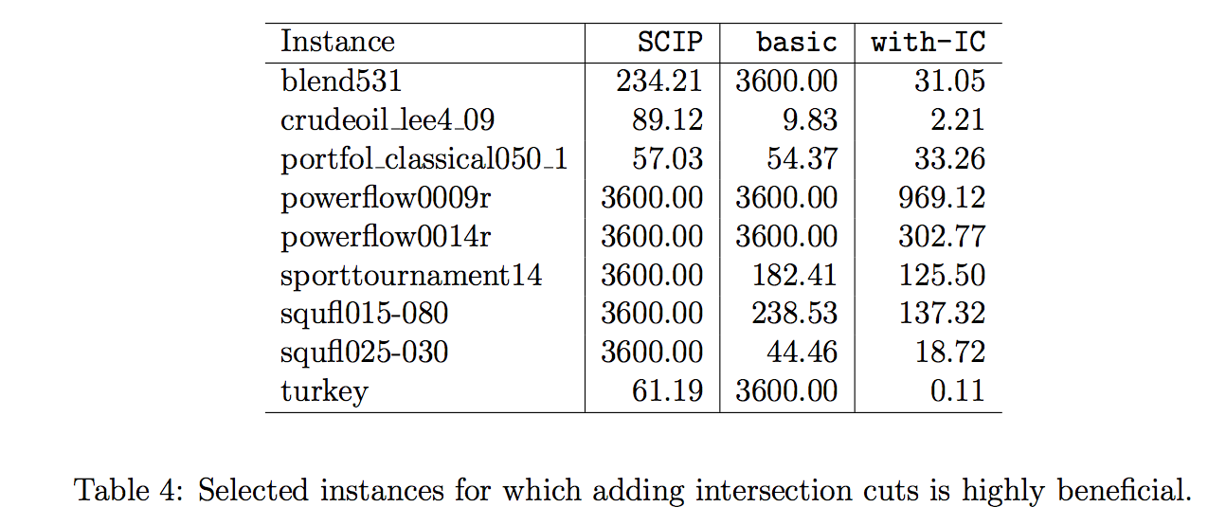
ICs can make a difference

Slide 17
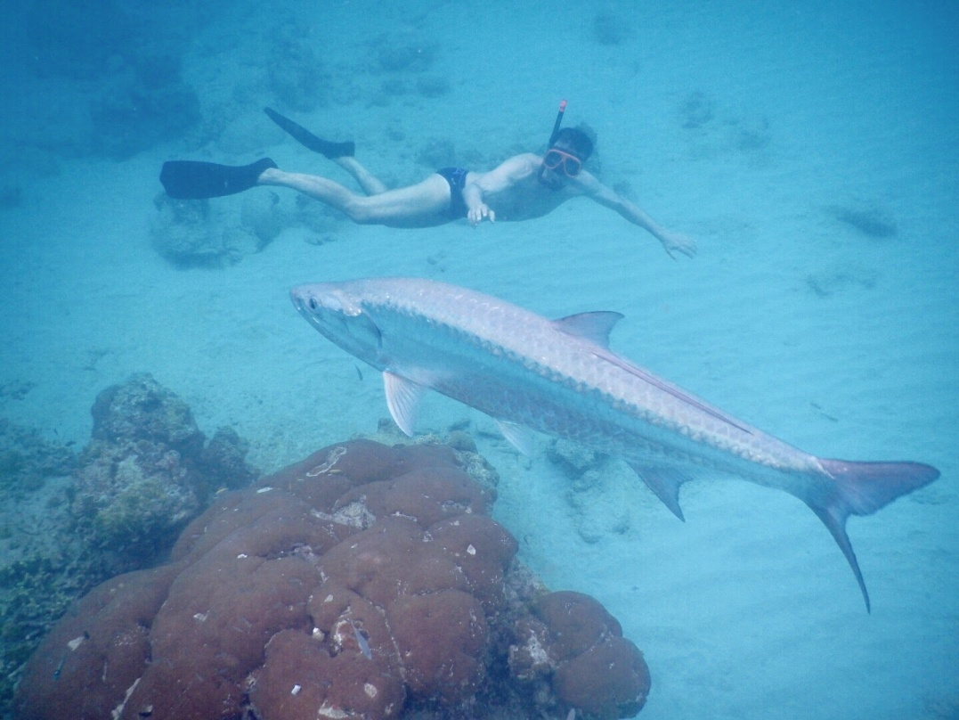
Thanks for your attention!
Paper available at http://www.dei.unipd.it/~fisch/papers/
Slides available at http://www.dei.unipd.it/~fisch/papers/slides/
.

