Slide 1

A Benders Decomposition Approach to the Time Window Assignment Traveling Salesperson Problem with Stochastic Travel Times
Matteo Fischetti, University of Padova
Joint work with
Francesco Cavaliere, Roberto Roberti, and Domenico Salvagnin
DEI, University of Padova

Slide 2
The TWATSP problem
Given:
𝐺 = (𝑉,𝐴) directed complete graph: 𝑉 = {0,...,𝑛}: 0 depot, V⁺ = {1,...,𝑛} custom.s
arc costs 𝑑_{𝑖𝑗} (deterministic) and travel times t_{𝑖𝑗} ≥ 0 (stochastic)
Maximum time T (deterministic “shift duration”)
Find
A Hamiltonian tour (ATSP sol. x_{𝑖𝑗} ) of total cost ≤ T
and assign each customer i a time window [t^{s}_{i} , t^{e}_{i} ] (s=start, e=end)
Note: time windows are decision var.s, not input data as in the classical TW-ATSP!
t_{𝑖𝑗}
0 (depot)
[t^{s}_{i} , t^{e}_{i} ]

Slide 3
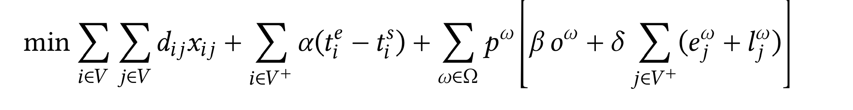
The TWATSP problem
Objective: minimize
the tour cost (i.e., the sum of the 𝑑𝑖𝑗’s of its arcs);
the sum of the durations t^{e}_{i} - t^{e}_{i} 𝑖 of all time windows, weighed by an input penalty factor 𝛼 ≥ 0;
For each scenario 𝜔 ∈ Ω, weighed by its probability 𝑝^{𝜔}:
3) the shift overtime 𝑜^{𝜔} (say) w.r.t. maximum shift duration 𝑇, weighed by 𝛽 ≥0;
the sum of the time-window violations e_{i}^{𝜔} (earliness) plus l_{i}^{𝜔} (lateness), weighed by 𝛿 ≥ 0

Slide 4
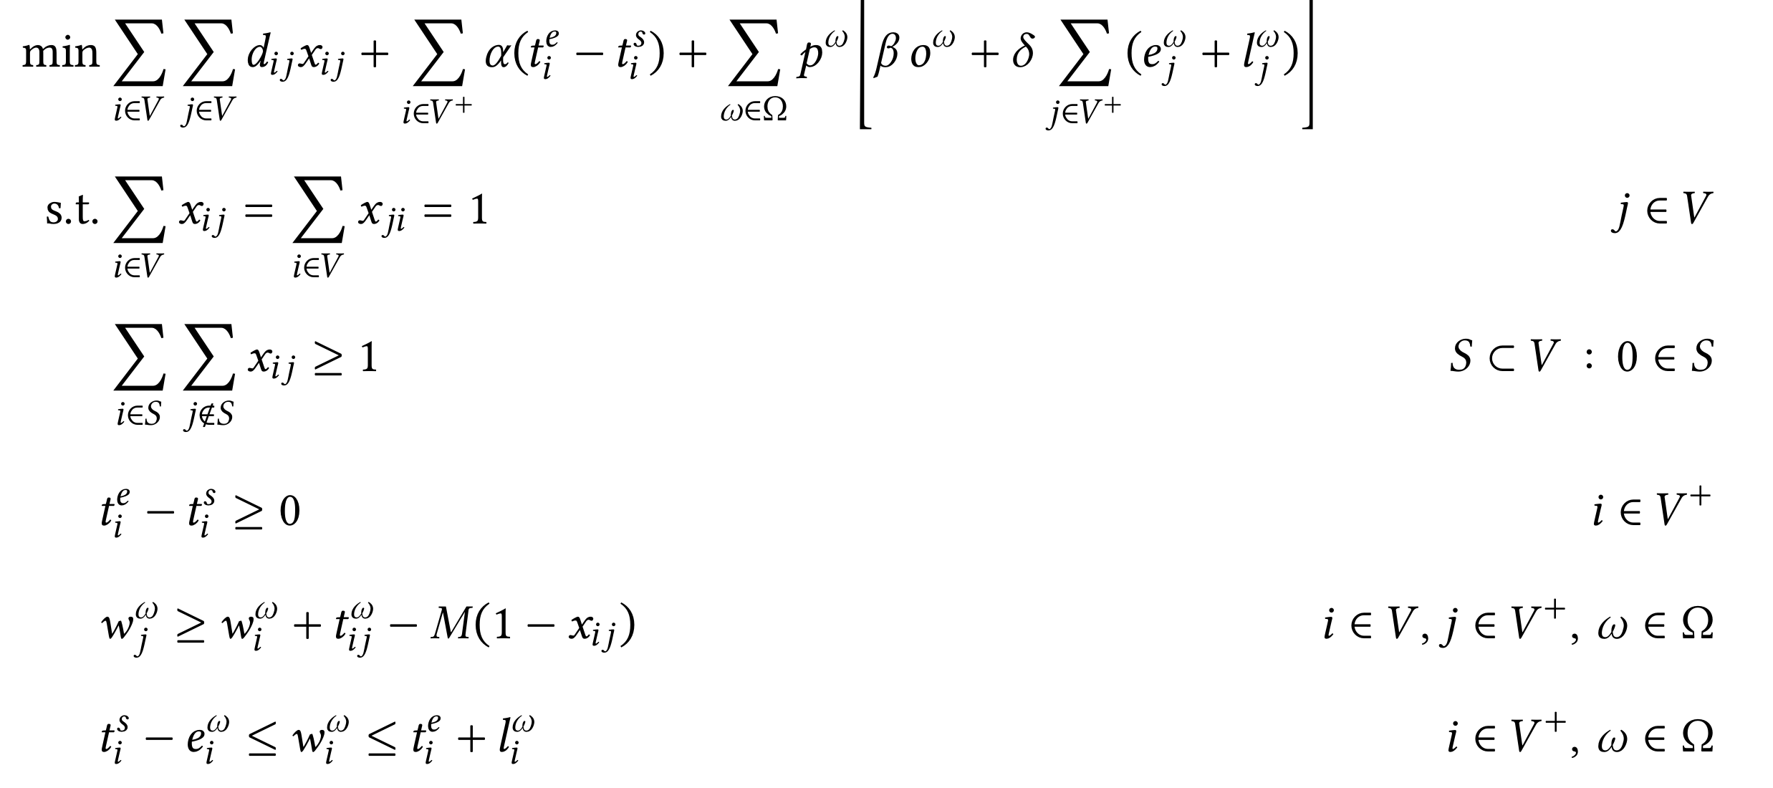
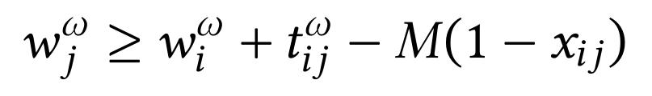
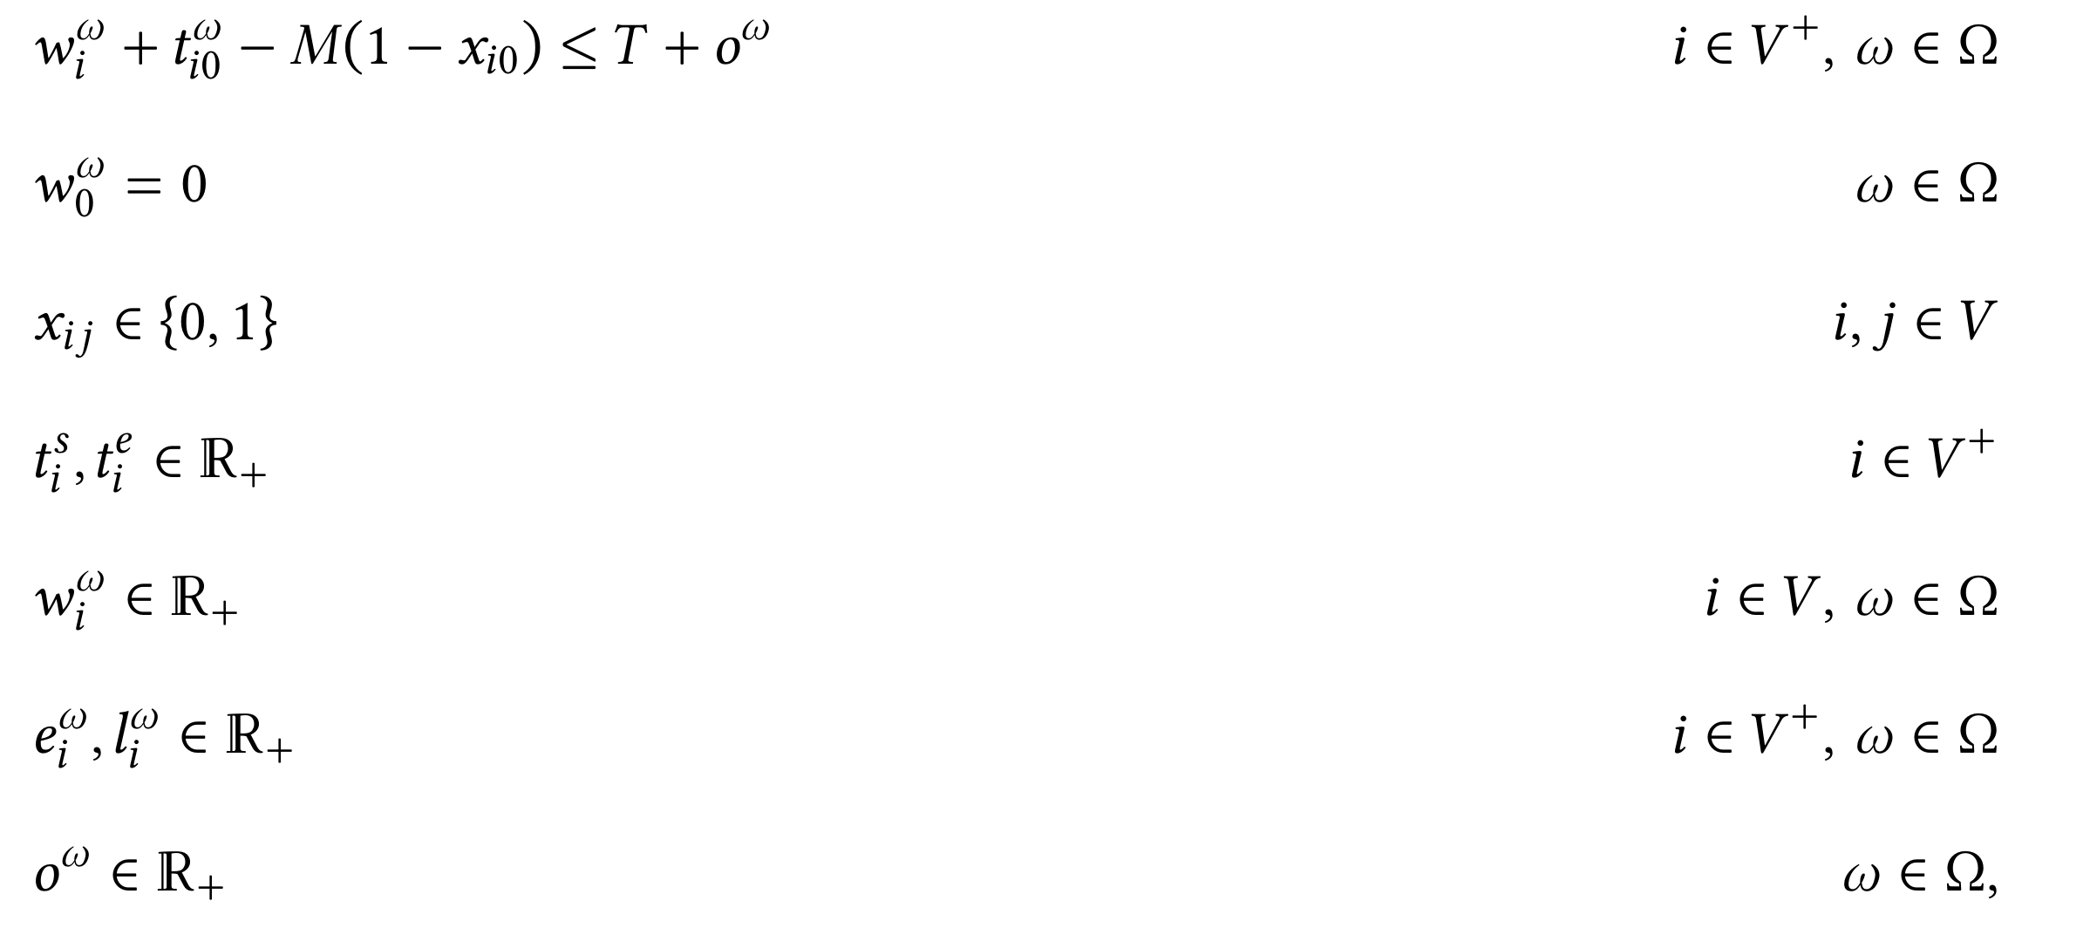
MILP model from the literature
Big-M constraint
𝑤_{i}^{𝜔} = arrival time at node i
Ş. Çelik, L. Martin, A. H. Schrotenboer, and T. Van Woensel. Exact two-step Benders decomposition for the time window assignment traveling salesperson problem. Transportation Science, 59(2):210–228, 2025.

Slide 5
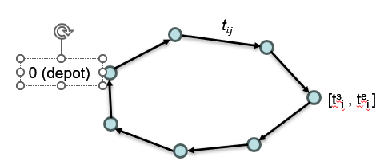
A new 3-index formulation
Idea: use positional (binary) variables
x_{ij}^{p} = 1 iff arc (i,j) selected in position p
as in: K.R. Fox, B. Gavish, and S.C. Graves. An n-constraint formulation of the (time-dependent) traveling salesman problem. Operations Research, 28 (4):1018–1021, 1980.
p=1
p=2
p=…

Slide 6
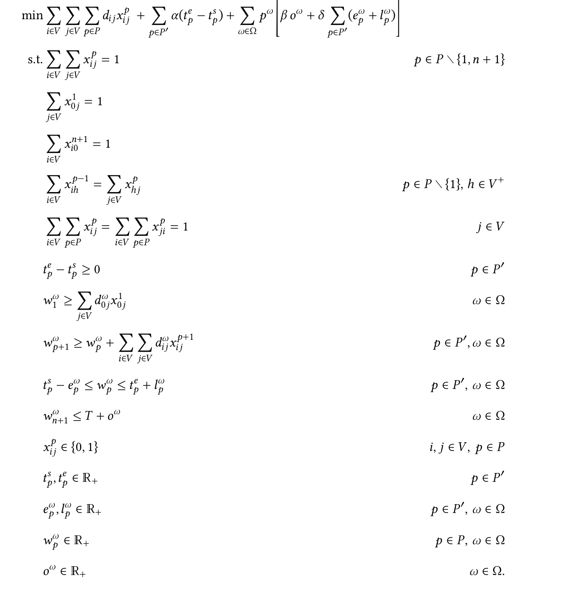
A new 3-index formulation
no big-M required:
𝑤^{𝜔}_{𝑝+1} ≥ 𝑤^{𝜔}_{𝑝}+∑_{𝑖∈𝑉} ∑_{𝑗∈𝑉} t^{𝜔}_{𝑖𝑗}𝑥^{𝑝+1}_{𝑖𝑗}

Slide 7
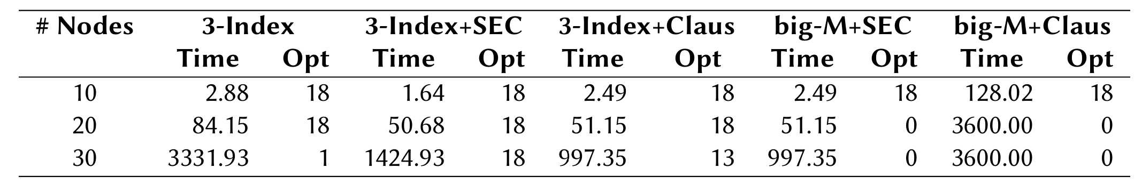
A computational comparison
Aggregated results (CPLEX black box):
big-M: model form the literature
3-index: our new model
+SEC: SECs have been separated on the fly,
+Claus: model augmented using Claus’ 3-index ATSP formulation
Time: computing time in sec.s (shifted geo. mean)
Opt: number of instances solved to proven optimum (1h time limit).

Slide 8
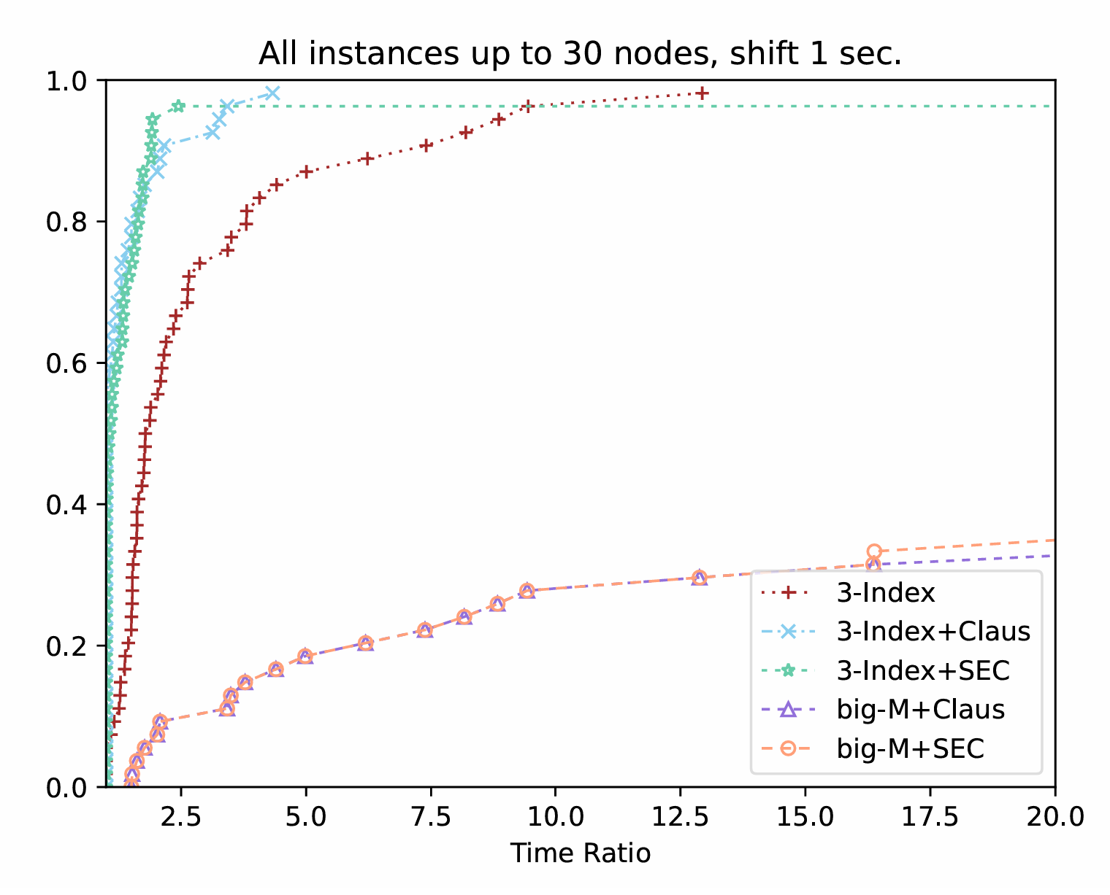
Performance profile plot

Slide 9
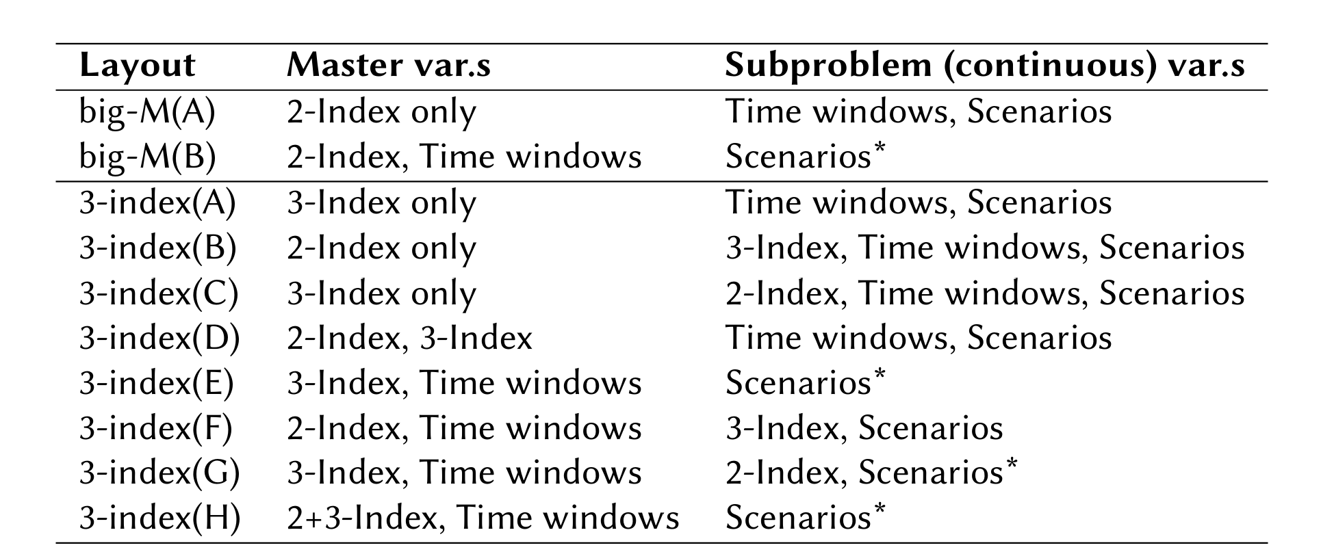
Ready for Benders?
Models are well suited for Benders decomposition…
… but several options are available
… which perform very differently!
In particular: how to split master and subproblem var.s?

Slide 10
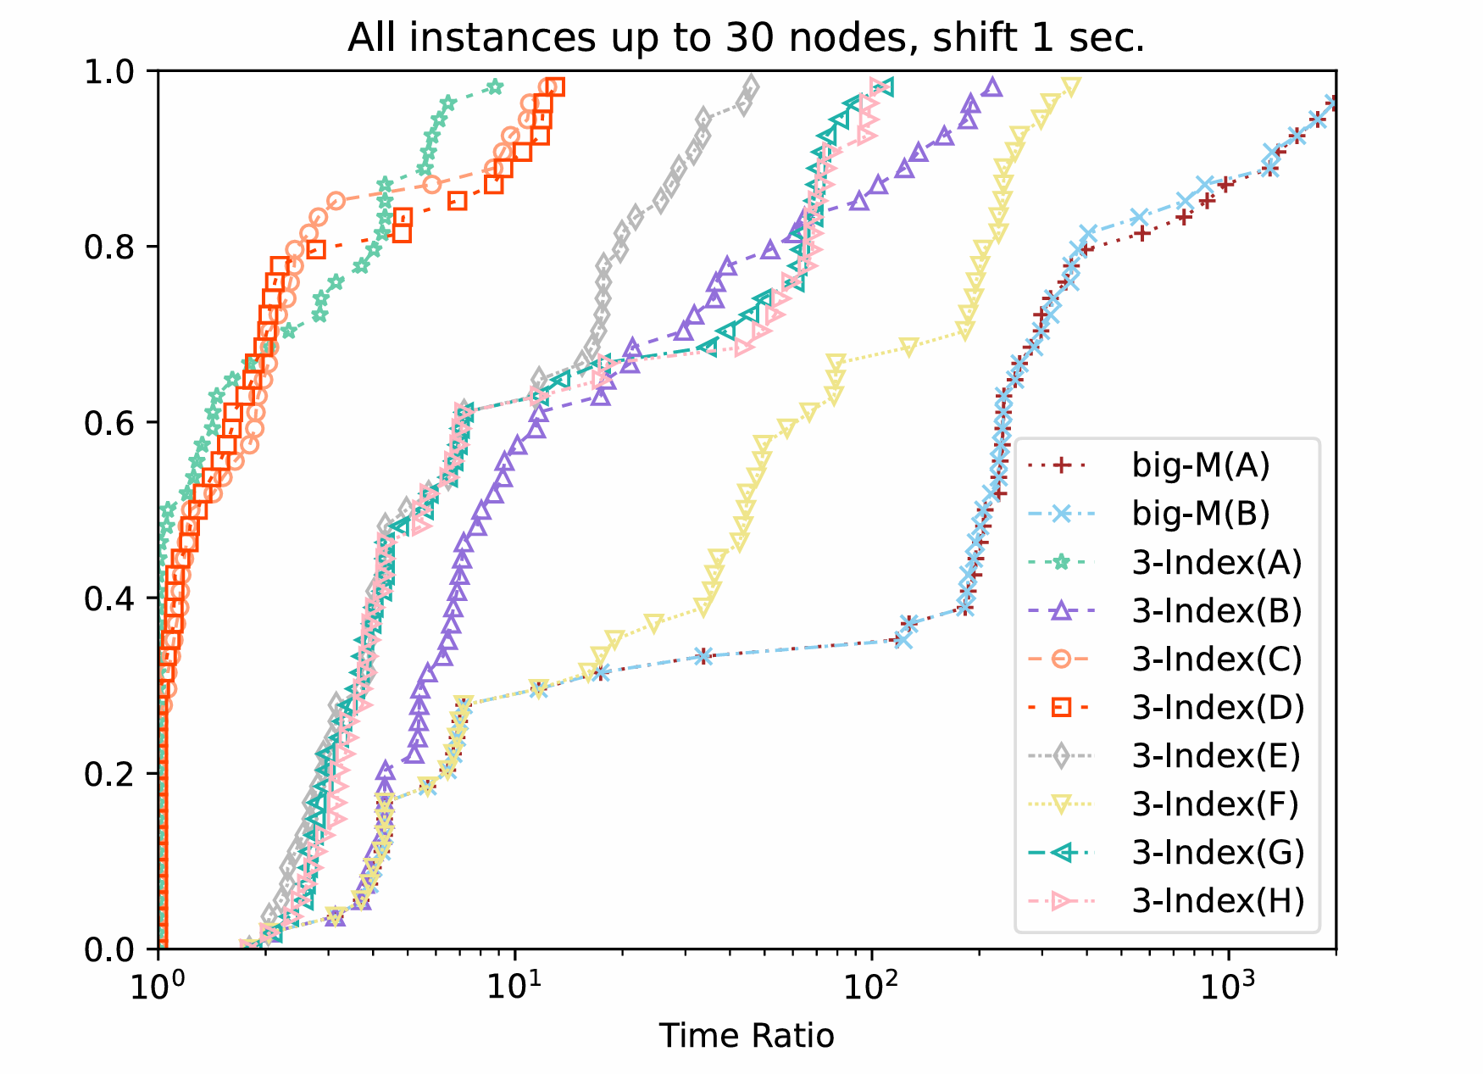
Comparison using CPLEX’s Benders
Worst: big-M formulations are (by far) the worst ones
Best: 3-index (D): 2- and 3-index var.s in the master, all time-related var.s (including time windows) in the subproblem

Slide 11
And now: coding!
We designed our own specialized Benders’ decomposition based on the outcomes of the previous experiments
Branch-and-cut based on CPLEX callbacks
Cut separation:
  SECs on the fly (all nodes, both fract. and integer sols.)
  Benders cuts for integer sol.s only (CANDIDATE callback)
  Scenario aggregation to speedup Benders separation (not in the master)
Initial primal heuristic: solve a relaxation without time windows (only overtime ∑_{𝑖∈𝑉} ∑_{𝑗∈𝑉} 𝑡^{𝜔}_{𝑖𝑗} 𝑥_{𝑖𝑗} ≤ 𝑇 + 𝑜^{𝜔} for all 𝜔)
…

Slide 12
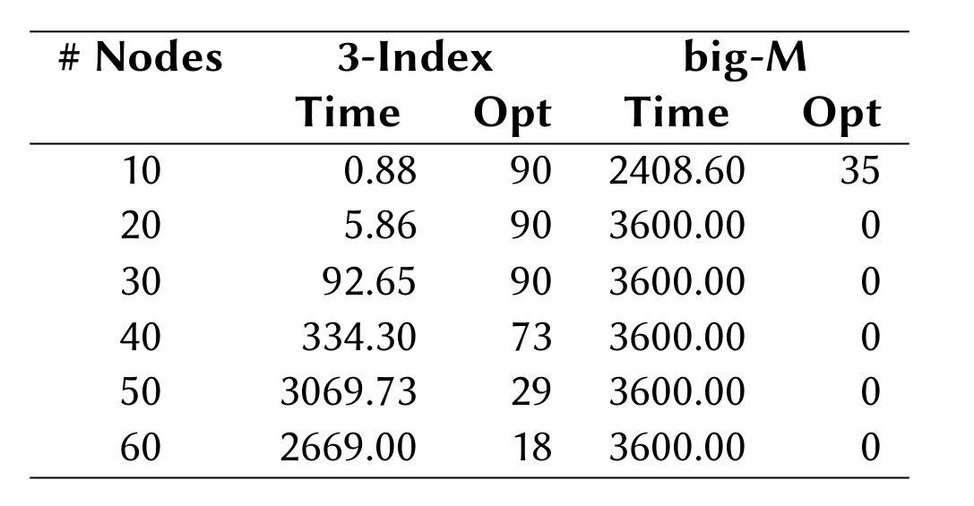
Computational results
Extensive computational analysis on a mixture of:
Localized Disruption Scenarios: small disruption probability (on average, less than one arc per route gets disrupted) -- customary in the literature
Spread Disruption Scenarios: disruption applied to each arc of the graph, using a gamma distribution: small travel-time differences are distributed in the whole network

Slide 13
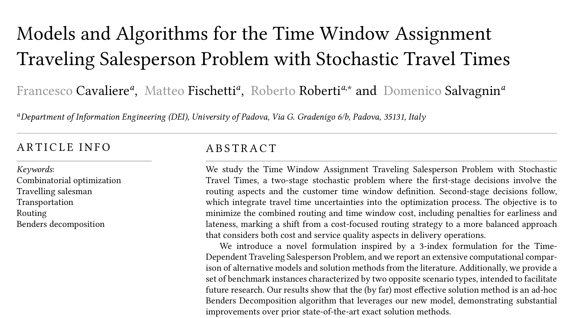
Thanks for your attention!
Paper:
F. Cavaliere, M. Fischetti, R. Roberti, D. Salvagnin, "Models and Algorithms for the Time Window Assignment Traveling Salesperson Problem with Stochastic Travel Times", European Journal of Operational Research, to appear, 2025
Slides available at http://www.dei.unipd.it/~fisch/papers/slides/
.

