Slide 1
Branch-and-Cut is our swiss army knife
Matteo Fischetti, University of Padova

Slide 2
The importance of Branch-and-Cut Implementation
Matteo Fischetti, University of Padova

Slide 3
A simple idea (?)
Mixed-Integer Programs (MIPs) can be solved by two alternative techniques:
Cutting planes (notably, Mixed-Integer Gomory cuts)
Branch and Bound
Pros and cons are complementary, so …
… why not merging them?
This idea was around already in the 1980’s
BUT: how to actually implement it?

Slide 4
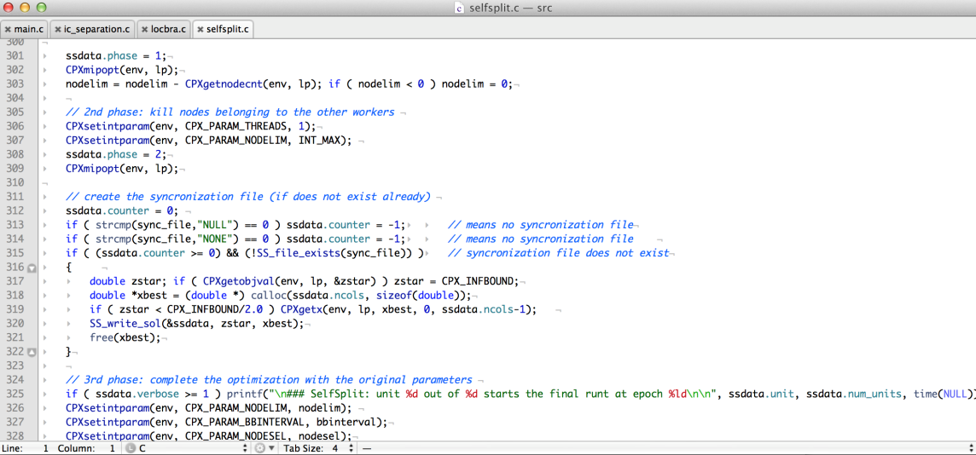
Why bothering about implementations?
Implementation
is not just coding!
Needed if we #orms want to have an impact in practical applications
… but often omitted in papers as “of no interest for a typical reader”
Ask yourself: would Artificial Intelligence (notably: deep learning) be so successful without gradient-descent algorithms served with their efficient #backpropagation implementations?

Slide 5
Algorithms as theorems
Proof: omitted as of no interest to the typical MP reader.
Describing an Algorithm without Implementation is like stating a Theorem without Proof
#just_a_computational_conjecture

Slide 6
Algorithms without implementation
Proof: omitted as of no interest to the typical MP reader.
Describing an Algorithm without Implementation is like stating a Theorem without Proof
#just_a_computational_conjecture

Slide 7
Branch & Cut ™
A “trademark” of Manfred Padberg and Giovanni Rinaldi
Proposed in the 1990’s for the TSP (and soon extended)
Comes as an algorithm entangled with its implementation
Theorem. Using cuts within an enumerative scheme is good.
Proof. Assume w.l.o.g. a good LP solver. Then apply B&Bound but
make use of families of (problem dependent) globally-valid inequalities
perform efficient exact/heuristic cut separation on the fly
use a data-structure (cut pool) to effectively share cuts among nodes
price variables in a dynamic way (well before branch-and-price!)
alternate row and column generation in a sound way …
suspend a node if “unattractive”
…

Slide 8
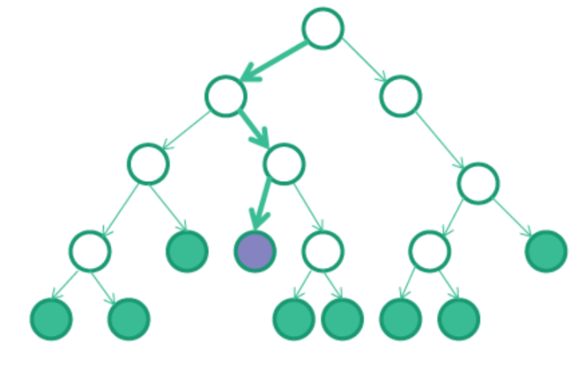
Modern B&C implementation
Modern B&C solvers such as Cplex, Gurobi, Express, SCIP etc. can be fully customized by using callback functions
Callback functions are just entry points
in the B&C code where an advanced user
(you!) can add his/her customizations
Most-used callbacks (using old-style Cplex’s jargon)
Lazy constraint: add “lazy constr.s” that should be part of the original model
User cut: add additional contr.s that hopefully help enforcing feasibility/integrality
Heuristic: try to improve the incumbent (primal solution) as soon as possible
Branch: modify the branching strategy
…

Slide 9
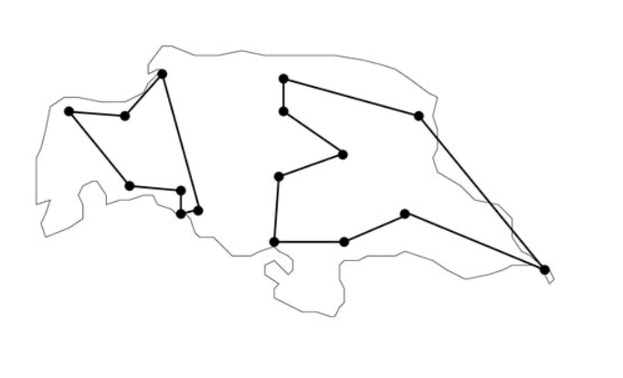
Lazy constraint callback CPX_CALLBACKCONTEXT_CANDIDATE
Automatically invoked when a solution is going to update the incumbent (meaning it is integer and feasible w.r.t. current model, e.g., because it comes from an internal primal heuristic)
This is the last checkpoint where we can discard a
solution for whatever reason (e.g., because it violates
a constraint that is not part of the current model)
To avoid be bothered by this solution again and again, we can/should return a violated constraint (cut) that is added (globally or locally) to the current model
Cut generation is often simplified by the
fact that the solution to be cut is known
to be integer (e.g., SECs for TSP)

Slide 10
Usercut callback CPX_CALLBACKCONTEXT_RELAXATION
Automatically invoked at every B&B node when the current solution is noninteger (e.g., just before branching)
A violated cut can possibly be returned, to be added (locally or globally) to the current model → often leads to an improved convergence to integer solutions
If no cut is returned, branching occurs as usual
Cut generation can be hard as the point is noninteger (heuristic approaches can be used)
User cuts are not mandatory for B&C correctness → being too clever on them can actually slow-down the solver because of the overhead in generating and using them (larger/denser LPs etc.)

Slide 11
Other callbacks
Branch callback: invoked at the end of each node (even when the LP solution is integer and apparently does not require any cut/branching) and used to impose/customize branching
Heuristic callback: used to build new (possibly problem-specific) feasible integer solutions to be posted, i.e., passed to the solver which will use them (at the appropriate time) to possibly update the incumbent
etc. etc.

Slide 12
Application: non-convex MIQP
(based on joint work with Michele Monaci, Univ. Bologna)
Goal: implement a Mixed-Integer (non-convex) Quadratic solver
Two approaches:
1. start with a continuous QP solver and add enumeration on top of it → implement B&B to handle integer var.s
2. start with a MILP solvers (B&C) and customize it to handle the non-convex quadratic terms → add McCormick & spatial branching
PROS: …
CONS: …

Slide 13
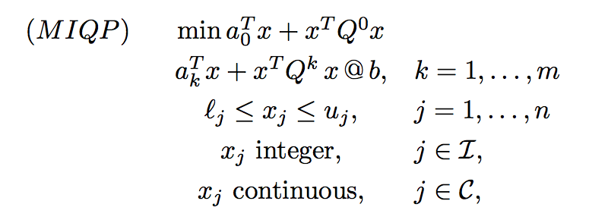
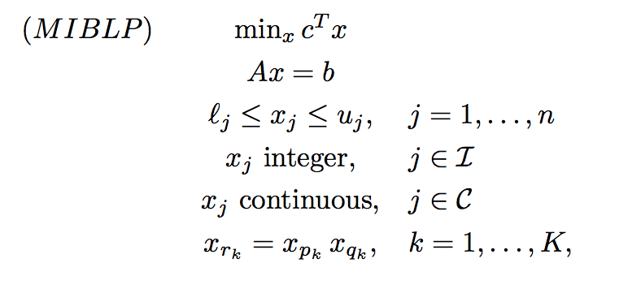
MIQP as a MILP with bilinear eq.s
The fully-general MIQP of interest reads
and can be restated as

Slide 14
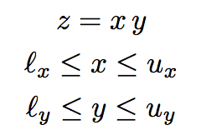
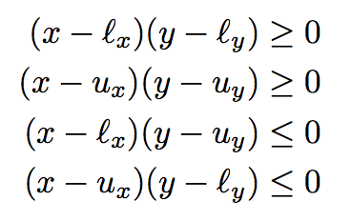
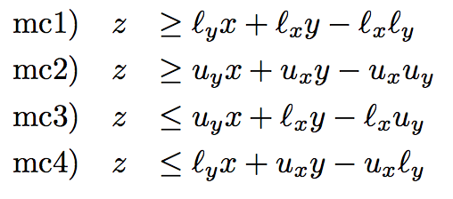
McCormick inequalities
To simplify notation, rewrite the generic bilinear eq. as:
Obviously
→
(just replace xy by z in the products on the left)
Note: mc1) and mc2) can be improved in case x=y → gradients cuts

Slide 15
Spatial branching
McCormick inequalities are not perfect
→ they are tight only when x and/or y
are at their lower/upper bound
→ at some B&C nodes, it may happen that the current (fractional or integer) solution satisfies all MC inequalities but some bilinear eq.s
z = xy are still violated (we call this #bilinear_infeasibility)
→ we need a bilinear-specific branching (the usual MILP branching on integrality does not work if all var.s are integer already)
Spatial branching: if z* = x* y* is a violated bilinear eq., branch on
(x ≤ x*) OR (x ≥ x*)
to make the upper (resp. lower) bound on x tight on the left (resp.
right) child node – thus improving the corresponding MC inequality

Slide 16
Vanilla B&C implementation
Lazy constraint callback: separation of MC inequalities
Usercut callback: not needed (and sometimes detrimental)
Branch callback: spatial branching on the “most violated” z = xy
Precision: LP precision higher (more restrictive) than bilinear tolerance
MILP heuristics (kindly provided by the MILP solver): active at their default level
MIQP-specific heuristics: not implemented
Implemented but not used in the vanilla version:
additional bilinear-specific cuts → Balas’ Intersection Cuts (ICs)
semi-spatial branching (branch threshold x*+δ → x* violates the x-bound in one of the two children, MC only needed in the other one)

Slide 17
Does it work?
Comparison with the SCIP 5.0 MIQP solver using CPLEX 12.8 as LP solver + internal nonlinear solver
Preliminary test on the quadratic MINLPlib (700+ instances) …
… but some instances removed as root LP was unbounded
→ they need bound tightening by preprocessing (TODO)
Results of our B&C callback-based vanilla implementation using CPLEX 12.8 as MILP solver; 1-thread runs (parallel runs not allowed in SCIP); only instances solved by both codes in the 1-hour time limit.
Overall, we are as fast as SCIP (but the latter solves more instances within the time limit → SCIP qualifies as a more robust solver).
We are 2 to 10 times faster than SCIP when the optimal/best-known solution from MINLPlib is used as a warm-start for both codes → evidently, we miss a sound bilinear-specific heuristic (TODO)

Slide 18
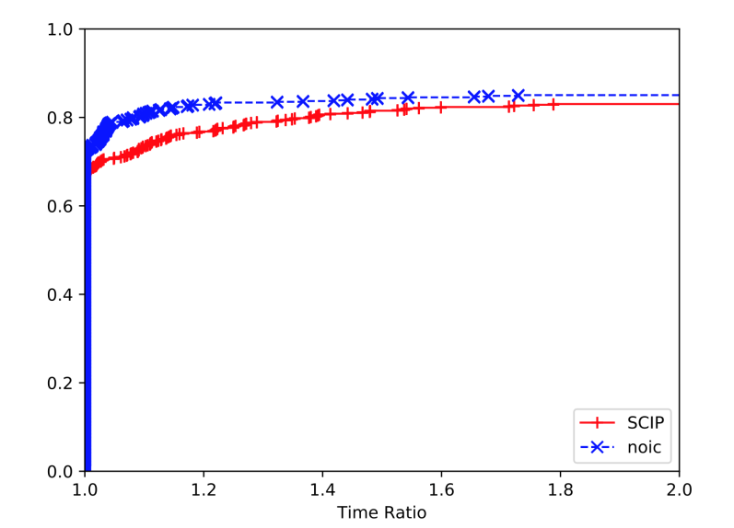
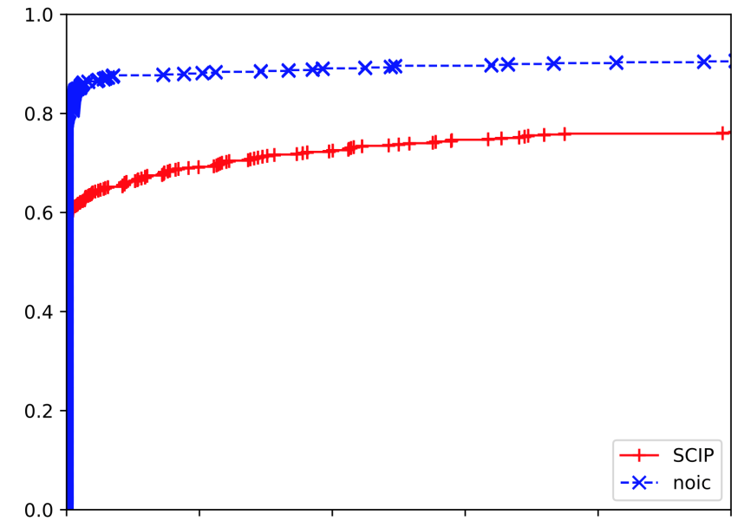
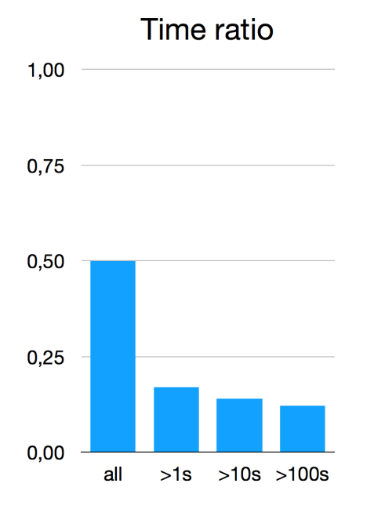
More detailed comparison
SCIP vs noic (our “vanilla”
version with no ICs and
classical spatial branching) →
Results with incumbent warm-start (only instances solved by both codes)

Slide 19
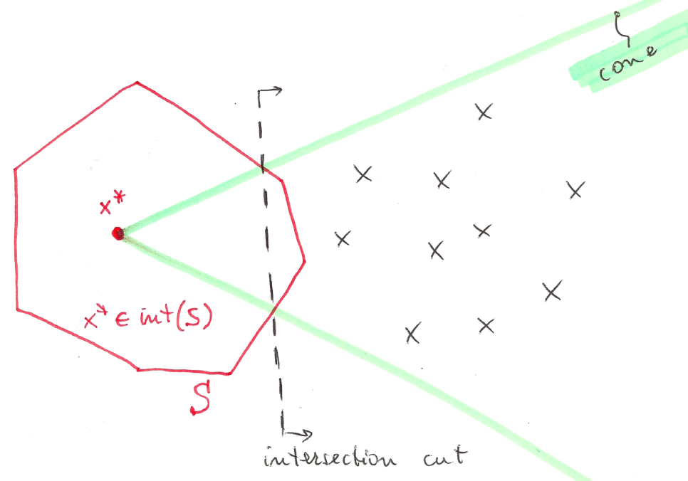
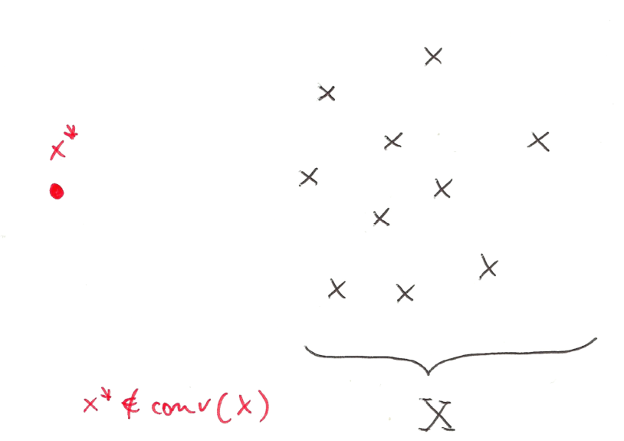
Intersection Cuts (ICs)
Intersection cuts (Balas, 1971): a powerful tool to separate a point x* from a set X by a liner cut
All you need is (love, but also)
a cone pointed at x* containing all x ε X
a convex set S with x* (but no x ε X) in its interior
If x* vertex of an LP relaxation, a suitable cone comes for the LP basis

Slide 20
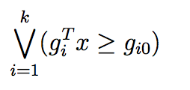
Bilinear-free sets
Observation: given an infeasible point x*, any branching disjunction violated by x* implicitly defines a convex set S with x* (but no feasible x) in its interior
→
Thus, in principle, one could always generate an IC instead of branching → not always advisable because of numerical issues, slow convergence, tailing off, cut saturation, etc. #LikeGomoryCuts
Candidate branching disjunctions (supplemented by MC cuts) are the 1- and 2-level (possibly shifted) spatial branching conditions:

Slide 21
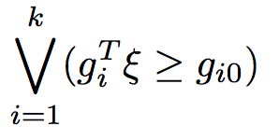
IC separation issues
IC separation can be probematic, as we need to read the cone rays from the LP tableau → numerical accuracy can be a big issue here!
Notation: consider w.l.o.g. an LP in standard form (no var. ub’s) and let
be the LP relaxation at a given node
be a given bilinear-free set
be the disjunction to be satisfied by all feas. sol.s

Slide 22
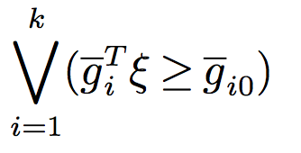
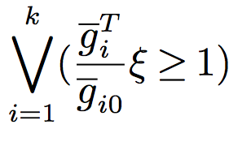
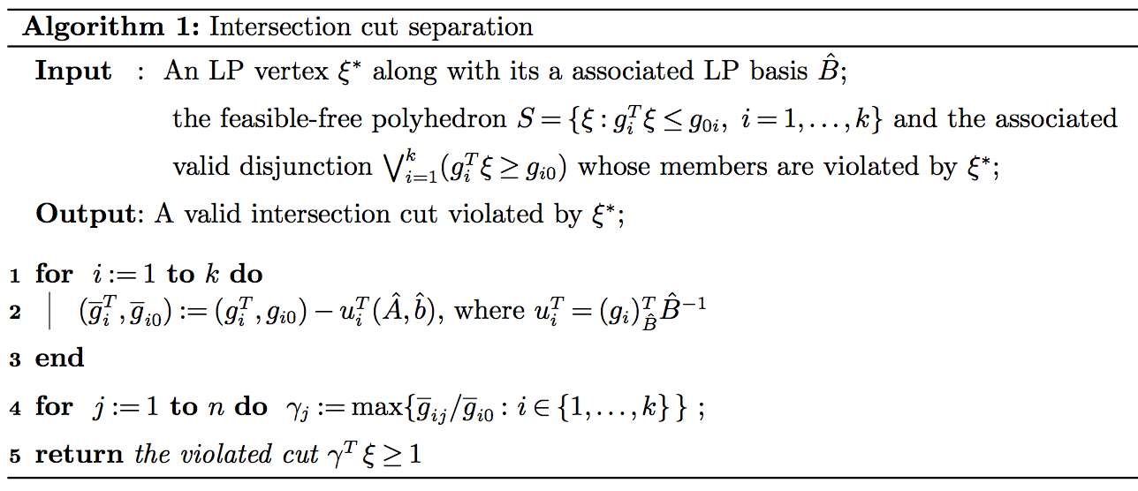
Numerically safe ICs
A single valid inequality can be obtained by
taking, for each variable, the worst LHS
Coefficient (and RHS) in each disjunction
To be applied to a reduced form of each
disjunction where the coefficient of all basic
variables is zero (kind of LP reduced costs)

Slide 23
Computational analysis
Three algorithms under comparison
SCIP: the general-purpose solver SCIP (vers. 5.0.1 using CPLEX 12.8 as LP solver + IPOPT 3.12.9 as nonlinear solver)
basic: our branch-and-cut algorithm without intersection cuts
with-IC: intersection cuts separated at each node where the LP solution is integral
Single-thread runs (parallel runs not allowed in SCIP) with a time limit of 1 hour on a standard PC Intel @ 3.10 GHz with 16 GB ram
Testbed: all quadratic instances in MINLPlib (700+ instances) …
… but some instances removed as root LP was unbounded
→ 620 instances left, 408 of which solved by all methods in 1 hour

Slide 24
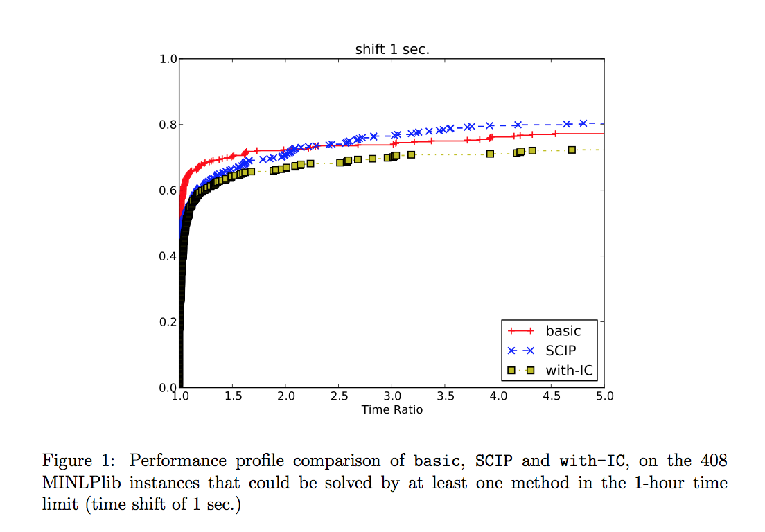
Results

Slide 25
Results (without small instances)

Slide 26
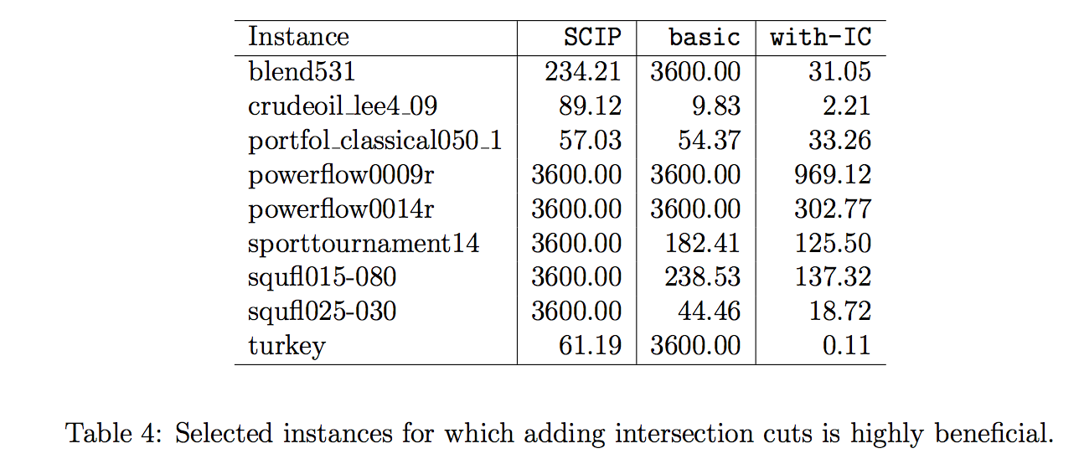
ICs can make a difference!

