Slide 1
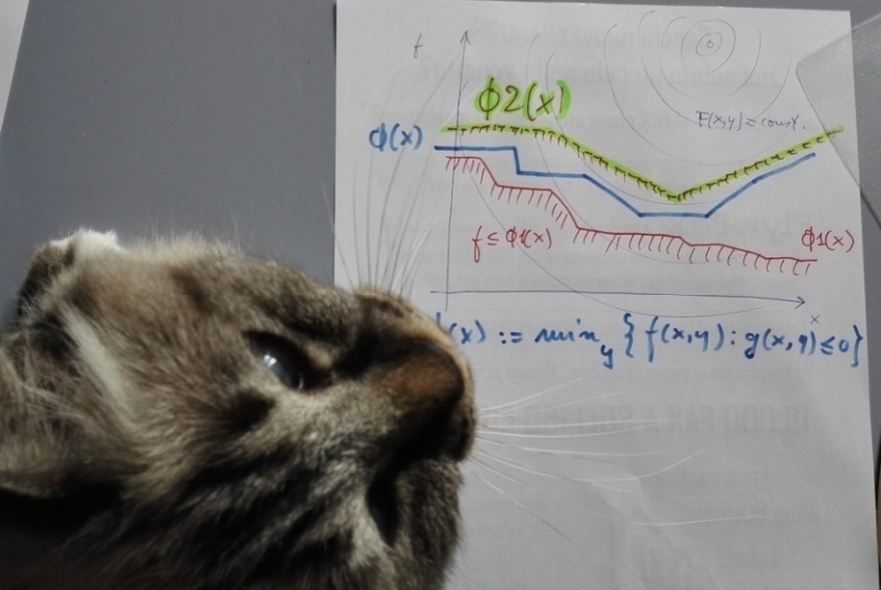
Implementing a B&C algorithm for Mixed-Integer Bilevel Linear Programming
Matteo Fischetti, University of Padova

Slide 2
Bilevel Optimization
The general Bilevel Optimization Problem (optimistic version) reads:
where x var.s only are controlled by the leader, while y var.s are computed by another player (the follower) solving a different problem.
A very very hard problem even in a convex setting with continuous var.s only
Convergent solution algorithms are problematic and typically require additional assumptions (binary/integer var.s or alike)

Slide 3
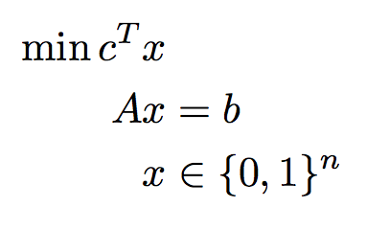
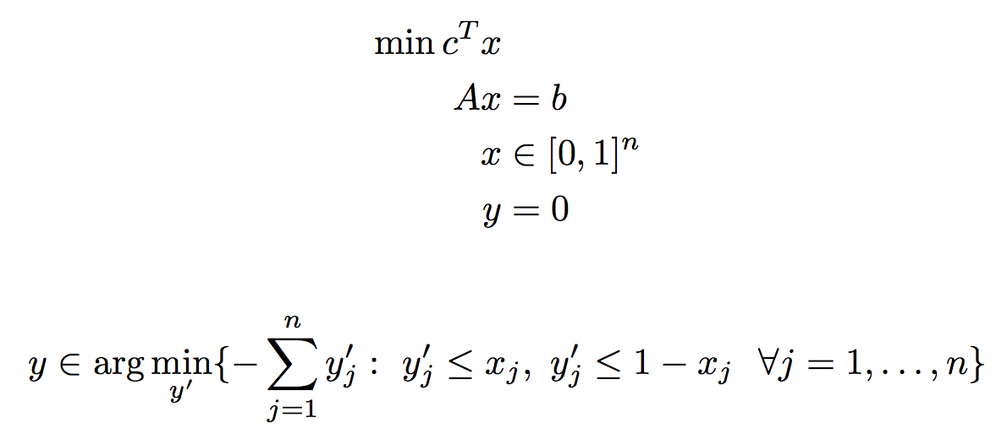
Example: 0-1 ILP
A generic 0-1 ILP
can be reformulated as
the following linear &
continuos bilevel problem
Note that y is fixed to 0 but it cannot be removed from the model!

Slide 4
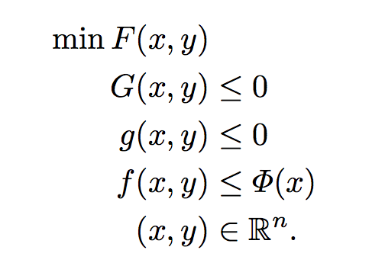
Reformulation
By defining the value function
the problem can be restated as
Dropping the nonconvex condition one gets the so-called High Point Relaxation (HPR)

Slide 5
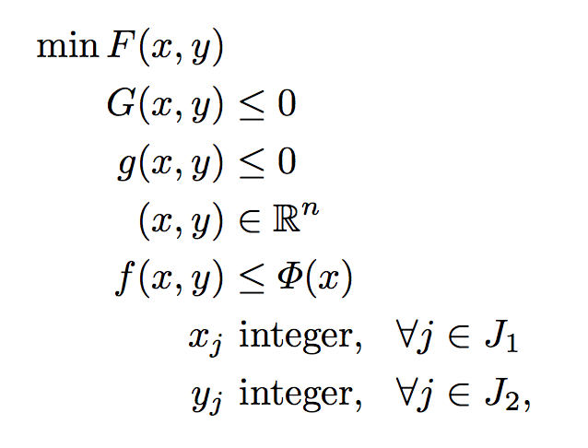
Mixed-Integer Bilevel Linear Problems
We will focus the Mixed-Integer Bilevel Linear case (MIBLP)
where F, G, f and g are linear (actually, affine) functions
Note that is nonconvex even when all y var.s are continuous

Slide 6
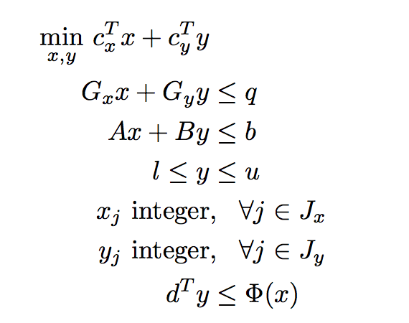
MIBLP statement
Using standard LP notation, our MIBLP reads
where for a given x = x* one computes the value function by solving the following MILP:

Slide 7
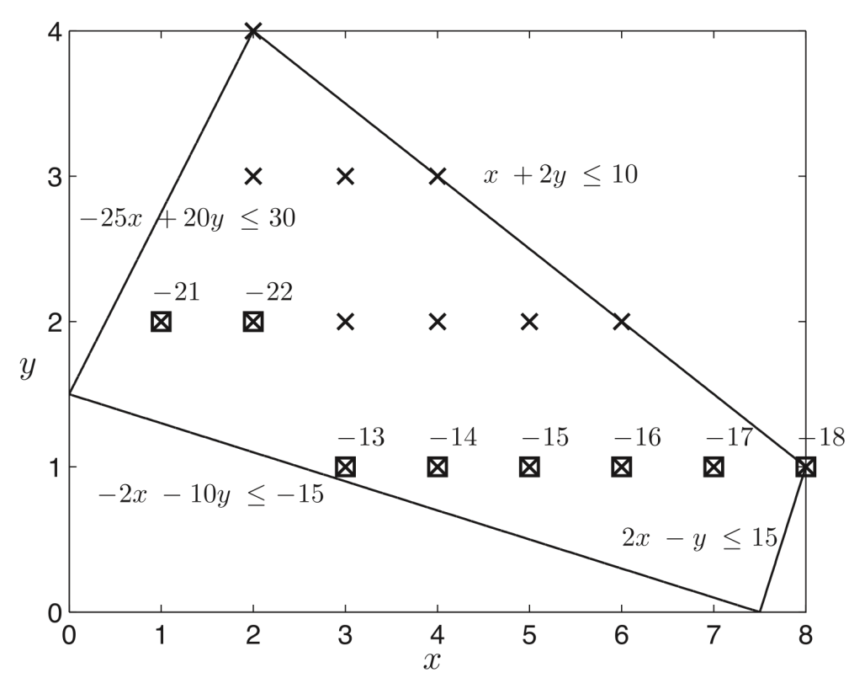
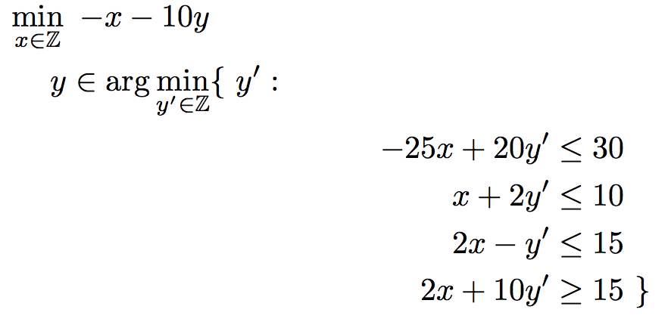
Example
A notorious example from
where f(x,y) = y
x points of HPR relax.
LP relax. of HPR

Slide 8
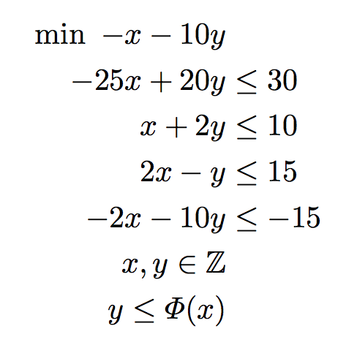
Example (cont.d)
Value-function reformulation

Slide 9
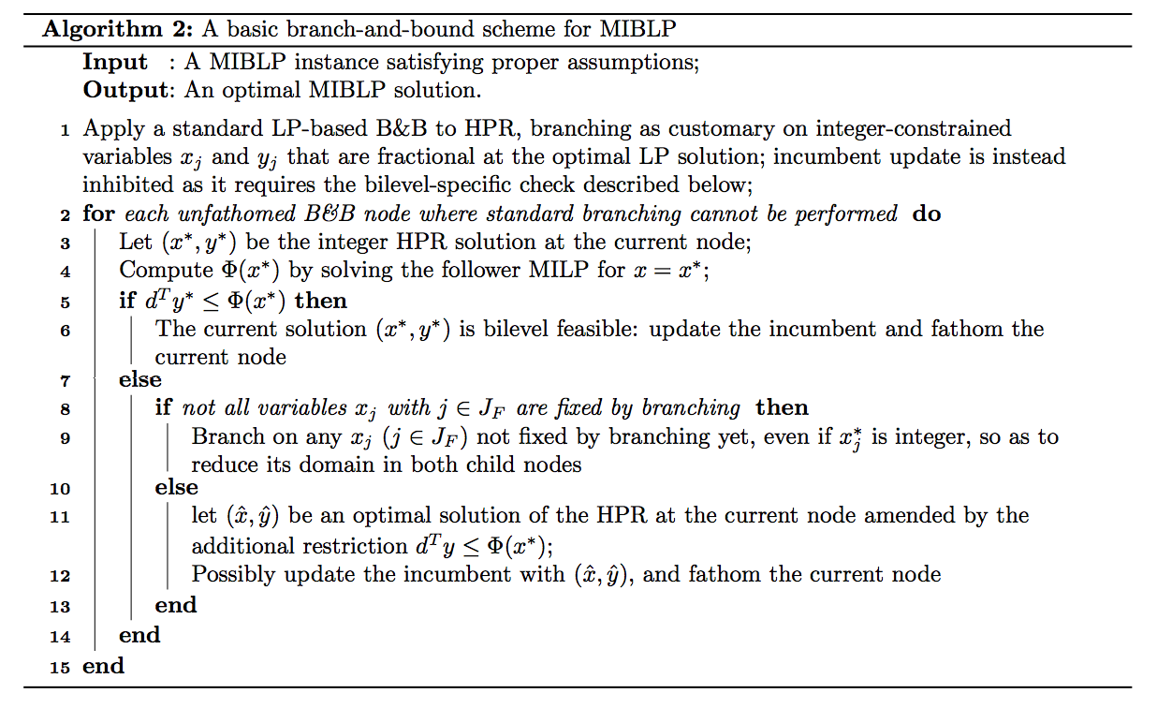
A convergent B&B scheme
Here is the set of the leader x-variables appearing in the follower problem, all of which are assumed to be integer constrained (we also exclude HPR unboundedness)

Slide 10
A MILP-based B&C solver
Suppose you want to apply a Branch-and-Cut MILP solver to HPR
Forget for a moment about internal heuristics (i.e., deactivate all of them), and assume the LP relaxation at each node is solved by the simplex algorithm
What do we need to add to the MILP solver to handle a MIBLP?
At each node, let (x*,y*) be the current LP optimal vertex:
if (x*,y*) is fractional → branch as usual
if (x*,y*) is integer and → update the incumbent as usual

Slide 11
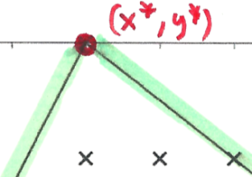
The difficult case
But, what can we do in third possible case, namely (x*,y*) is integer but not bilevel-feasible, i.e., when ?
Question: how can we cut this integer (x*,y*) ?
Possible answers from the literature
If (x,y) is restricted to be binary, add a no-good cut requiring to flip at least one variable w.r.t. (x*,y*) or w.r.t. x*
If (x,y) is restricted to be integer and all MILP coeff.s are integer, add a cut requiring a slack of 1 for the sum of all the inequalities that are tight at (x*,y*)
Are weak conditions as they do not addresses the reason of infeasibility by trying to enforce somehow

Slide 12
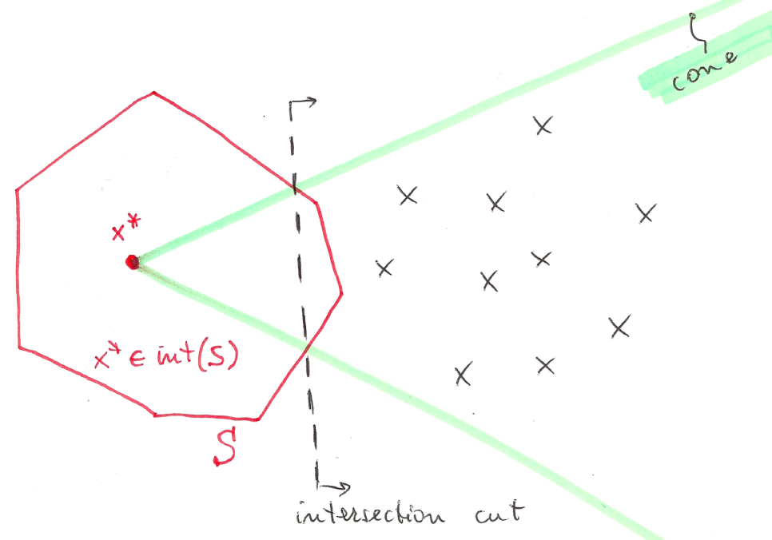
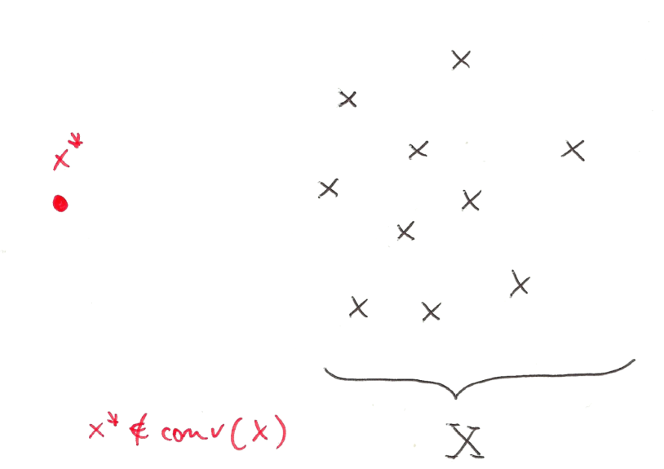
Intersection Cuts (ICs)
Try and use of intersection cuts (Balas, 1971) instead
ICs are a powerful tool to separate a point x* from a set X by a linear cut
All you need is
a cone pointed at x* containing all x ε X
a convex set S with x* (but no x ε X) in its strict interior
If x* vertex of an LP relaxation, a suitable cone comes for the LP basis

Slide 13
ICs for bilevel problems
Our idea is first illustrated on the Moore&Bard example
where f(x,y) = y
x points of HPR relax.
LP relax. of HPR

Slide 14
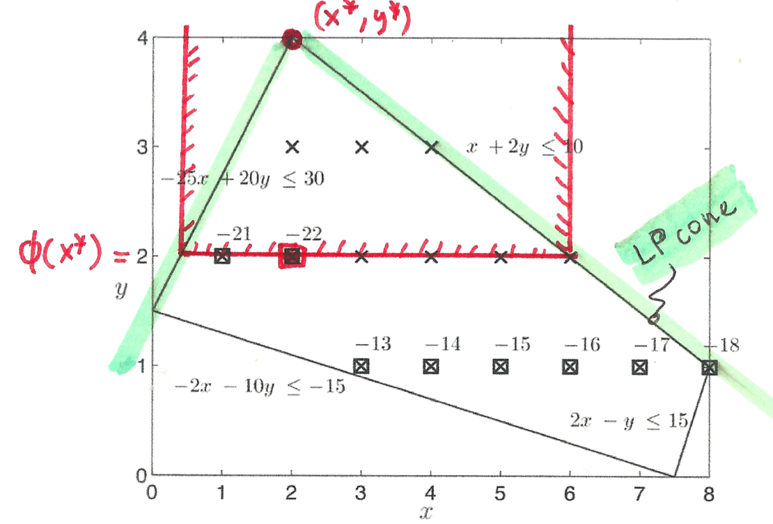
Define a suitable bilevel-free set
Take the LP vertex (x*,y*) = (2,4) → f(x*,y*) = y* = 4 > Phi(x*) = 2

Slide 15
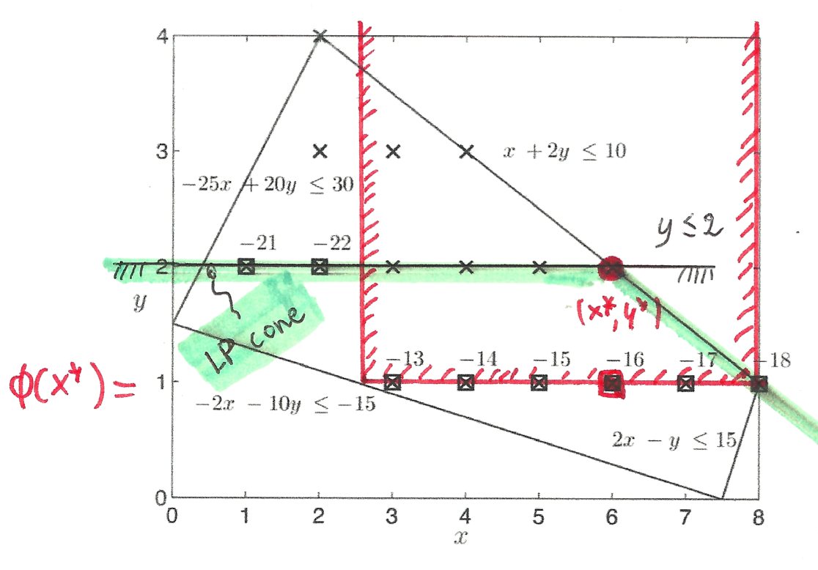
Intersection cut
We can therefore generate the intersection cut y ≤ 2 and repeat

Slide 16
A basic bilevel-free set
Note: is a convex set (actually, a polyhedron) when f and g are affine functions, i.e., in the MIBLP case
Separation algorithm: given an optimal vertex (x*,y*) of the LP relaxation of HPR
Solve the follower for x=x* and get an optimal sol., say
if (x*,y*) strictly inside then
generate a violated IC using the LP-cone pointed at (x*,y*)
together with the bilevel-free set

Slide 17
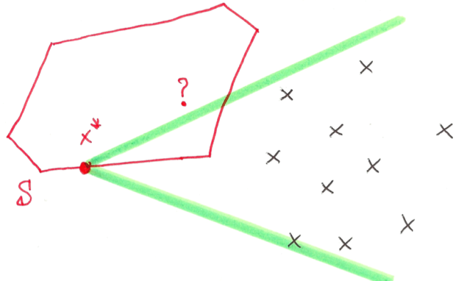
A technical issue…
However, the above does not lead to a proper MILP algorithm as a bilevel-infeasible integer vertex (x*,y*) can be on the frontier of the bilevel-free set S, so we cannot be sure to cut it by using our IC’s
We need to define the bilevel-free set in a more clever way if we want be sure to cut (x*,y*)

Slide 18
An enlarged bilevel-free set
Assuming g(x,y) is integer for all integer HPR solutions, one can “move apart” the frontier of so as be sure that vertex (x*,y*) belongs to its interior
The corresponding IC is always violated by (x*,y*) → IC separation to be implemented in a lazy constraint/usercut callback to produce a (locally valid) violated cut → B&C solver for MIBLP
Note: alternative bilevel-free sets can be defined to produce hopefully deeper ICs

Slide 19
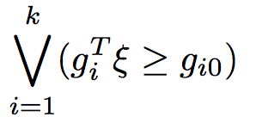
IC separation issues
IC separation can be probematic, as we need to read the cone rays from the LP tableau → numerical accuracy can be a big issue here!
For MILPs, ICs like Gomory cuts are not mandatory (so we can skip their generation in case of numerical problems), but for MIBLPs they are more instrumental #SeparateOrPerish
Notation change: let
be the LP relaxation at a given node
be the bilevel-free set
be the disjunction to be satisfied by all feas. sol.s

Slide 20
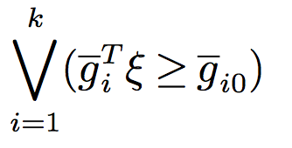
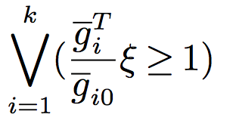
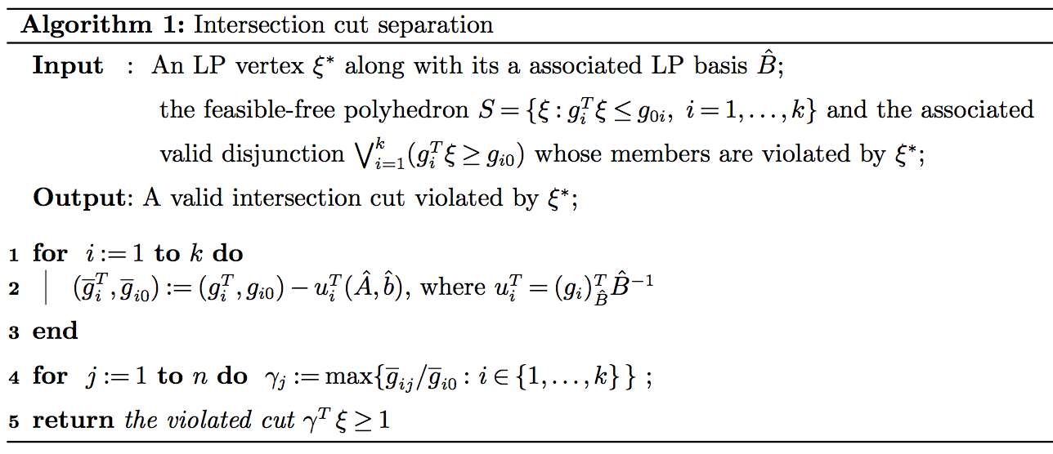
Numerically safe ICs
A single valid inequality can be obtained by
taking, for each variable, the worst LHS
coefficient (and RHS) in each disjunction
To be applied to a reduced form of each
disjunction where the coefficient of all basic
variables is zero (kind of LP reduced costs)

Slide 21
Conclusions
Mixed-Integer Bilevel Linear Programming is a MILP plus additional constr.s
Intersection cuts can produce valuable information at the B&B nodes
Sound MIBLP heuristics, preprocessing etc. (not discussed here) available
Many instances from the literature can be solved in a satisfactory way
Binary code available (ask Markus Sinnl for a free license)
Slides http://www.dei.unipd.it/~fisch/papers/slides/
Reference papers:
M. Fischetti, I. Ljubic, M. Monaci, M. Sinnl, "Intersection cuts for bilevel optimization", in Integer Programming and Combinatorial Optimization: 18th International Conference, IPCO 2016 Proceedings, 77-88, Mathematical Programming 172(1), 77-103, 2018
M. Fischetti, I. Ljubic, M. Monaci, M. Sinnl, "A new general-purpose algorithm for mixed-integer bilevel linear program", Operations Research 63 (7), 2146-2162, 2017.
M. Fischetti, I. Ljubic, M. Monaci, M. Sinnl, "Interdiction Games and Monotonicity",
INFORMS Journal on Computing 31(2), 390-410, 2019.

