Slide 1
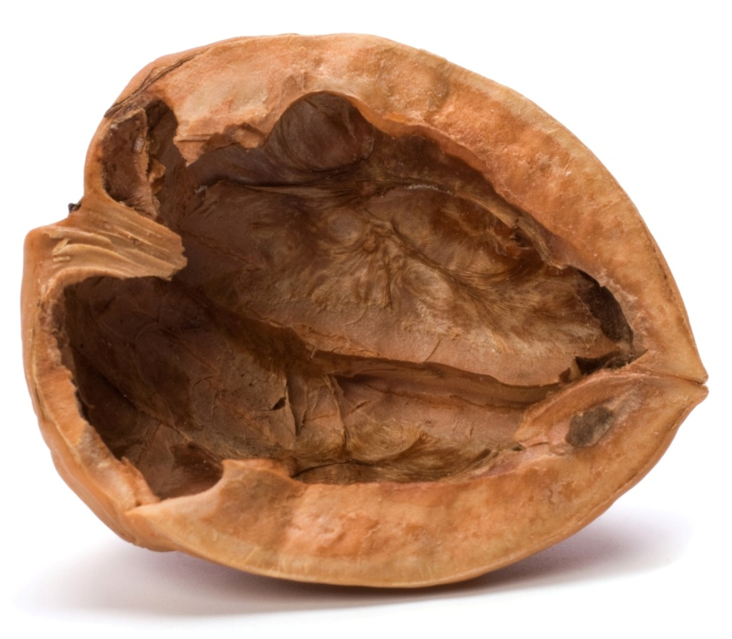
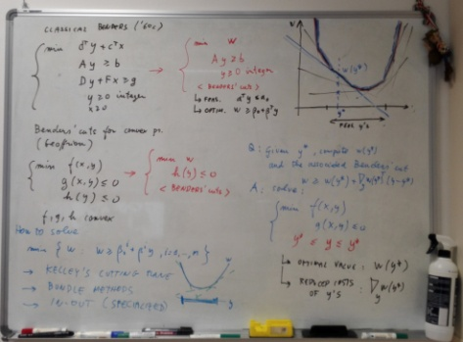
Branch-and-cut implementation of Benders’ decomposition
Matteo Fischetti, University of Padova

Slide 2
What do you actually mean by “Benders decomposition”?
The original Benders decomposition from the ‘60s uses two distinct
ingredients for solving a Mixed-Integer Linear Program (MILP):
1) A cut loop strategy where a relaxed (NP-hard) MILP on a variable subspace is solved exactly (i.e., to integrality) by a black-box solver, and then is iteratively tightened by means of additional “Benders” linear cuts
2) The technicality of how to actually compute those cuts (Farkas’ projection)
Papers proposing “a new Benders-like scheme” typically refer to 1)
Students scared by “Benders implementations” typically refer to 2)
Later developments in the ‘70s:
Folklore (Miliotios for TSP?): generate Benders cuts within a single B&B tree to cut any infeasible integer solution that is going to update the incumbent
McDaniel & Devine (1977): use Benders cuts to cut fractional sol.s as well (root node only)
Everything fits very naturally within a modern Branch-and-Cut (B&C) framework.

Slide 3
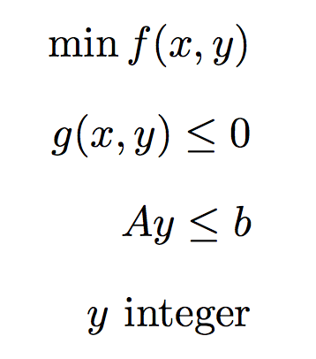
Modern Benders
Consider the convex MINLP in the (x,y) space
and assume for the sake of simplicity that is nonempty and bounded, and that
is nonempty, closed and bounded for all y ∈ S
→ the convex function is well defined for all y ∈ S
→ no “feasibility cuts” needed (this kind of cuts will be discussed later on)
Warning: the important var.s are the y’s !

Slide 4
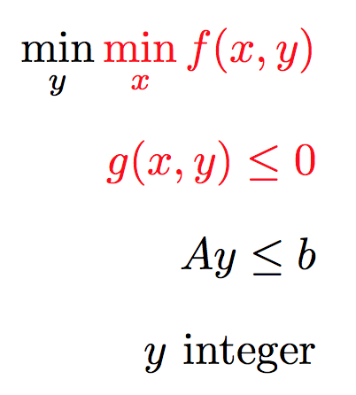
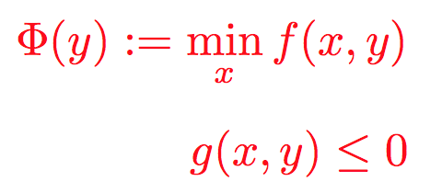
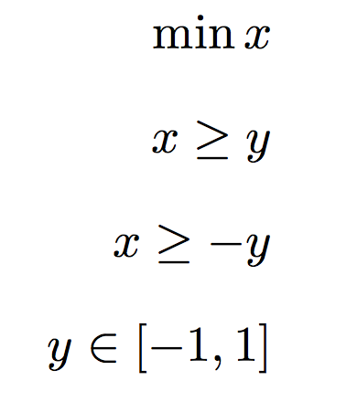
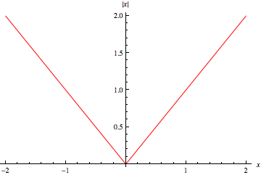
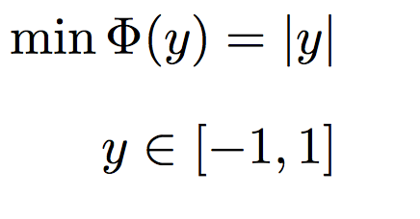
Working on the y-space (projection)
(1) (2) (3)
Original MINLP in the (x,y) space → Benders’ master problem in the y space
Warning: projection changes the objective function (e.g., linear → convex nonlinear)
“isolate the inner minimization over x”

Slide 5
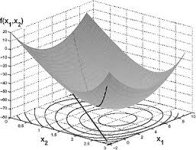
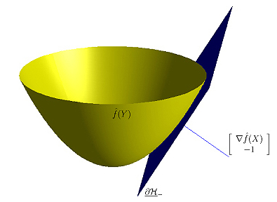
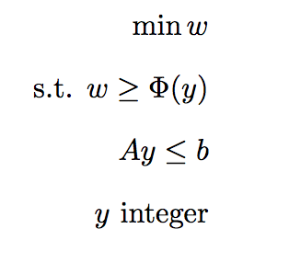
Life of P(H)I
Solving Benders’ master problem calls for the
minimization of a nonlinear convex function
(even if you start from a linear problem!)
Branch-and-cut MINLP solvers generate a
sequence of linear cuts to approximate this
function from below (outer-approximation)
subgradient
(aka Benders) cut →

Slide 6
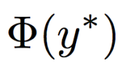
Benders cut computation
Benders (for linear) and Geoffrion (general convex) told us how to compute a subgradient to be used in the cut derivation, by using the optimal primal-dual solution (x*,u*) available after computing
The above formula is problem-specific and perhaps #scaring
Introduce an artificial variable vector q (acting as a copy of y) to get
and to obtain the following simpler and completely general cut-recipe:

Slide 7
Benders feasibility cuts
For some important applications, the set
can be empty for some “infeasible” y ∈ S
→ undefined
This situation can be handled by considering the “phase-1” feasibility condition
where the function is convex
→ it can be approximated by the usual subgradient “Benders feasibility cut”
to be computed using reduced costs as before

Slide 8
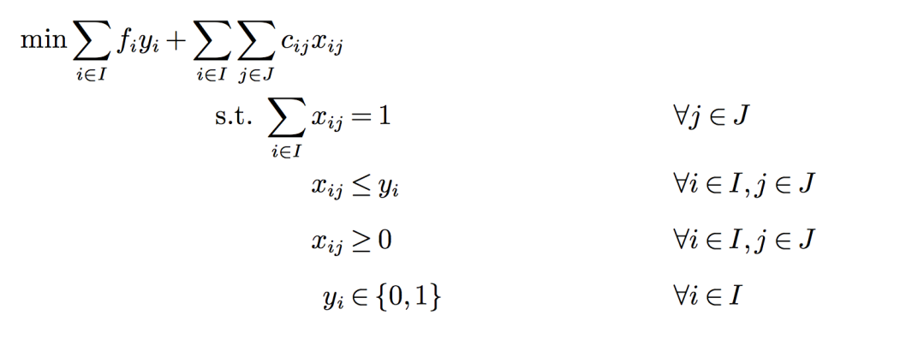
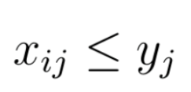
Successful Benders applications
Benders decomposition works well when fixing y = y* for computing
makes the problem much simpler to solve.
This usually happens when
The problem for y = y* decomposes into a number of independent subproblems
Stochastic Programming
Uncapacitated Facility Location
etc.
Fixing y = y* changes the nature of some constraints:
in Capacitated Facility Location, tons of constr.s of the form
become just variable bounds
Second Order Constraints become quadratic constr.s
etc.

Slide 9
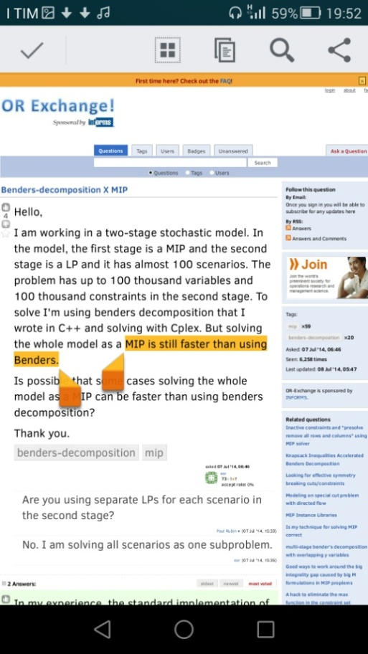
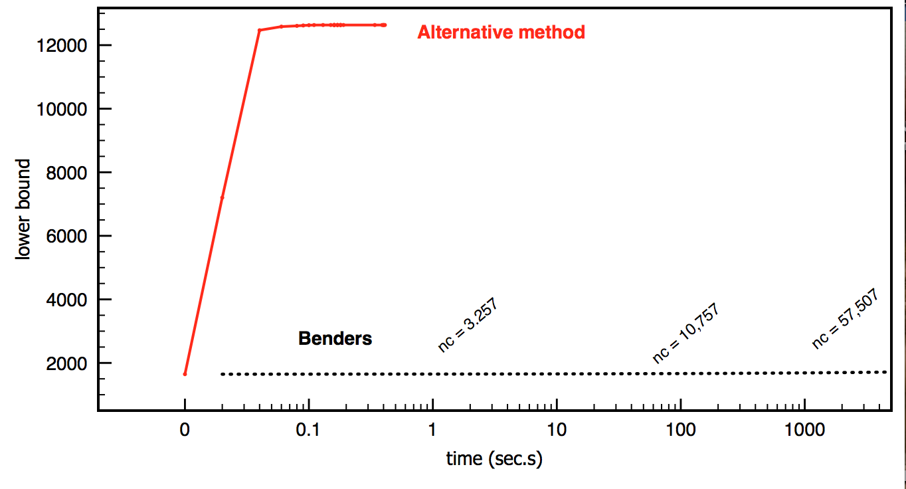
That’s it … or not?
In practice, Benders decomposition can work quite
well, but sometimes it is desperately slow
… as the root node bound does not improve even
after the addition of tons of Benders cuts
Slow convergence is generally attributed to the poor quality of Benders cuts, to be cured by a more clever selection policy (Pareto optimality of Magnanti and Wong, 1981, etc.) but there is more…

Slide 10
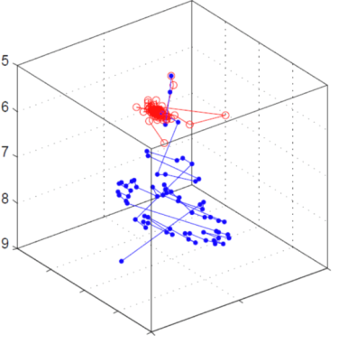
Role of the cut loop
B&C codes generate cuts, on the fly, in a sequential fashion
Consider e.g. the root B&C node (arguably, the most critical one)
A classical cut-loop scheme (described here for MILPs)
J. E. Kelley. The cutting plane method for solving convex programs, Journal of the SIAM, 8:703-712, 1960.
Find an optimal vertex x* of the current LP relaxation
Invoke a separation function on x*, add the returned violated cut (if any) to the current LP, and repeat
Can be very ineffective in the first iterations
when few constraints are specified, and x*
moves along an unstable zig-zag trajectory
... which is precisely what often happens with Benders cuts

Slide 11
But… alternative cut loops do exist!
Kelley’s cut loop implemented in standard MI(L)P solvers:
PROS: natural, efficient reopt., often works well
CONS: can be VERY ineffective, e.g., in
column generation or in some
under-constrained cutting plane methods
Ellipsoid & Analytic Center cut loops:
kind of binary search in the multi-dimensional space:
at each iteration, a core point q “well inside” the
current relaxation is computed and separated
CONS: q can be difficult to find and to separate
PROS: overall convergence does not depend
on the quality of the cut (facets not required here!)
Cheaper alternatives often preferred: bundle (Lemaréchal) or in-out (Ben-Ameur and Neto) methods

Slide 12
Stabilizing Benders can be easy!
To summarize:
Benders cut machinery is easy to implement …
… but the root node cut loop can be very critical
→ many implementations sank here!
Kelley’s cut loop can be desperately slow
Stabilization using “interior points” is a must
→ this is well-known in subgradient optimization and Dantzig-Wolfe decomposition (column generation), but holds for Benders as well
E.g., for facility location problems, we implemented a very simple
“chase the carrot” heuristic to determine a stabilized path
towards the optimal y
Mimics Frank-Wolfe alg. for minimizing a convex function over a convex set

Slide 13
Our #ChaseTheCarrot heuristic
We (the donkey) start with y = (1,1,…,1)
and optimize the master LP as in Kelley,
to get optimal y* (the carrot on the stick).
We move y just half-way towards y*. We then
separate a point y’ in the segment [y, y*] close
to the new y.
The generated Benders cut is added to the master LP, which is reoptimized
to get the new optimal y* (carrot moves).
Repeat until bound improves, then switch to Kelley for final bound refinement
(kind of cross-over)
Warning: adaptations needed if feasibility Benders cuts need to be generated…

Slide 14
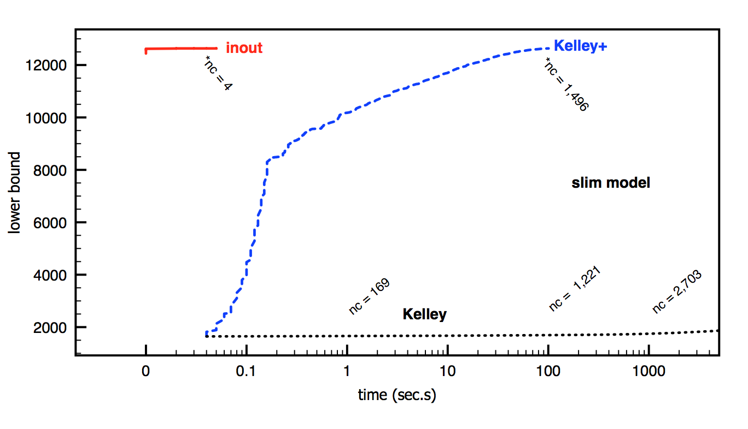
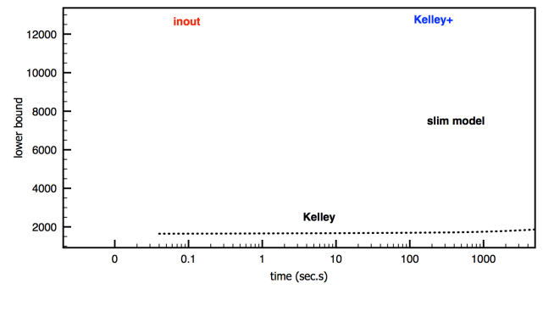
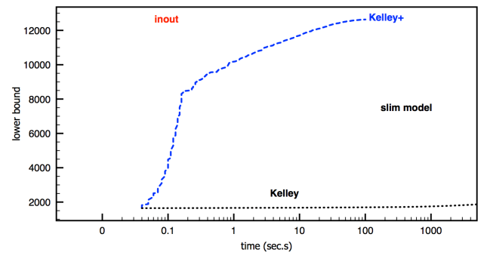
Effect of the improved cut loop
Comparing Kelley cut loop at the root node with Kelley+ (add epsilon to y*) and with our chase-the-carrot method (inout)
Koerkel-Ghosh qUFL instance gs250a-1 (250x250, quadratic costs)
*nc = n. of Benders cuts generated at the end of the root node
times in logarithmic scale

Slide 15
Conclusions
To summarize:
Benders cuts are easy to implement within modern B&C (just use a callback where you solve the problem for y = y* and compute reduced costs)
Kelley’s cut loop can be desperately slow hence stabilization is a must
Implemented in CPLEX general MIP solver since version 12.7
Slides available at http://www.dei.unipd.it/~fisch/papers/slides/
Reference papers:
M. Fischetti, I. Ljubic, M. Sinnl, "Benders decomposition without separability: a computational study for capacitated facility location problems", European Journal of Operational Research, 253, 557-569, 2016.
M. Fischetti, I. Ljubic, M. Sinnl, "Redesigning Benders Decomposition for Large Scale Facility Location", Management Science 63 (7), 2146-2162, 2017.
.

