Slide 1

Branch-and-Cut is our swiss army knife
Matteo Fischetti, University of Padova

Slide 2
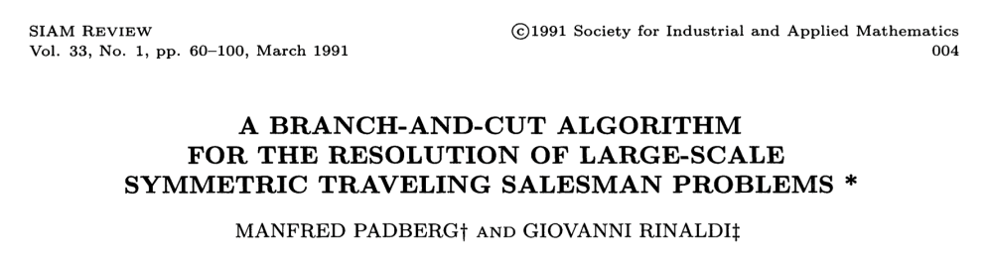
Branch & Cut ™
A “trademark” by Manfred Padberg and Giovanni Rinaldi
Proposed in the 1990’s for the TSP (and soon extended)
Comes as an algorithm entangled with its implementation
Conjecture: Using cuts within an enumerative scheme is good.
Proof. Assume w.l.o.g. a good LP solver. Then apply B&Bound but
make use of families of (problem dependent) globally-valid inequalities
perform efficient exact/heuristic cut separation on the fly
use a data-structure (cut pool) to effectively share cuts among nodes
price variables in a dynamic way (well before branch-and-price!)
alternate row and column generation in a sound way …
suspend a node if “unattractive”
…

Slide 3
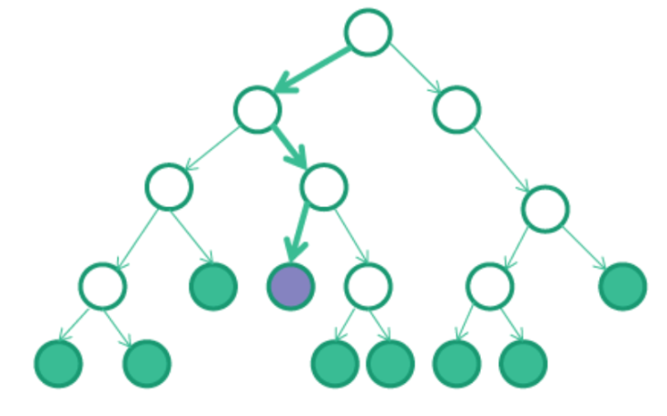
Modern B&C implementation
Modern B&C solvers such as Cplex, Gurobi, Express, SCIP etc. can be fully customized by using callback functions
Callback functions are just entry points
in the B&C code where an advanced user
(you!) can add his/her customizations
Most-used callbacks (using old-style Cplex’s jargon)
Lazy constraint: add “lazy constr.s” that should be part of the original model
User cut: add additional contr.s that hopefully help enforcing feasibility/integrality
Heuristic: try to improve the incumbent (primal solution) as soon as possible
Branch: modify the branching strategy
…

Slide 4

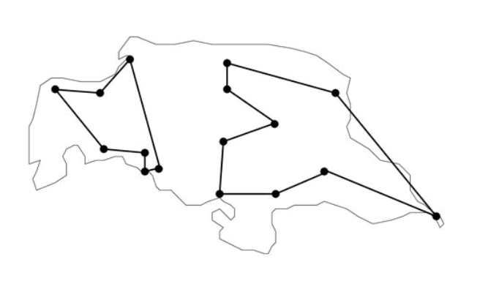
Lazy constraint callback CPX_CALLBACKCONTEXT_CANDIDATE
Automatically invoked when a solution is going to update the incumbent (meaning it is integer and feasible w.r.t. current model, often coming from an internal primal heuristic)
This is the last checkpoint where we can discard a
solution for whatever reason (e.g., because it violates
a constraint that is not part of the current model)
To avoid be bothered by this solution again and again, we can/should return a violated constraint (cut) that is added (globally or locally) to the current model
Cut generation is often simplified by the
fact that the solution to be cut is known
to be integer (e.g., SECs for TSP)

Slide 5

Usercut callback CPX_CALLBACKCONTEXT_RELAXATION
Automatically invoked at every B&B node when the current solution is noninteger (e.g., just before branching)
A violated cut can possibly be returned, to be added (locally or globally) to the current model → often leads to an improved convergence to integer solutions
If no cut is returned, branching occurs as usual
Cut generation can be hard as the point is noninteger (heuristic approaches can be used)
User cuts are not mandatory for B&C correctness → being too clever on them can actually slow-down the solver because of the overhead in generating and using them (larger/denser LPs etc.)

Slide 6
Other callbacks
Branch callback: invoked at the end of each node (even when the LP solution is integer and apparently does not require any cut/branching) and used to impose/customize branching
Heuristic callback: used to build new (possibly problem-specific) feasible integer solutions to be posted, i.e., passed to the solver which will use them (at the appropriate time) to possibly update the incumbent
etc. etc.

Slide 7
But… how do we generate cuts?
Problem-specific cuts
General-purpose MIP cuts trying to enforce integrality (e.g. Gomory cuts)
Modern solvers already have a lot of them, implemented in the most effective way…
Cuts coming from an alternative extended formulation
Benders cuts
…
Cuts dealing with nonlinearities
Intersection cuts (e.g., for bilevel optimization)
…

Slide 8
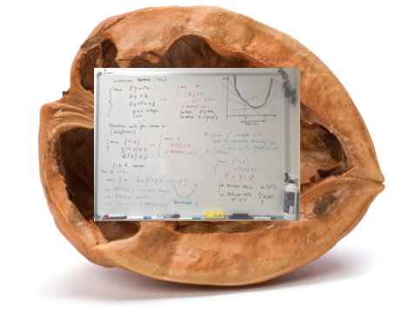
Benders’ cuts for dummies
The original Benders’ paper from the ‘60s uses two distinct
ingredients for solving a Mixed-Integer Linear Program (MILP):
A cut loop strategy where a relaxed (NP-hard) MILP is solved exactly (i.e., to integrality) by a black-box solver, and then is iteratively tightened by means of additional “Benders” linear cuts
2) The technicality of how to actually compute those cuts (Farkas’ projection)
Papers proposing “a new Benders-like scheme” typically refer to 1)
Students scared by “Benders implementations” typically refer to 2)

Slide 9
Benders cuts for dummies
Later developments in the ‘70s
Folklore (Miliotios for TSP?)
generate Benders cuts within a single B&B tree to cut any infeasible integer solution that is going to update the incumbent
→ lazycuts
McDaniel & Devine (1977)
use Benders cuts to cut fractional sol.s as well
→ usercuts
Everything fits very naturally within a modern Branch-and-Cut (B&C) framework!

Slide 10
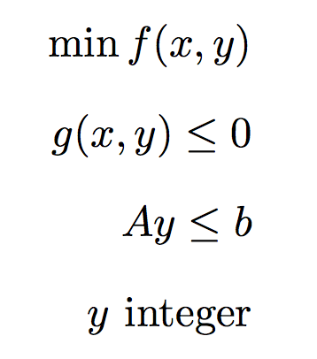

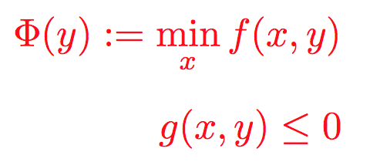
Modern Benders
Consider the convex MINLP in the (x,y) space
For the sake of simplicity, assume that:
the set is nonempty and bounded
the convex function
is well defined for all y ∈ S
Warning: the important var.s are the y’s !

Slide 11
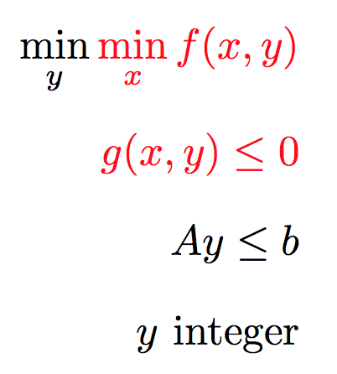
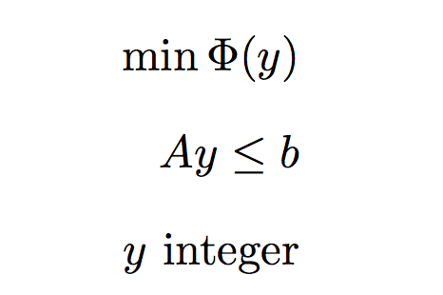
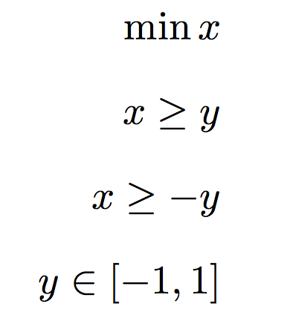
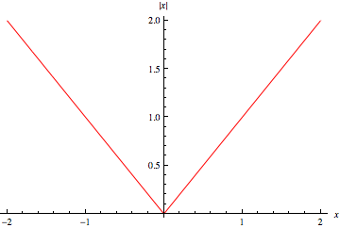
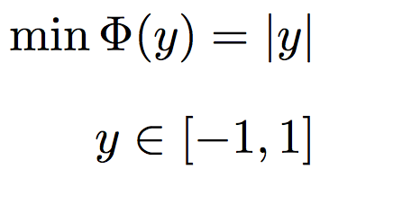
Working on the y-space (projection)
(1) (2) (3)
Original MINLP in the (x,y) space → Benders’ master problem in the y space
Warning: projection changes the objective function (e.g., linear → convex nonlinear)
“isolate the inner minimization over x”

Slide 12

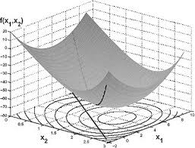
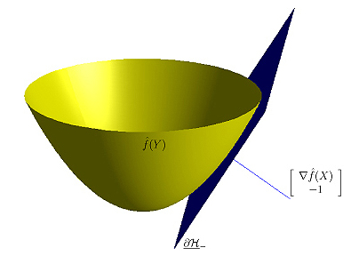
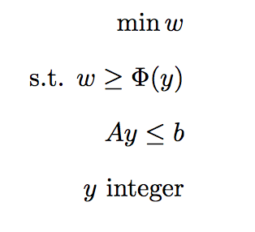

Life of P(H)I
Solving Benders’ master problem calls for the
minimization of a nonlinear convex function
(even if you start from a linear problem!)
Branch-and-cut MINLP solvers generate a
sequence of linear cuts to approximate this
function from below (outer-approximation)
subgradient
(aka Benders) cut →

Slide 13
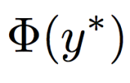


Benders cut computation
Benders (for linear) and Geoffrion (general convex) use Linear/Lagrangian duality to compute a subgradient to be used in the cut derivation
Given an optimal primal-dual solution (x*,u*) available after computing
, a subgradient of in y* is computed as
→
The above formula is problem-specific and sometimes cumbersome
This is maybe the reason why Benders cuts are considered “too sophisticated” by students

Slide 14
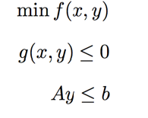
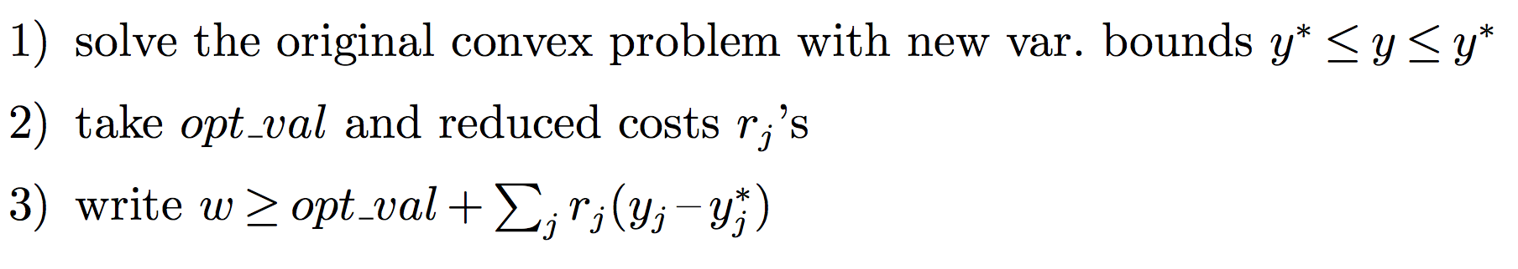
1-2-3: Benders!
But … you can kindly ask your solver
to make all calculations for you!
Here is the recipe:

Slide 15

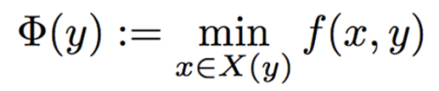


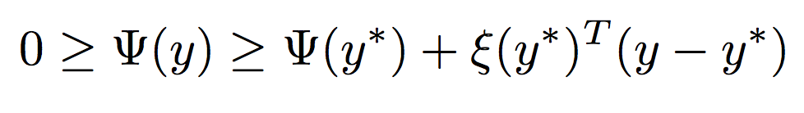
Benders feasibility cuts
For some important applications, the set
can be empty for some “infeasible” y ∈ S
→ undefined
This situation can be handled by considering the “phase-1” feasibility condition
where the function is convex
→ it can be approximated by the usual subgradient “Benders feasibility cut”
to be computed using reduced costs as before

Slide 16

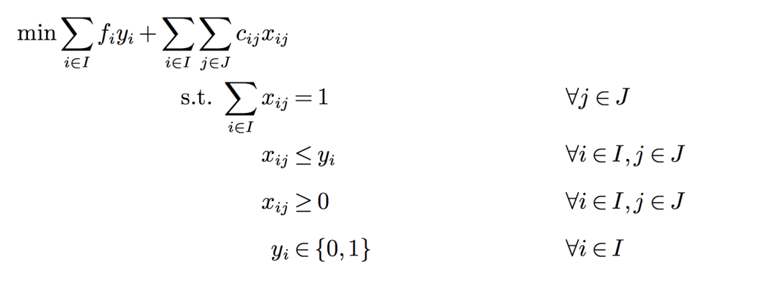
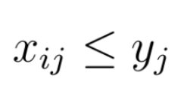

Successful Benders applications
Benders cuts work well when fixing y = y* for computing
makes the problem much simpler to solve.
This usually happens when
The problem for y = y* decomposes into a number of independent subproblems
Stochastic Programming
Uncapacitated Facility Location
etc.
Fixing y = y* changes the nature of some constraints:
in Capacitated Facility Location, tons of constr.s of the form
become just variable bounds
Second Order Constraints become quadratic constr.s
etc.

Slide 17
Benders cuts instability
B&C codes generate cuts, on the fly, in a sequential fashion
Consider e.g. the root B&C node (arguably, the most critical one)
A classical cut-loop scheme (described here for MILPs)
J. E. Kelley. The cutting plane method for solving convex programs, Journal of the SIAM, 8:703-712, 1960.
Find an optimal vertex y* of the current LP relaxation
Invoke a separation function on y*, add the returned violated cut (if any) to the current LP, and repeat

Slide 18
Benders cuts instability
This cut loop can be very ineffective
in the first iterations when few
Benders cuts have been generated, and
the system A y ≤ b contains just few
constraints (often, only variable bounds)
In this situation:
the current master sol. y* is
almost unconstrained
→ zig-zagging phenomenon
Benders cuts convey information
around “erratic” points y* far from the region of interest
→ Stabilization is needed, e,g. through Frank-Wolfe cut loop

Slide 19
Conclusions
To summarize:
Benders cuts are easy to implement within modern B&C (just use a callback where you solve the problem for y = y* and compute reduced costs)
Kelley’s cut loop can be desperately slow hence stabilization is a must
Benders implemented in CPLEX general MIP solver since version 12.7
Slides available at http://www.dei.unipd.it/~fisch/papers/slides/
Reference papers:
M. Fischetti, I. Ljubic, M. Sinnl, "Benders decomposition without separability: a computational study for capacitated facility location problems", European Journal of Operational Research, 253, 557-569, 2016.
M. Fischetti, I. Ljubic, M. Sinnl, "Redesigning Benders Decomposition for Large Scale Facility Location", Management Science 63 (7), 2146-2162, 2017.
.

