Slide 1

CRABSS: CalRAdio-Based advanced Spectrum Scanner for cognitive networks
R.Manfrin, L.Boscato, A. Zanella, M. Zorzi
{rmanfrin,zanella,zorzi}@dei.unipd.it
luca.boscato@gmail.com
Dept. Of Information Engineering - University of Padova, Italy
Consorzio Ferrara Ricerche (CFR) – Ferrara Italy
Consorzio Nazionale Interuniversitario per le Telecomunicazioni (CNIT)

Slide 2
Outline:
- Intro
  Motivations to our work
- CRABSS overview
  Functional/architectural description
- Results
- Future enhancements

Slide 3

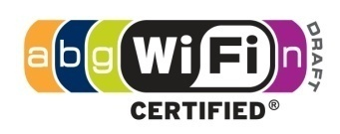


ISM 2.4GHz Spectrum usage
Overlapping Radio Access Technologies
f
2.400GHz
2.412GHz
2.422GHz
2.432GHz
2.442GHz
2.452GHz
2.462GHz
2.472GHz
2.482GHz
2.492GHz

Slide 4
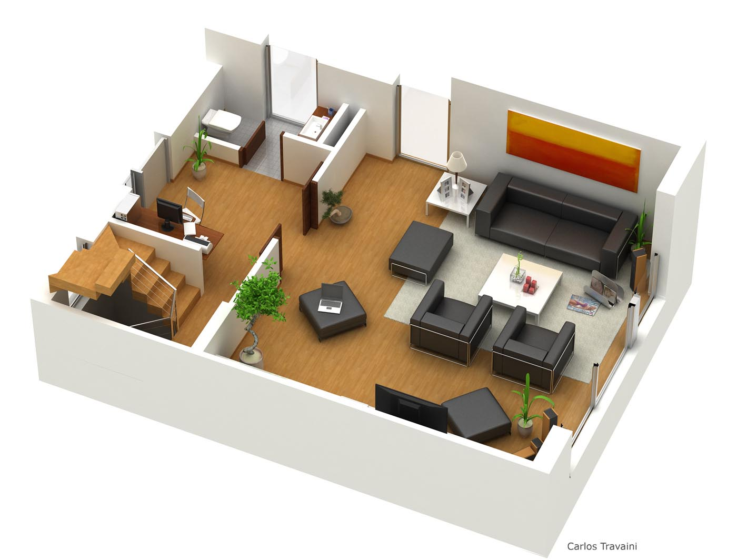








A typical home scenario
ISM 2.4GHz Spectrum usage
2.4GHz proprietary
Frequency hopping anti-intrusion system
Neighbor’s
Microwave oven
Work
Station
Cellphone
Laptop
Alarm
System
TV MediaCenter
Proprietary 802.15.4 Remote Control System
Notes:
Pesca immagine da report aragorn che mostrano interferenze e.g. in home scenario

Slide 5
Problem statement
Spectrum and energy resources cannot be wasted!
How to help “network aware” applications (Link Users) to benefit from lower layer's network information
...
disregarding the specific technology/proprietary API implementation involved?
    ISSUES
- Different Access Technologies
- Different Hardware (proprietary APIs)
- Different Operating Systems

Slide 6
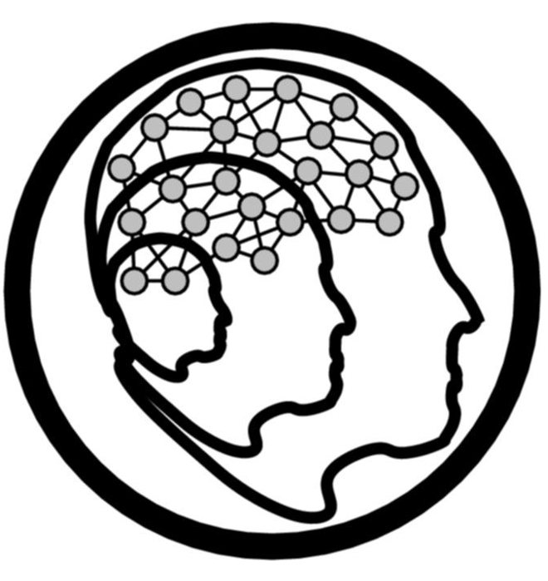
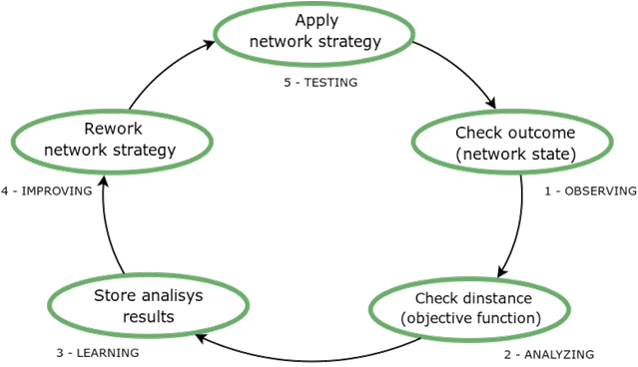
Cognition process in wireless networks
Network coexistence, coordination and cooperation principles must be adopted by different RATs to avoid conflicts and guarantee a correct network behavior even when critical situations occur.
Observation of the surrounding environment
ARAGORN EU project
Real-Time
conflicts
avoidance
Long -Term timescale optimizations
Notes:
Aggoungi reference ad Aragorn: saying something like. The cognition paradigm is being pursued by the ARAGORN EU project, within which we developped the CRABSS solution that we are going to present in the following.

Slide 7
Cognition process in wireless networks
REQUIREMENTS:
1. Agile devices that can acquire data during standard operational mode
2. Abstraction layer to share the acquired data with other network entities
DATA REQUIREMENTS:
1. Comparable
2. Uncorrelated with the data source
Notes:
Aggoungi reference ad Aragorn: saying something like. The cognition paradigm is being pursued by the ARAGORN EU project, within which we developped the CRABSS solution that we are going to present in the following.

Slide 8
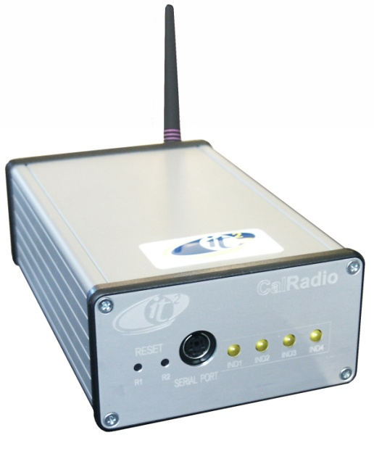
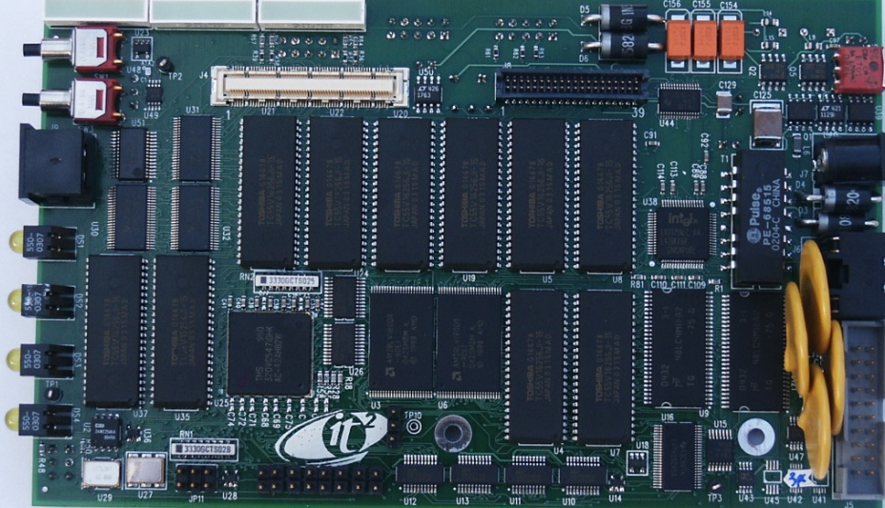
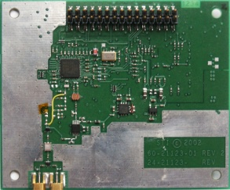
CalRadio 1 SDR overview
- ARM-Linux embedded box
- 802.11b interface controlled by a TI
100MHz clocked DSP
- Software MAC run on the DSP
- Set of tunable PHY settings
802.11 PHY
RF Transceiver
Baseband
ARM/DSP

Slide 9
CR hardware design

Slide 10
CR MAC 802.11 software design
ARM (Linux)‏
DSP (MAC driver/fw)‏
BB/RF
DMA operations
(atomic)‏
kernel
spin-locked
shared
buffers
DSP INTERNAL MEMORY
cmds
PHY config
Tx
buff
tx
tx_skb_queue
Rx
buff
pkt fetch
cca
pkt push
hw_interrupt
ACK/CTS
fast reply
rx
rx
ack tx
rx_skb_queue
Once-per-ML
performed operations
Asynchronous signal (Time Slot driven) to check before tx
(during backoff)
Asynchronous event, triggers DMA hw-interrupt
and sw-handler

Slide 11
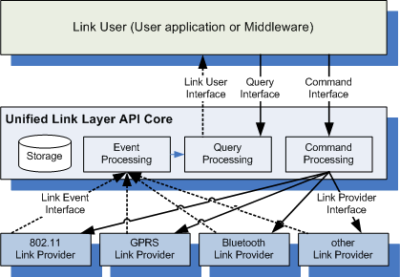
Unified Link Layer API
framework within ARAGORN
Link User (Cognitive Resource Engines)‏

Slide 12
CRABSS solution
Cognitive Resource Engine
(L3 and above entity)
Std WiFi 802.11 interface (iwtools)
ULLA abstraction layer
CalRadio 1 SDR
Standard set of communication APIs
ULLA Link Layer Adapter
802.11 MAC & PHY
(Horizontal OP mode)
Scanning interface
(Vertical OP mode)
Tasks:
  Enhancement CR with sensing capabilities while preserving the 802.11 standard functionality
  Integration of the CR with the ULLA framework
  Extension of the ULLA framework to support CR spectrum sensing features

Slide 13
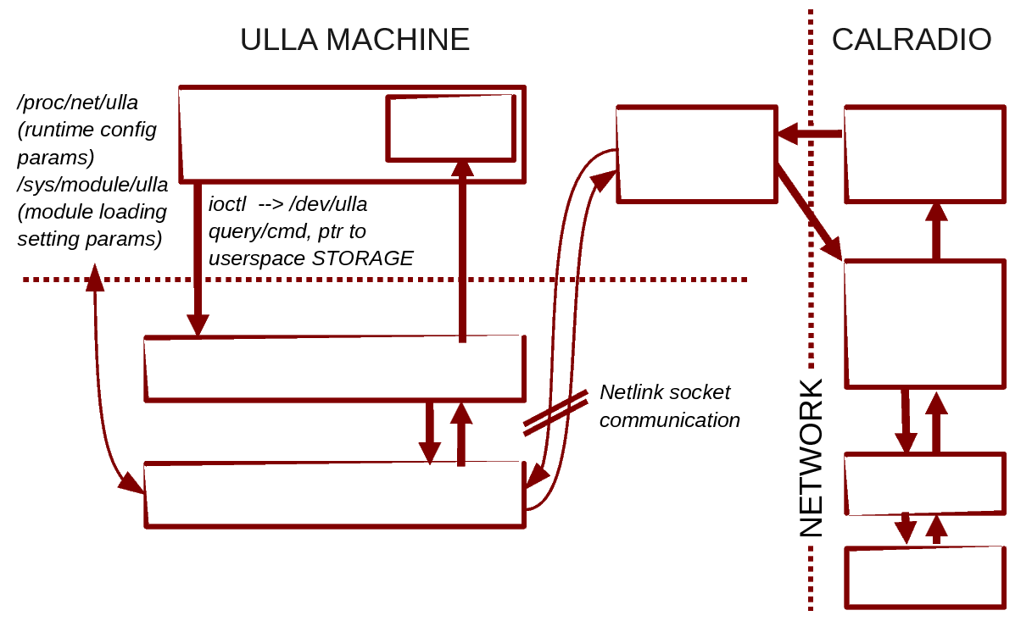
CRABSS solution
Cognitive
Engine
Storage
Cyclic Buffer
Storage
module
ULLA/CAL
WRAPPER
USER
KERNEL
CalRadio
Network
Device
ULLA Core
Link Layer Adapter (LLA)
DSP
RF

Slide 14



CRABSS Exported Parameters
Horizontal mode:
WiFi-specific information
MAC 802.11b counters
#Access Points
#STAs
#Data retransmissions
#PHY rate
#Exchanged bytes
Other MIBs
Counters can report statistics on a per-link basis where a link is intended as a tuple (SRC MAC address, DST MAC address).
Vertical mode:
Technology independent information
  Channel Busy Time: estimate of the interference in terms of busy Clear Channel Assessment (CCA) readings over time
  Energy Burstiness: average value and standard deviation for the duration of sensed energy bursts

Slide 15
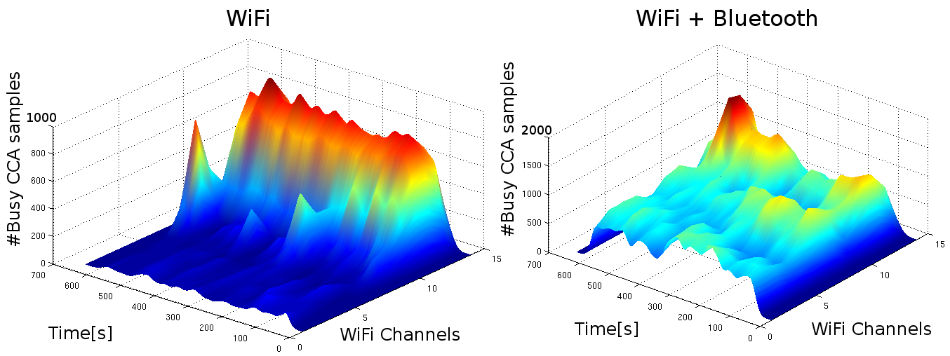
Results:
Comparison between a WiFi trace (on channel 13) and the plateau originated by the Frequency Hopping patterns of an additional Bluetooth trace detected during a file transfer

Slide 16
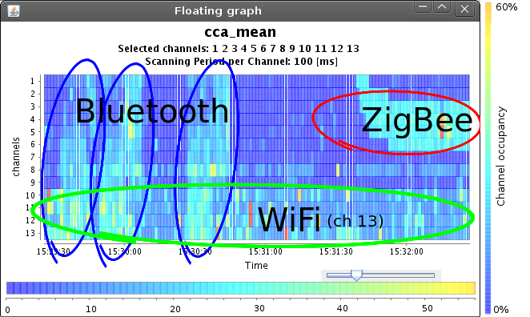
Results:
Snapshot of the information exported to the Cognitive Resource Engine (Link User).

Slide 17
Results:
By exploiting the statistic of the interference bursts duration we can compare the cost of sticking to an interfered channel (and wait for the interference to stop) with respect to the cost of switching channel (hence initiate a new communication, negotiate and elect a suitable channel, etc…)
Example (802.15.4 Tmote Sky WS nodes):
If interference bursts > 0.5 s channel switching becomes advantageous
Devices agility can improve timings hence make the network more dynamic and fast in detecting interference/congestion/anomalies

Slide 18
Conclusions:
CRABSS empowers 802.11MAC protocol with sensing capabilities for multi technology interference detection and avoidance
Modular approach (distributed solution, scalability)
Most common 2.4GHz commercial technologies can be detected
Jammers/generic interference (i.e. microwave ovens) are detected
Multi-technologies interfaces can register to the ULLA core to
provide collected statistics
ULLA provides an abstraction layer for the collected data

Slide 19
Future enhancements:
MAC & PHY data
Time-frequency energy patterns
Standard wireless functionalities
Technology inference algorithms
(ANALYSIS)
  Channel access probability
  Collision probability
  (Latency, Throughput, Jitter, …)

Slide 20
Thank you

