Slide 1
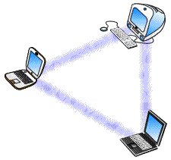
Long-range IoT technologies: the dawn of LoRaTM
Lorenzo Vangelista
Michele Zorzi
Andrea Zanella
SIGnals processing & NETworking research group
SIGNET
FABULOUS 23-25 Sep. 2015, Ohrid, Rep. of Macedonia

Slide 2
IoT Service Requirements
Place-&-Play
Ubiquitous coverage
Low Cost
Simple Hardware
Massive production
Zero-configuration
Little maintenance
Very long battery life
Very low fault rate
Digital Divide*
Educate people in using the technologies
Providing basic Internet access for free
* Credits to the inspiring talk by Josef Noil

Slide 3
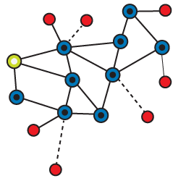
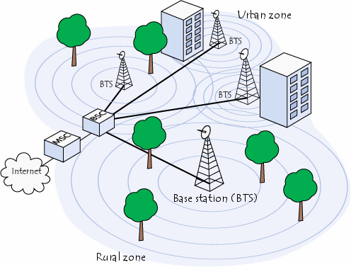
Three main approaches
Short-range multihop
ZigBee
WiFi low energy
RFID
Cellular
GSM
LTE-A
5G
Low Power Wide Area Networks (LPWAN)
SIGFOX
Neul
LoRa
LPWAN gateway
Internet
NetServer
LPWAN gateway

Slide 4
Quick comparison
Geographical
coverage, penetration
Range
Power
consumption
LPWAN
Shortrange
multihop
Transmission
latency
Bitrate
cellular
Number of
Base Stations/collectors
Radio chipset
costs
Service subscription costs

Slide 5
LPWAN: general profile
ISM Frequency Bands
In Europe: Short Range Device 860 MHz: 863-870 MHz
“Short Range” is misleading → regulations constraints are on transmit power and channel occupancy only
Two main solutions
UNB: Ultra Narrow Band
Bandwidth in the order of 25 kHz;
WB: Wideband (spread spectrum)
Bandwidth from 125 kHz to 250 kHz

Slide 6
Origin:
Founded in 2009, and growing very fast since then
First LPWAN technology proposed in the IoT market
$115 million from investors as Telefonica and Vodafone
Secret sauce: proprietary network layer protocols
UNB modulation, SDR860 band (Europe)
Coverage:
30-50 km in rural areas and 3-10 km in urban areas

Slide 7
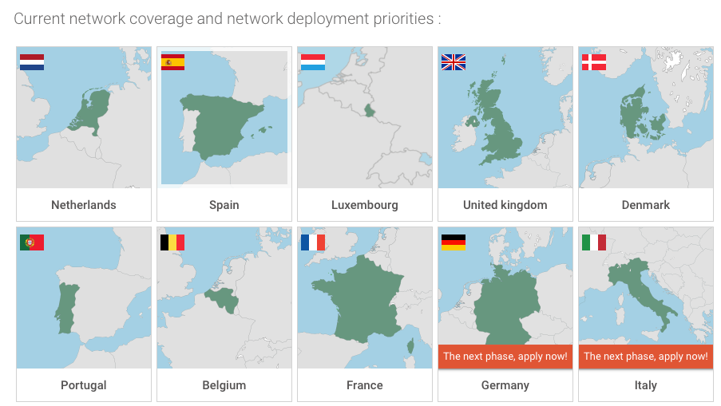
SIGFOX coverage
Source: http://www.sigfox.com/en/#!/connected-world/sigfox-network-operator

Slide 8
Origin:
Open standard backed by Neul
Acquired by Huawei in 2014 for $25 millions
Secret sauce: multiple flavours
Star topology, UNB, sub-GHz or TV white space
 | Wightless-N | Wightless-P | Wightless-W
Directionality | 1-way | 2-way | 2-way
Feature set | Simple | Full | Extensive
Range | 5km+ | 2km+ | 5km+
Battery life | 10 years | 3-8 years | 2-5 years
Terminal cost | Very low | Low | Low-medium
Network cost | Very low | Low | Low-medium
Notes:
Weightless-N
star network architecture in sub-GHz
UNB technology,
excellent range of several kilometres even urban
Weightless-P
narrowband channels of 12.5 kHz, with FDMA&TDMA
adaptive data rate from 0.2 kbit/s to 100 kbit/s
time-synchronised aggregators
Weightless-W
star topology operating in TV white space spectrum

Slide 9
Origin:
Started in San Diego (USA) as On-Ramp Wireless
Started with smart metering
Pioneering the 802.15.4k standard
Raised at least $67 million to date, mainly from energy and electric utility companies
Secret sauce:
Random Phase Multiple Access (RPMA) – patented
Work on ISM 2.4 GHz with very low receiver sensitivity
Apply power control, adaptive spreading, multipacket reception, …
Capacity & Coverage
~19kbit/MHz over up to 10 km in EU, 30 km in USA

Slide 10
SEMTECH LoRA
Img source: http://wataridori.megamistudios.com/2015/04/the-dawn-to-end-all-nights-thats-what-we-thought-it-was/

Slide 11
Origin:
First proposed by SemTech (France)
Now being developed by the LoRa Alliance
https://www.lora-alliance.org
Cisco, IBM, SemTech, …
Secret sauce:
Wideband CIRP-like PHY layer with adaptive rate
Simple but effective LoRA WAN MAC protocol
Capacity & Coverage
From order of 10² to 10⁴ bit/s over up to 1-3 km in EU

Slide 12
LoRaTM system architecture
LoRA
End Device
LoRA
End Device
LoRA
End Device
LoRA
End Device
LoRA
End Device
LoRa links
LoRA
GW
LoRa links
LoRA
GW
IP connections
LoRA
End Device
LoRA
End Device
LoRA
End Device
LoRA
End Device
INTERNET
LoRa Network Server

Slide 13
LoRa Class A
Class A (all)
Mandatory supported by all LoRa devices
End-devices start packet exchange with uplink tx followed by two receive windows
Adaptive modulation
Very low energy consumption
Suitable for monitoring services, with mostly uplink traffic

Slide 14
LoRa Class B
Class B (beacon)
Time synchronization using beacons sent by gateways → receive window opens in planned periodic intervals
Low energy consumption (especially for asynchronous bidirectional communications)
Suitable for switches/actuators controlled by NetServer
Command latency in the order of seconds

Slide 15
LoRa Class C
Class C (continuously listening)
End devices are always ready to receive signals from the gateways (except when transmitting)
Medium/High energy consumption at end device
Suitable for actuations with strict time constraints
Automation, control, etc…

Slide 16
PHY frame and bitrates
Source: SX1272/3/6/7/8: LoRa Modem Designer’s Guide AN1200.13
6 channels of 125 kHz + 1 channel of 250 kHz (EU)
7 different spreading factors → bitrates from 0.3 kbit/s to ~11 kbit/s
Gateways can receive multiple signals simultaneously
Because of the orthogonality of spreading sequences

Slide 17
Wrapping up
Wideband chirp modulation allows for long-range, robust communications, with low complexity, low power and low cost receivers
Can use common upper layer protocols
e.g., the security mechanisms already tested in IEEE 802.15.4 networks
LoRa Alliance is boosting LoRa technology, marketing, strategy, and interoperability aspects → development of a strong eco-system around the technology!

Slide 18
Conclusions
LPWNA landscape is getting already crowded!
Debated aspects:
Wideband or UNB?
2.4 GHz or sub-GHz?
Not yet a definite answer to these questions and no objective comparisons (not biased by marketing) of the different solutions exist yet!

Slide 19
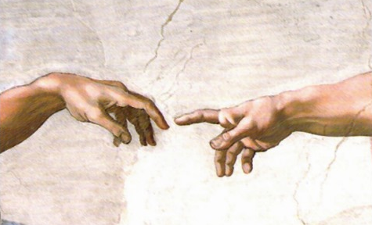
Contacts
Andrea Zanella – zanella@dei.unipd.it

Slide 20
Short range multihop
Pros
Very cheap
Low energy consumption
Cons
High complexity of large networks
Instability
Troublesome maintenance
See: https://www.youtube.com/watch?v=xUFUp-ylfC4

Slide 21
Cellular-based solutions
Pros
Long range
Cons
Costs
Almost ubiquitous coverage
Well-established technology
Easy integration with rest of the world
Energy efficiency
Architectural limits
Notes:
Pros
Long range
Almost ubiquitous coverage
Well-established technology
Easy integration with rest of the world
Cons
Costs
Terminal hardware costs are tens of dollars rather than the one or two dollar price point
Subscription costs are high rather than a few dollars per year
Energy efficiency
Battery life cannot be extended much beyond a month
Architectural limits
GSM based networks are often ill-suited to the short message sizes typical in IoT use cases
Significant overheads associated with signaling in order to move terminals from passive to active states

Slide 22
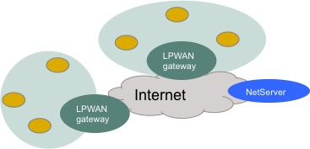
LPWAN
Pros
Low cost
Very long range
Cons
Low bitrate
Long delays
Low power

Slide 23
LoRa PHY
Proprietary modulation scheme derivative of Chirp Spread Spectrum (CSS)
linear frequency modulated pulses whose frequency increases or decreases over a certain amount of time to encode information
Main advantages:
processing gain due to spread spectrum technique
high tolerance to frequency misalignment
Support of variable Forward Error Correction codes and Spreading Factors
possibility to trade throughput for coverage range/robustness/energy consumption while keeping constant bandwidth

