Slide 1

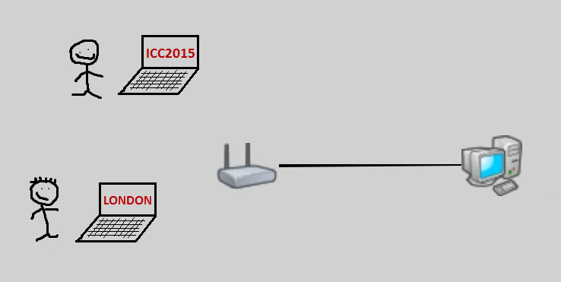
QoE-aware Video Rate Adaptation algorithms in multi-user IEEE 802.11 wireless networks
Federico Chiariotti
Chiara Pielli
Andrea Zanella
Michele Zorzi
ICC2015 - London
Contact: zanella@dei.unipd.it

Slide 2
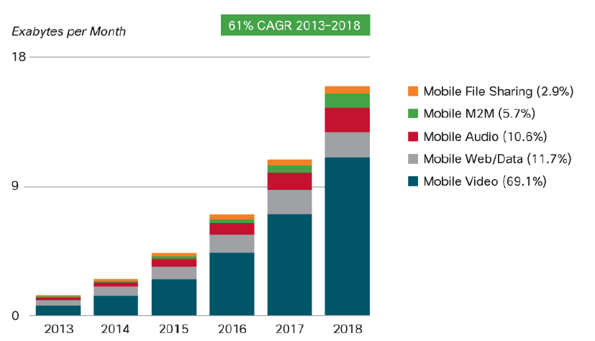
Multimedia traffic growth
source:
Cisco report (2014)
Notes:
Extremely fast growth of video streaming
Dominant traffic source on the Internet

Slide 3
Goal
Provide Quality of Experience (QoE) guarantees to wireless video customers
video user 1
Video server
Wireless
Access Point
video user 2
Video
user n
video user 3
Notes:
Growth of video streaming + Increase in bitrate because of HD
→ Resource allocation problems in wireless networks
Gap between lower layer network features and final user’s experienceì
Need to use an objective metric to measure the user’s experience

Slide 4
State of the art*
Plenty of Call Admission (CA) control and Video Rate Adaptation (VRA) algorithms in the literature
Many [6-9] are QoS-based
  do not consider QoE
Others [11-15] consider user-centric distributed solutions
  may not achieve overall optimal utilization of wireless resources
* See Bibliography in paper

Slide 5
Our starting point
In our recent works we showed that:
  [16] Different videos with equal rate have different quality (which can be measured in terms of SSIM)
  [17] The rate/distortion characteristic of a video can be estimated using a deep learning approach
  [18] Resource sharing based on per-video rate/distortion characteristics achieves higher performance than QoS-based approaches (over wired connections)

Slide 6
In this work we propose…
QoE-aware CA&VRA for wireless systems, which are
Centralized
  Algorithms are run at the wireless access point (AP)
Based on rate/distortion characteristics
  Minimum QoE is guaranteed to each admitted clients
Notes:
CA: already proved to be a successful scheme with VoIP. Decides wheter to admit or block a new streaming request according to the network state
VRA: dynamic adjustment of the video bitrate by modifying the video compression
known video traces: durations, SSIM for each compression level
users do not want to watch low-quality or always- freezing videos→ need to guarantee a minimum quality level
SSIM, since it has been found to correlate closely to perceived quality

Slide 7
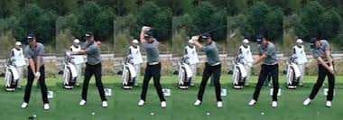


Settings and notation
3 second long chunks
rate/distortion curves
Increase
compression
Quality (q)
Increase
compression
Video source Rate (R)

Slide 8
VRA constraints
Quality above threshold (q_{thr})
Network stability
Quality of video required by user i at compression level j
Quality threshold for user i
Source rate of video required by user i at compression level j
Number of users
stability margin
Fraction of resources taken by user i
User i throughput
Notes:
Need to fulfil quality expectation and rather than experiencing a terrible quality, we deem it is better not to be admitted
Hence, quality of client i with compression level j
must not dip below the imposed threshold
Cannot use more resources than those that are avalaible
n: # of active clients
r: video bitrate
R application layer rate
s: safety threshold (against rate fluctuations)

Slide 9
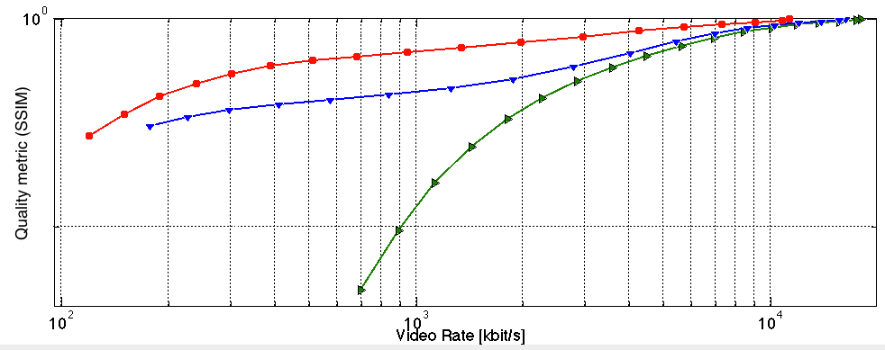
Quality-Based algorithm (QB)
q_{thr}
α₁
α₂
α₃
1

Slide 10
Quality-Based algorithm (QB)
q_{thr}
α₁
α₂
α₃
1
OK!
New video is accepted
New encoding of active videos are enforced

Slide 11
Quality-Based algorithm (QB)
q_{thr}
α₁
α₂
α₃
1
BLOCK!
New video is NOT accepted
Current encoding of active videos is maintained

Slide 12
Time-Based algorithm (TB)
q_{thr}
All above threshold→ok
α₂=1/3
α₁=1/3
α₃=1/3
New video is accepted
New encoding of active videos are enforced

Slide 13
Benchmark algorithm (BM)
Clients autonomously adapt to network conditions according with average application-layer performance
  if the time needed to receive M frames increases above threshold→ increase compression level
  If it drops below another threshold (for a few consecutive frames) → decrease compression level
Notes:
Used as a baselline to measure the efficiency of our heuristics
Non QoE-aware
Client-side: users autonomously chhose the required comprssion level according to network conditions
To measure the state of the network, a time measure is used:
measure the time needed to receive M frames:
- above threshold: increase comprssion
- below threshold for 3 consecutive times: decrease
conmpression

Slide 14
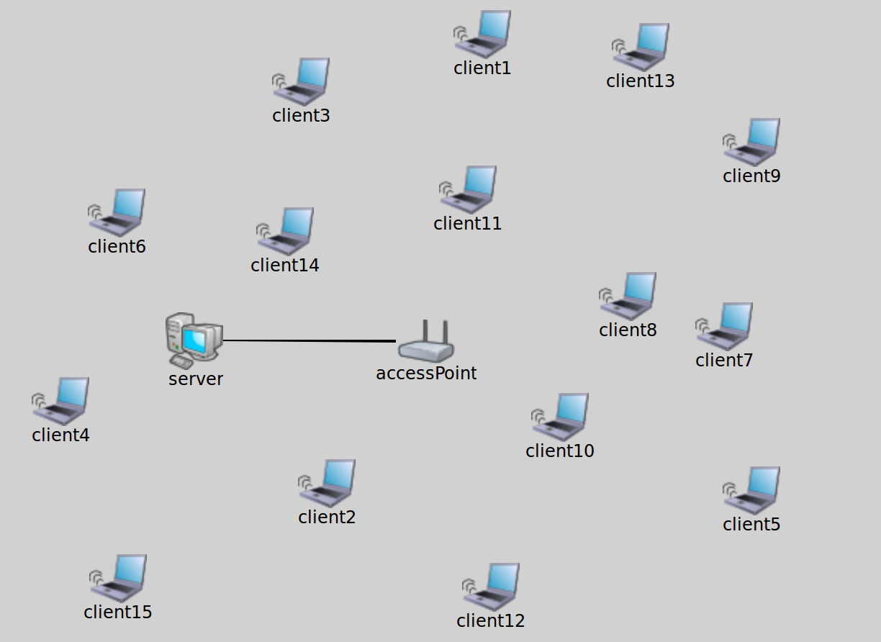
Versions of the algorithms
Clients are divided in three classes, based on SNR
  Gold
    Silver
      Bronze
VRA algorithms can be
  S: Single-class
    same q_{thr} for all clients
  C: Class-based
    q_{thr} depends on class
Notes:
S: no discrimination among clients
C: differentiation according to the SNR (→distance from AP)
Fairer distributions of resources, because if the same constraint were imposed, clients with lower SNR would require higher tx power

Slide 15
Scenario
IEEE 802.11g
N=15 clients
uniformly distributed over the WiFi cell
Random video requests (Poisson process)
Notes:
802.11g uses OFDM. 20MHz band centered at 2.4GHz
max Phy rate: 54Mbps
max appl rate: 31.3Mbps
15 non –moving clients randomly placed ina circular area with uniform distribution
video requests with exponential distribution, to ensure traffic load of !=Mbps or 20Mbps (differnet simulations)

Slide 16
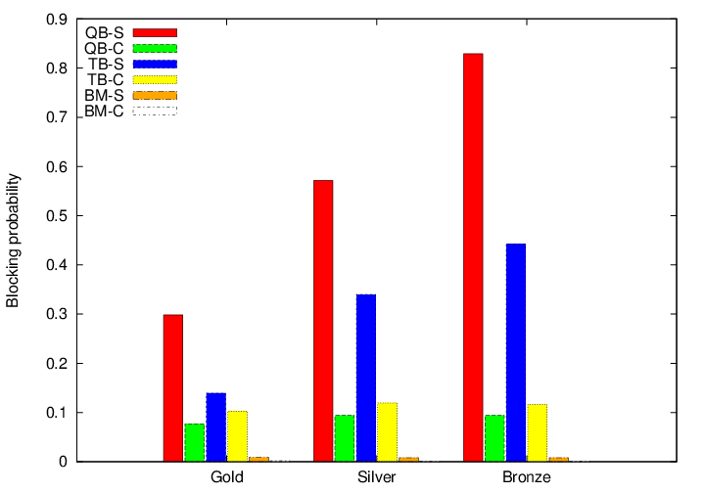
Blocking probability
Notes:
It actually is a blocking probability for QB e TB, a dropping probabilty for BM (it does not perform initial CA)
QoE aware alg Classbase versions: almost uniform probab
QoE aware alg Classless versions: privilege clients with higher SNR
BM (both C and S versions) exhibit very low dropping probabilities, as they work very close to the imposed quality thresholds → admit almost all requests but with poorer QoE

Slide 17
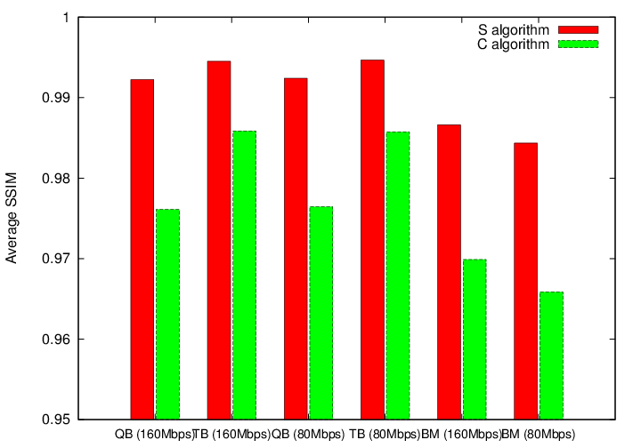
Average SSIM
Notes:
S algorithms higher SSIM than C versions because imposed threshold is 0.99 for all cliens
BM algorithms often go below the thresholds

Slide 18
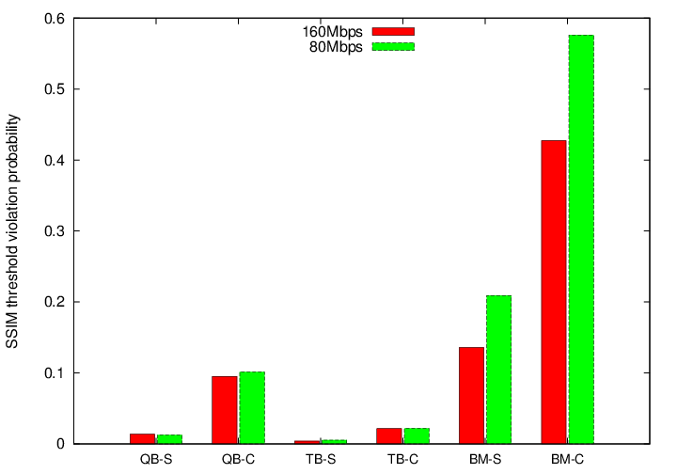
Quality Threshold violation
Notes:
As BM algorithms do not consider the specific dynamics of each video, it is inevitable to have some SSIM fluctuations, which result in the QoE dipping below the minimum threshold.
As the traffic increases (GRREN), thw probability of not respecting the quality constarint becomes higher, because of BM algorithms’ lax dropping policy.
Even the QoE-aware algorithms sometimes do not guarantee the minimum quality level , and ithis is due to the fact that compression lvels are recomputed at each new request instaed of every GoP, to have lighter computational weight on the AP

Slide 19
Conclusions
Class-based versions achieve more uniform (and lower) blocking probabilities, but they pay a price in terms of average SSIM
TB is the most efficient algorithm, blocking fewer requests and maintaining a higher average quality
further research can improve the algorithms (foresight, mobility support)

Slide 20
QoE-aware Video Rate Adaptation algorithms in multi-user IEEE 802.11 wireless networks
Any questions?
Contact: zanella@dei.unipd.it

Slide 21
Simulation setup
video duration based on traces
average offered load of ~10 videos
QoE for each class:
Class | Minimum SSIM | SNR | Approximate target MOS
Gold | 0.99 | dB | 5
Silver | 0.98 | 12.35 – 20dB | 4.5
Bronze | 0.96 | < 12.35dB | 4
Notes:
BM does not perform pure CA; it’s up to clients to adapt their cmpression levels to netowrk conditions. We determined the compression levels corresponding to the three classses, i.e. the threshold BM algorithms must respect in order to respect the quality constraint.
These maximum compression levels are: 9 for gold class, 11 for silver class and 14 for the bronze one.

Slide 22
Simulation setup
average offered application layer traffic: 10MBps and 20Mpbs
10 simulations of 5000s each for both traffic intensities
random clients distribution within circular area with radius of 150m

Slide 23
Quality-Based algorithm (QB)
Start from
full quality
No
Increase compression
of videos with
larger margin from q_{thr}
Stable?
Yes
Accept new videos &
adjust rate of all
active videos
Yes
No
q_{i}>q_{thr}?
Block new video

Slide 24
Time-Based algorithm (TB)
Equally split
bandwidth
among
all videos
Redistribute
excess
bandwidth
Start from
full quality
Bandwidth
enough for
video i?
Yes
No
Increase
compression
of video i
Accept new videos &
adjust rate of all
active videos
Yes
q_{i}>q_{thr}?
No
Block new video

