Slide 1

When bits get wet: introduction to microfluidic networking
Andrea Zanella, Andrea Biral
zanella@dei.unipd.it
Trinity College Dublin – 8 July, 2013
This work was funded by the University of Padova through the MiNET university project, 2012
Most of experimental pictures in this presentations are complimentary from Prof. Mistura (Univ. of Padova)

Slide 2
Purposes
Quick introduction to the microfluidic area
Exemplify some of the problems that arise when dealing with microfluidic networks
Providing an idea of the possible research challenges that are waiting for you!
Growing the interest on the subject… to increase my citation index! ☺

Slide 3
What is it all about?

Slide 4
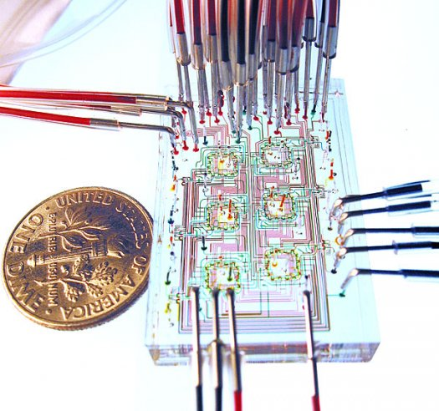
Microfluidics
Microfluidic is both a science and a technology that deals with the control of small amounts of fluids flowing through microchannels
Applications:
  Inkjet printheads
  Biological analysis
  Chemical reactions
Many foresee microfluidic chips will impact on chemistry and biology as integrated circuit did in electronics

Slide 5
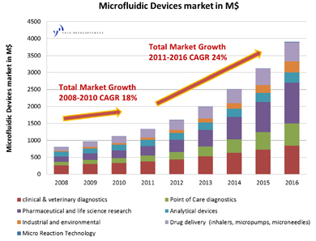
Advantages in fluidic miniaturization
Portability
Optimum flow control
  Accurate control of concentrations and molecular interactions
Very small quantities of reagents
  Reduced times for analysis and synthesis
  Reduced chemical waste

Slide 6
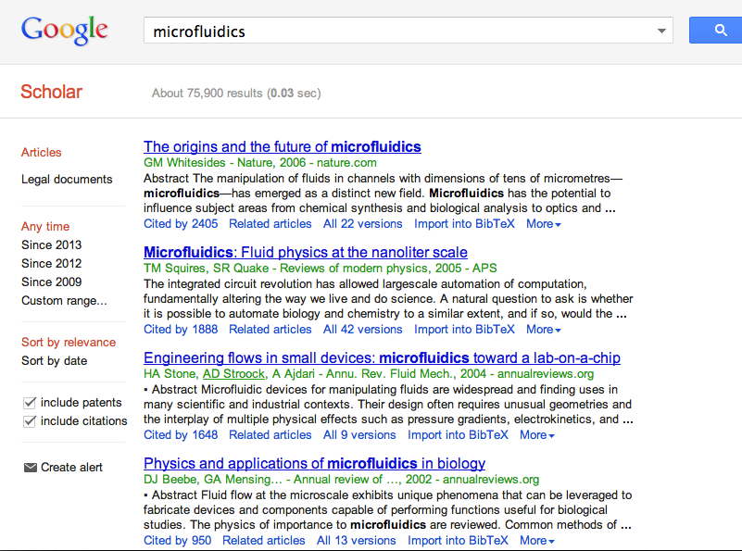
Popularity

Slide 7
Features
MACROSCALE: inertial forces >> viscous forces
turbolent flow
microscale: inertial forces ≈ viscous forces
laminar flow
Notes:
Specific characteristics:
very low Reynolds number
Re=inertial forces/viscous forces
Re>4000 → turbulent flow
Re<1000 → laminar flow
viscous forces dominates inertial forces
linear and predictable flow

Slide 8
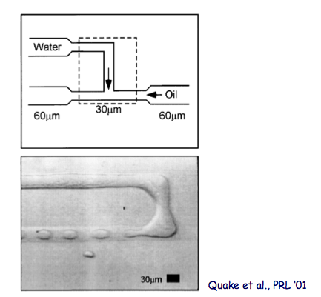
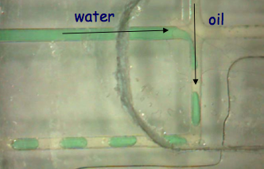
Droplet-based microfluidics
The deterministic nature of microfluidic flows can be exploited to produce monodisperse microdroplets
This is called squeezing regime

Slide 9
What’s microfluidic networking?
Current microfluidics devices are special purpose
  One device for each specific application
Next frontier: developing basic networking modules for enabling flexible microfluidic systems
Versatility: multi-purpose system
Capabilities: LoCs can be interconnected to perform multiple phases reactions
Costs: less reactants, less devices, lower costs
Enable flexible microfluidic systems using pure passive hydrodynamic manipulation!

Slide 10
SWITCHING: control droplet path

Slide 11
Switching principle
Switching is based on 2 simple rules
At bifurcations, droplets always flow along the path with least instantaneous resistance
A droplet increases the resistance of the channel proportionally to its size

Slide 12
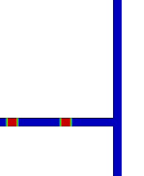
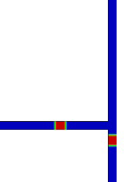
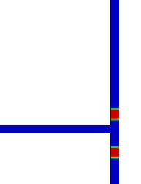
Simulative example
Two close droplets arrive at the junction
First drop “turns right”
Second drop “turns left”

Slide 13
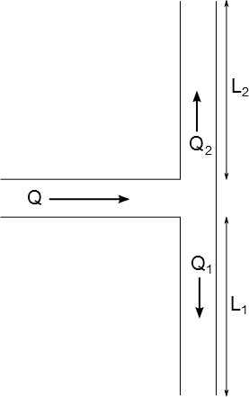
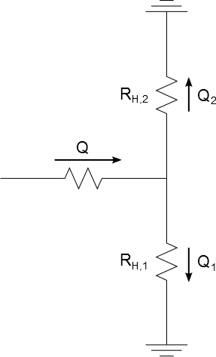
Microfluidic-electric duality
Volumetric flow rate → Electrical current
Pressure difference → Voltage drop
Hydraulic resistance → Electrical resistance
Hagen-Poiseuille’s law → Ohm laws
→

Slide 14
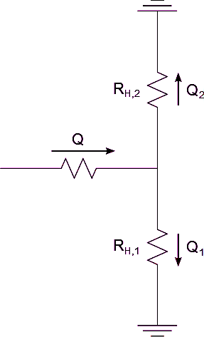
Example
Droplet 2
Droplet 2
Droplet 2
Droplet 1
Droplet 1
R₁<R₂ → First droplet takes branch 1
R₁+δ>R₂ →
Second droplet takes branch 2
Droplet 1
Droplet 2
Droplet 2
Droplet 2
Droplet 1
Droplet 1
Droplet 1

Slide 15
The network

Slide 16
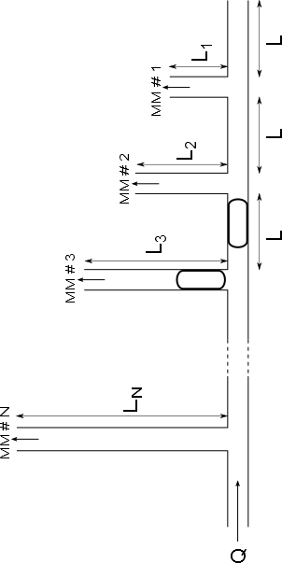
Case study: microfluidic network with bus topology
Payload
Header

Slide 17
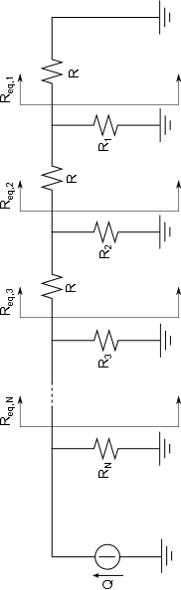
Equivalent electrical circuit

Slide 18
Topological constraints (I)
Header must always flow along the main path:
  R_{n}=αR_{eq,n} with α >1 →
  Outlet branches closer to the source are longer
^{expansion factor}

Slide 19
Topological constraints (II)
Payload shall be deflected only into the target branch
Different targets require headers of different length
Payloads
Headers
MM #N
MM #2
MM #1
1st constraint on the value of the expansion factor α

Slide 20
Topological constraints (III)
Header must fit into the distance L between outlets
The header for Nth outlet must be shorter than L
L_{n}
L_{n-1}
L_{n-2}
2nd constraint on the value of the expansion factor α

Slide 21
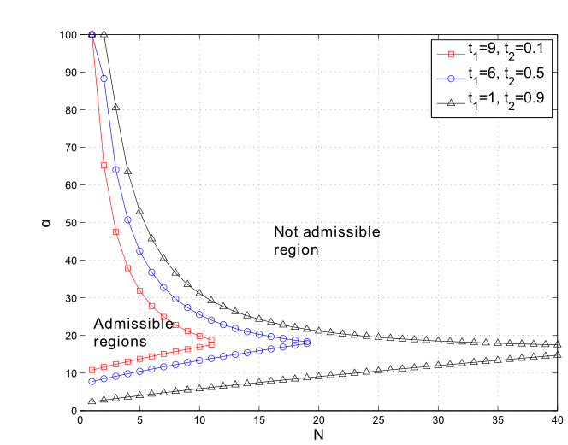
Network dimensioning
“t₁”: design margin on condition 1
“t₂”: design margin on condition 2
Robustness to manufacturing noise requires large t₁ and small t₂
Design space reduces as N grows
Number of interconnected microfluidic machines

Slide 22
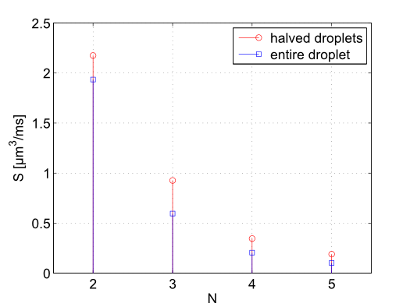
Results
Throughput: volume of fluid conveyed to a generic MM per time unit (S [μm³/ms])
Simplest Scheduler: “exclusive channel access”
Simulations
  Squares: maximum size payload droplet
  Circles: halved-size payload droplets

Slide 23
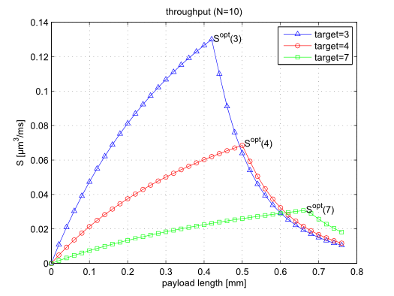
Maximum throughput
Longer payload droplets yield larger throughput as long as ℓ_{d} is lower than ℓ_{d}^{opt}(n)
For longer ℓ_{d} input flow speed has to be reduced to avoid breakups → performance drops

Slide 24
Conclusions and open challenges
Issues addressed
  definition of a totally passive droplet’s routing model
  case study → bus network
  system with memory → network behavior depends on the traffic
(Some) open challenges
  Design of data-buffer devices
    How to queue a droplet inside the circuit and realese it when required
  Joint design of network topology and MAC&scheduling protocols
    Topology and protocols are not longer independent here!
    What’s the best topology? (Before that, what does “the best” mean here?)
  Design of MAC/scheduling mechanisms
    How to trigger a droplet to be realsed by a MM?
    How to exploit pipeli9ne effect?
  Investigation of droplet break-up regime

Slide 25
When bits get wet: introduction to microfluidic networking
Any questions?
If we are short of time at this point… as it usually is,
just drop me an email!
zanella@dei.unipd.it

Slide 26
Spare slides

Slide 27
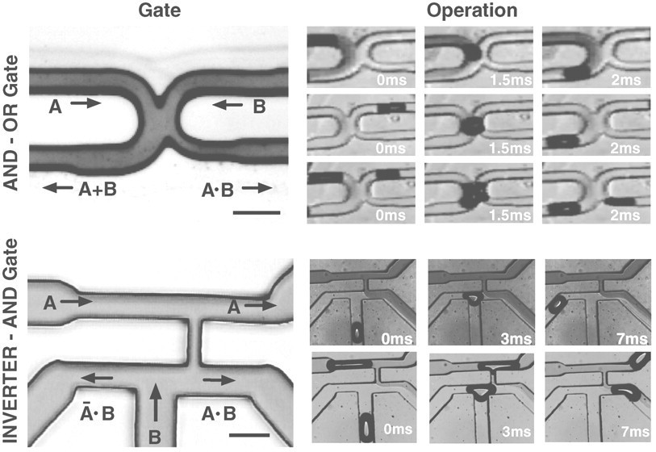
Microfluidic bubble logic
Recent discoveries prove that droplet microfluidic systems can perform basic Boolean logic functions, such as AND, OR, NOT gates.
A | B | A+B | AB
1 | 0 | 1 | 0
0 | 1 | 1 | 0
1 | 1 | 1 | 1

Slide 28
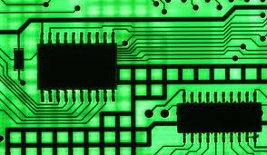
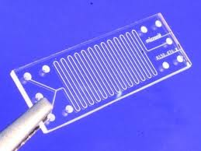
Microelectronics vs. Microfluidics
 | Integrated circuit | Microfluidic chip
Transport quantity | Charge (no mass) | Mass (no charge)
Building material | Inorganic (semiconductors) | Organic (polymers)
Channel size | ~10⁻⁷ m | ~10⁻⁴ m
Transport regime | Similar to macroscopic electric circuits | Different from macroscopic fluidic circuits

Slide 29
Key elements
Source of data
Switching elements
Network topology

Slide 30
SOURCE: droplet generation

Slide 31
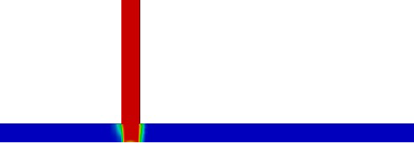
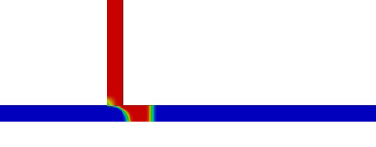
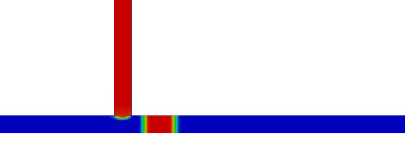
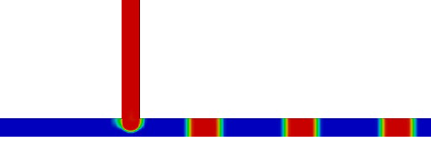
Droplets generation (1)
Breakup in “cross-flowing streams” under squeezing regime

Slide 32
Droplets generation (2)
By changing input parameters, you can control droplets length and spacing, but NOT independently!

Slide 33
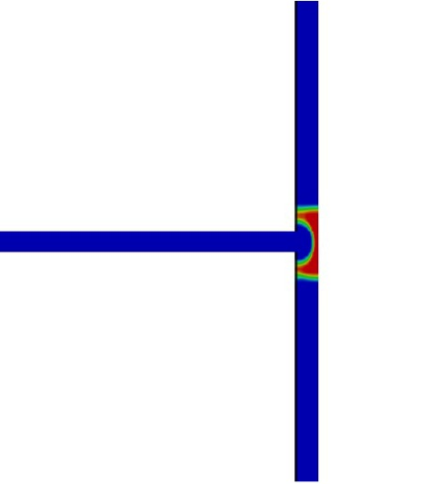
Junction breakup
When crossing a junction a droplet can break up…

Slide 34
Junction breakup
To avoid breakup, droplets shall not be too long… ^{[1]}
^{[1]}A. M. Leshansky, L. M. Pismen, “Breakup of drops in a microfluidic T-junction”, Phys. Fluids, 21.

Slide 35
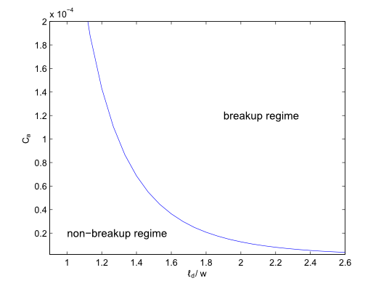
Junction breakup
Max length increases for lower values of capillary number C_{a}…
Non breakup

Slide 36
Switching questions
What’s the resistance increase brought along by a droplet?
Is it enough to deviate the second droplet?
  Well… it depends on the original fluidic resistance of the branches…
  To help sorting this out… an analogy with electric circuit is at hand…
The longer the droplet, the larger the resistance
Dynamic viscosity

Slide 37
Topological constraints (II)
Payload shall be deflected only into the target branch
Different targets require headers of different lengths
  ρ_{n} : resistance increase due to header
  To deviate the payload on the nth outlet it must be
Main stream has lower resistance
nth secondary stream has lower resistance → payload switched
1st constraint on the value of the expansion factor α

Slide 38
Topological constraints (III)
Header must fit into the distance L between outlets
Longest header for Nth outlet (closest to source)
L_{n}
L_{n-1}
L_{n-2}
2nd constraint on the value of the expansion factor α

