Slide 1

When bits get wet: introduction to microfluidic networking
Authors: Andrea Zanella, Andrea Biral
zanella@dei.unipd.it
INW 2014 – Cortina d’Ampezzo, 14 Gennaio 2014

Slide 2
Purposes
Quick introduction to the microfluidics area
Overview of the research challenges we are working on…
Growing the interest on the subject… to increase my citation index! ☺

Slide 3
Microfluidics…
What is it all about?

Slide 4
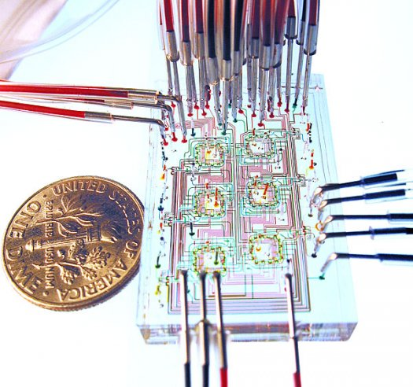
Microfluidics
Microfluidics is both a science and a technology that deals with the control of small amounts of fluids flowing through microchannels

Slide 5
Features
MACROSCALE: inertial forces >> viscous forces
turbolent flow
microscale: inertial forces ≈ viscous forces
laminar flow
Notes:
Specific characteristics:
very low Reynolds number
Re=inertial forces/viscous forces
Re>4000 → turbulent flow
Re<1000 → laminar flow
viscous forces dominates inertial forces
linear and predictable flow

Slide 6
Advantages
Optimum flow control
  Accurate control of concentrations and molecular interactions
Very small quantities of reagents
  Reduced times for analysis and synthesis
  Reduced chemical waste
Portability

Slide 7
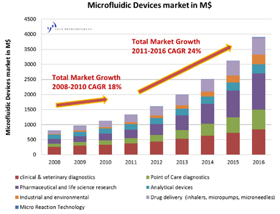
Market
Inkjet printheads
Biological analysis
Chemical reactions
Pharmaceutical analysis
Medical treatments
…

Slide 8
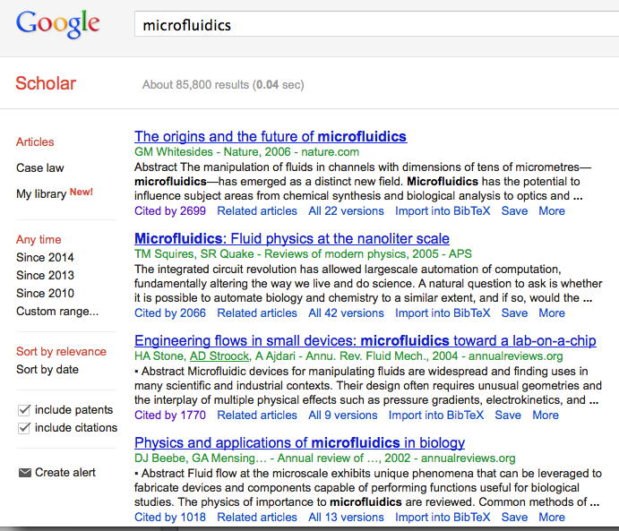
Popularity

Slide 9
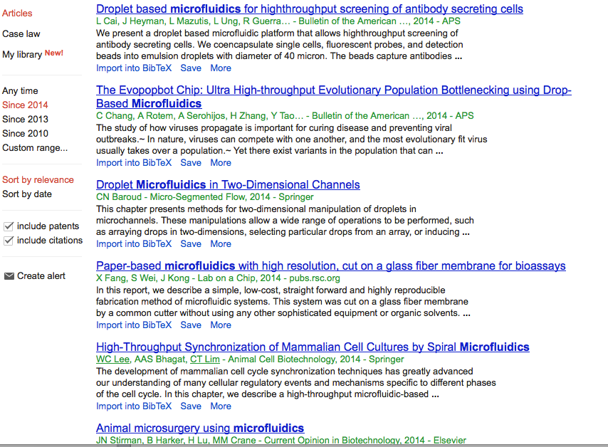
Recent papers (2014)

Slide 10
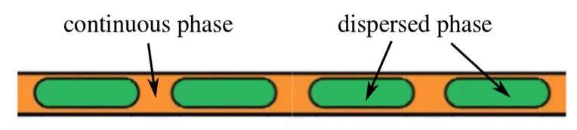
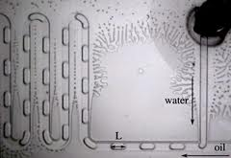
Droplet-based microfluidics
Small drops (dispersed phase) are immersed in a carrier fluid (continuous phase)
very low Reynolds number (Re«1)
  Viscous dominates inertial forces
    linear and predictable flow
    generation of mono-dispersed droplets
low Capillary number (C_{a}«)
  surface tension prevail over viscosity
    cohesion of droplets

Slide 11
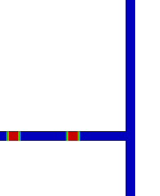
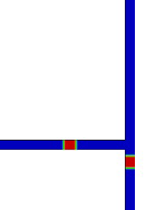
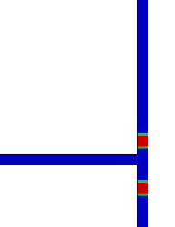
Pure hydrodynamic switching principle
Droplets flow along the path with minimum hydraulic resistance
Channel resistance is increased by droplets
Two close droplets arrive at the junction
First drop “turns right”
Second drop “turns left”

Slide 12
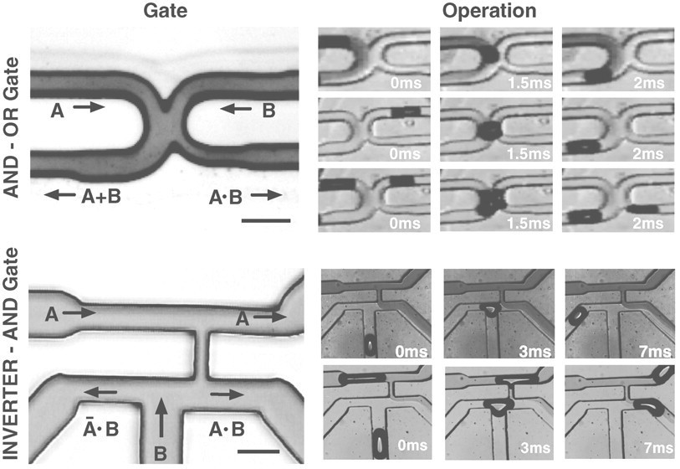
Microfluidic bubble logic
Droplet microfluidics systems can perform basic Boolean logic functions, such as AND, OR, NOT gates
A | B | A+B | AB
1 | 0 | 1 | 0
0 | 1 | 1 | 0
1 | 1 | 1 | 1

Slide 13
Next frontier
Developing basic networking modules for the interconnection of different LoCs using purely passive hydrodynamic manipulation
  versatility: same device for different purposes
  control: droplets can undergo several successive transformations
  energy saving
  lower costs

Slide 14
Challenges
Droplets behavior is affected by various intertwined factors
  flows in each channel depend on the properties of the entire system
    Topology & geometrical parameters
    Fluids characteristics (density, viscosity, …)
    Obstacles, imperfections, …
Time evolution of a droplet-based microfluidic network is also difficult to predict
    the speed of the droplets depends on the flow rates, which depend on the hydraulic resistance of the channels, which depend on the position of the droplets…

Slide 15
Our contributions
Derive simple ``macroscopic models’’ for the behavior of microfluidic systems as a function of the system parameters
Define a simple Microfluidic Network Simulator framework
Apply the method to study the performance of a microfluidic network with bus topology

Slide 16
“Macroscopic” models

Slide 17
Basic building blocks
Droplet source
Droplet switch
Droplet use (microfluidic machines structure)

Slide 18
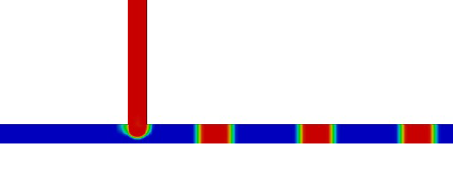
Droplets generation (1)
Breakup in “cross-flowing streams” under squeezing regime

Slide 19
Droplets generation (2)
By changing input parameters, you can control droplets length and spacing, but NOT independently!
(volumetric flow rate Q_{d})
(volumetric flow rate Q_{c})
Constant (~1)

Slide 20
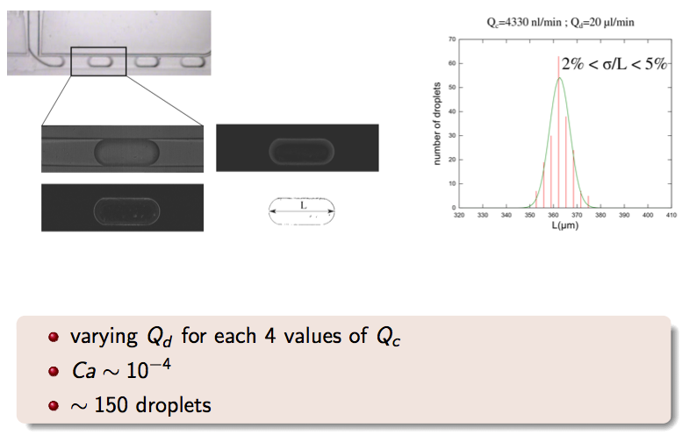
Experimental results

Slide 21
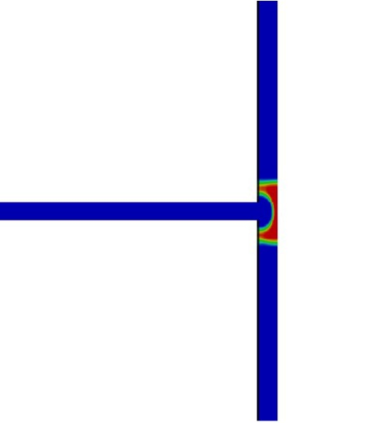
Junction breakup
When crossing a junction a droplet can break up…
To avoid breakup, droplets shall not be too long… ^{[1]}
[1] A. M. Leshansky, L. M. Pismen, “Breakup of drops in a microfluidic T-junction”, Phys. Fluids, 21.

Slide 22
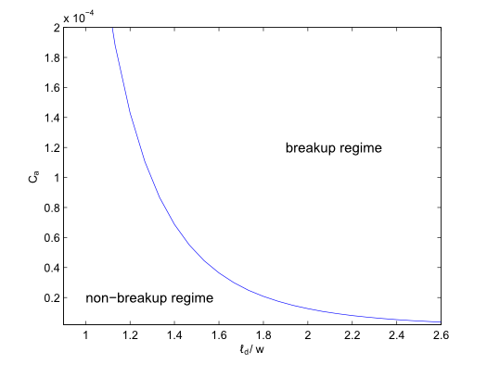
Junction breakup
To increase droplet length you must reduce capillary number C_{a} → reduce flow rate → droplets move more slowly!
Non breakup

Slide 23
Microfluidic Network Simulator

Slide 24
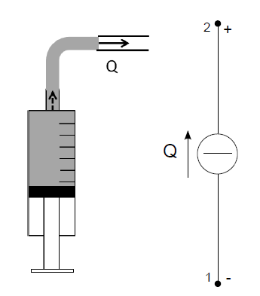
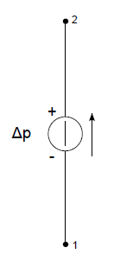
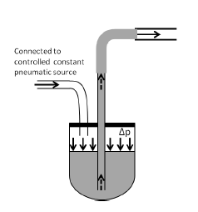
Microfluidic/electrical analogy (I)
Volumetric flow rate → Electrical current
Pressure difference → Voltage drop
Hydraulic resistance → Electrical resistance
Hagen-Poiseuille’s law → Ohm laws
→
Syringe pump → current generator
Pneumatic source → voltage generator

Slide 25
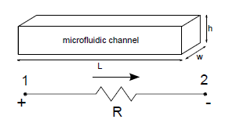
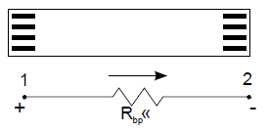
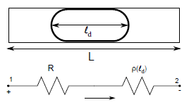
Microfluidic/electrical analogy (II)
Microfluidic channel filled only by continuous phase
↓
resistor with
Bypass channel (ducts that droplets cannot access)
↓
resistor with negligeable resistance
Microfluidic channel containing a droplet
↓
series resistor with

Slide 26
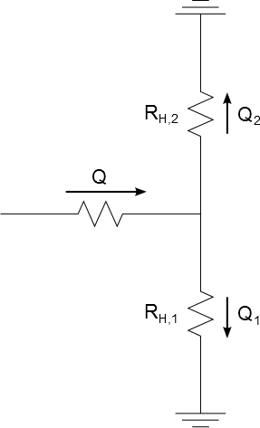
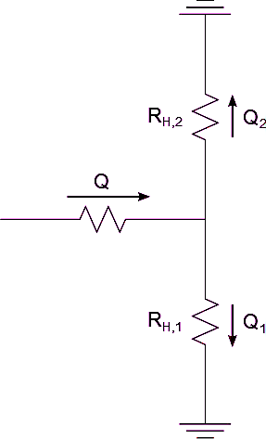
Example
Droplet 2
Droplet 2
Droplet 2
Droplet 1
Droplet 1
R₁<R₂ → First droplet takes branch 1
R₁+δ>R₂ →
Second droplet takes branch 2
Droplet 1
Droplet 2
Droplet 2
Droplet 2
Droplet 1
Droplet 1
Droplet 1

Slide 27
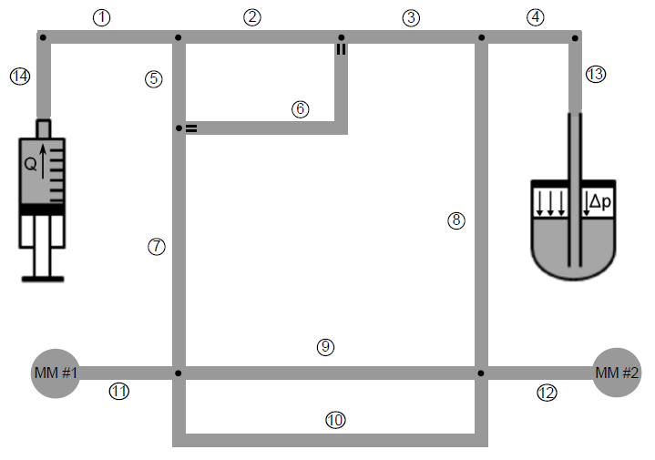
Microfluidic Network Model
G(t)=(V,E)
  V={v₁,…,v_{Nnodes}} E={e₁,…,e_{Nedges}}

Slide 28
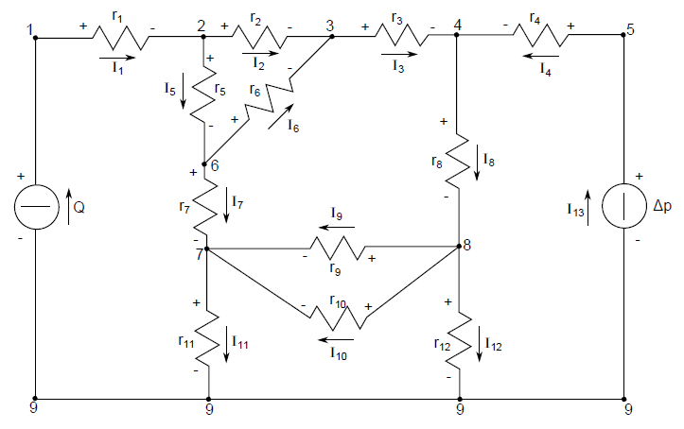
Parallel with electrical network
Static MN graph is mapped into the dual electric circuit
  flow generator
  pressure generator
  microfluidic channel
  bypass channel

Slide 29
Resistance evaluation
Each droplet is associated to its (additional) resistance which is added to that of the channel

Slide 30
Simulation cycle
Compute the flow rates using Kirchhoff laws
Compute the motion of each droplet
Determine the outgoing branch when droplets enter junctions
Update the resistance of each channel depending on droplets position

Slide 31
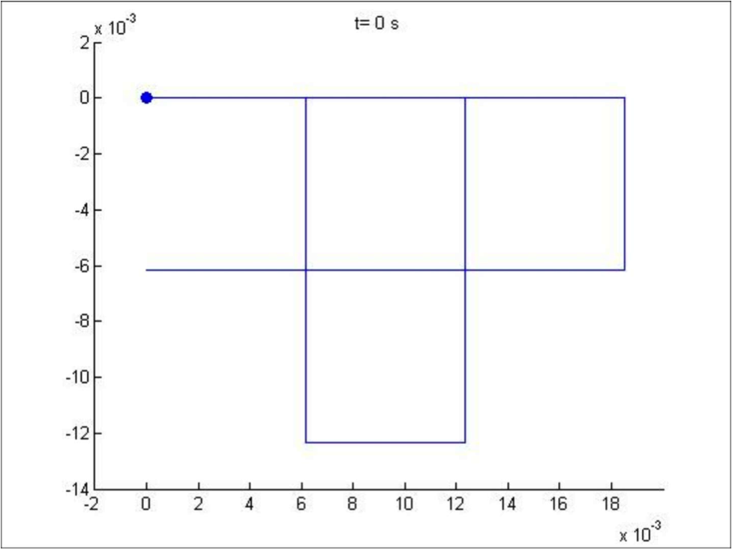
Simulative example

Slide 32
Bus Network analysis

Slide 33
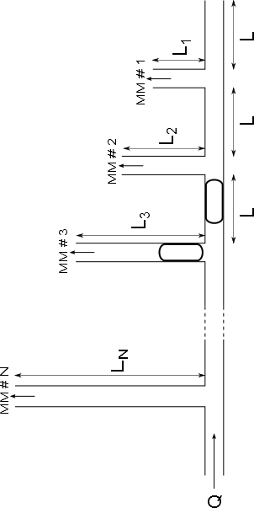
Case study: microfluidic network with bus topology
Payload
Header

Slide 34
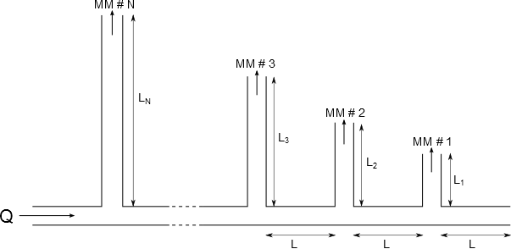
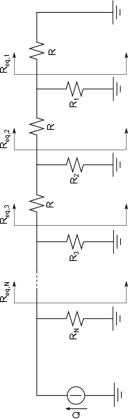
Equivalent electrical circuit

Slide 35
Topological constraints (I)
Header must always flow along the main path:
^{expansion factor}
with α >1 →
  Outlet branches closer to the source are longer

Slide 36
Topological constraints (II)
Payload shall be deflected only into the correct target branch
Different targets require headers of different length
HEADER RESISTANCE
Headers
MM #N
MM #2
MM #1

Slide 37
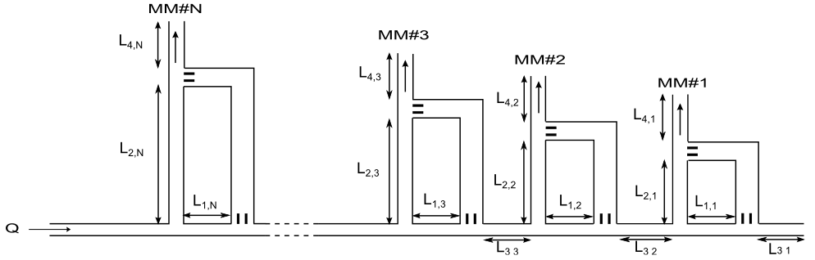
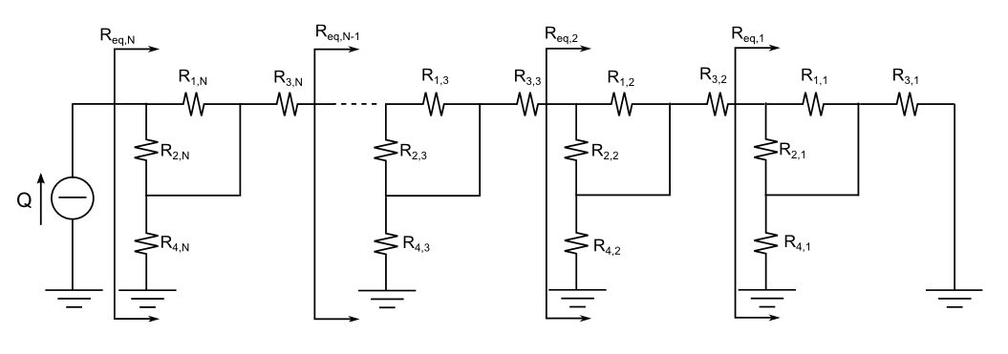
Microfluidic bus network with bypass channels

Slide 38
Performance
Throughput
  volume of fluid conveyed to a generic MM per time unit (S [μm³/ms])
Access strategy
  “exclusive channel access”: one header-payload at a time!

Slide 39
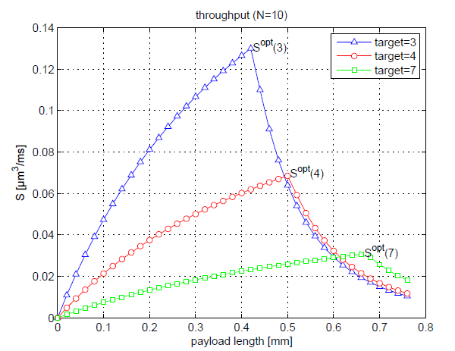
Bus network with simple T-junctions

Slide 40
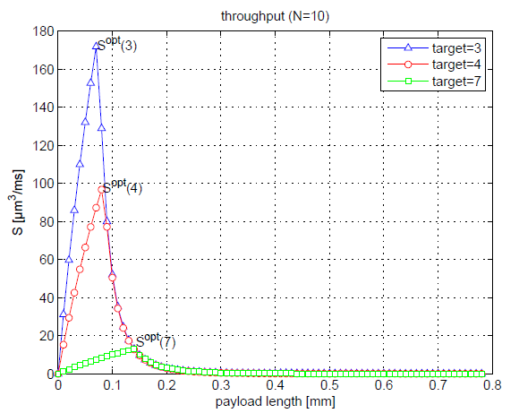
Bus network with bypass channels

Slide 41
Conclusions and future developments
Addressed Issues:
  Definition of a totally passive droplet’s switching model
  Design of a macroscopic droplet-based Microfluidic Network Simulator
  Analysis of case-study: microfluidic bus network
A look into the future
  Joint design of network topology and MAC/scheduling protocols
  Design and analysis of data-buffer devices
  Proper modeling of microfluidics machines
  Characterization of microfluidics traffic sources
  Information-theory approach to microfluidics communications
  …

Slide 42
When bits get wet: introduction to microfluidic networking
Any questions?
If we are short of time at this point… as it usually is,
just drop me an email… or take a look at my papers!

Slide 43
Spare slides

Slide 44
Microfluidic bubble logic
Recent discoveries prove that droplet microfluidic systems can perform basic Boolean logic functions, such as AND, OR, NOT gates.
A | B | A+B | AB
1 | 0 | 1 | 0
0 | 1 | 1 | 0
1 | 1 | 1 | 1

Slide 45
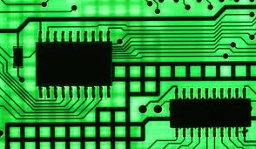
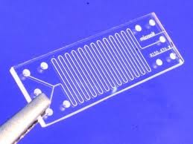
Microelectronics vs. Microfluidics
 | Integrated circuit | Microfluidic chip
Transport quantity | Charge (no mass) | Mass (no charge)
Building material | Inorganic (semiconductors) | Organic (polymers)
Channel size | ~10⁻⁷ m | ~10⁻⁴ m
Transport regime | Similar to macroscopic electric circuits | Different from macroscopic fluidic circuits

Slide 46
Key elements
Source of data
Switching elements
Network topology

Slide 47
SOURCE: droplet generation

Slide 48
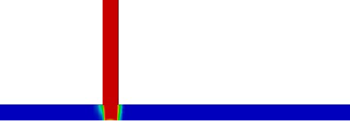
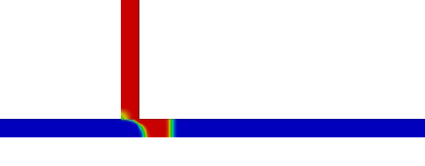
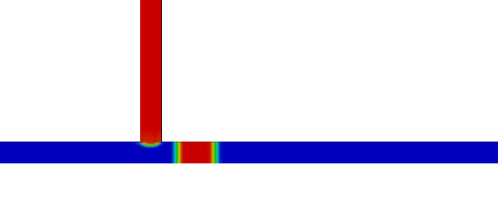
Droplets generation (1)
Breakup in “cross-flowing streams” under squeezing regime

Slide 49
Droplets generation (2)
By changing input parameters, you can control droplets length and spacing, but NOT independently!

Slide 50
Junction breakup
When crossing a junction a droplet can break up…

Slide 51
Junction breakup
To avoid breakup, droplets shall not be too long… ^{[1]}
^{[1]}A. M. Leshansky, L. M. Pismen, “Breakup of drops in a microfluidic T-junction”, Phys. Fluids, 21.

Slide 52
Junction breakup
Max length increases for lower values of capillary number C_{a}…
Non breakup

Slide 53
Switching questions
What’s the resistance increase brought along by a droplet?
Is it enough to deviate the second droplet?
  Well… it depends on the original fluidic resistance of the branches…
  To help sorting this out… an analogy with electric circuit is at hand…
The longer the droplet, the larger the resistance
Dynamic viscosity

Slide 54
Topological constraints (II)
Payload shall be deflected only into the target branch
Different targets require headers of different lengths
  ρ_{n} : resistance increase due to header
  To deviate the payload on the nth outlet it must be
Main stream has lower resistance
nth secondary stream has lower resistance → payload switched
1st constraint on the value of the expansion factor α

Slide 55
Topological constraints (III)
Header must fit into the distance L between outlets
Longest header for Nth outlet (closest to source)
L_{n}
L_{n-1}
L_{n-2}
2nd constraint on the value of the expansion factor α

